Slide 1
Zodiacal Light and Gegenschein
Dr. Bill Romanishin
http://hildaandtrojanasteroids.net
Email: wromanishin@ou.edu

Slide 2
The first few slides show the 3 “great circles” on the celestial sphere that are important to astronomers:
The celestial equator – extension of the plane of the Earths equator
The ecliptic – extension of the plane of the Earths orbit around Sun- all the planets orbit the Sun in planes that are tilted a little, but not too much, from the ecliptic plane
The celestial equator and ecliptic are tilted by 23.5 degrees relative to each other, as the Earth rotational axis (line from north to south poles) is tilted by 23.5 degrees from the perpendicular to the ecliptic plane
The last important great circle is the plane that defines the disk of the Milky Way

Slide 3
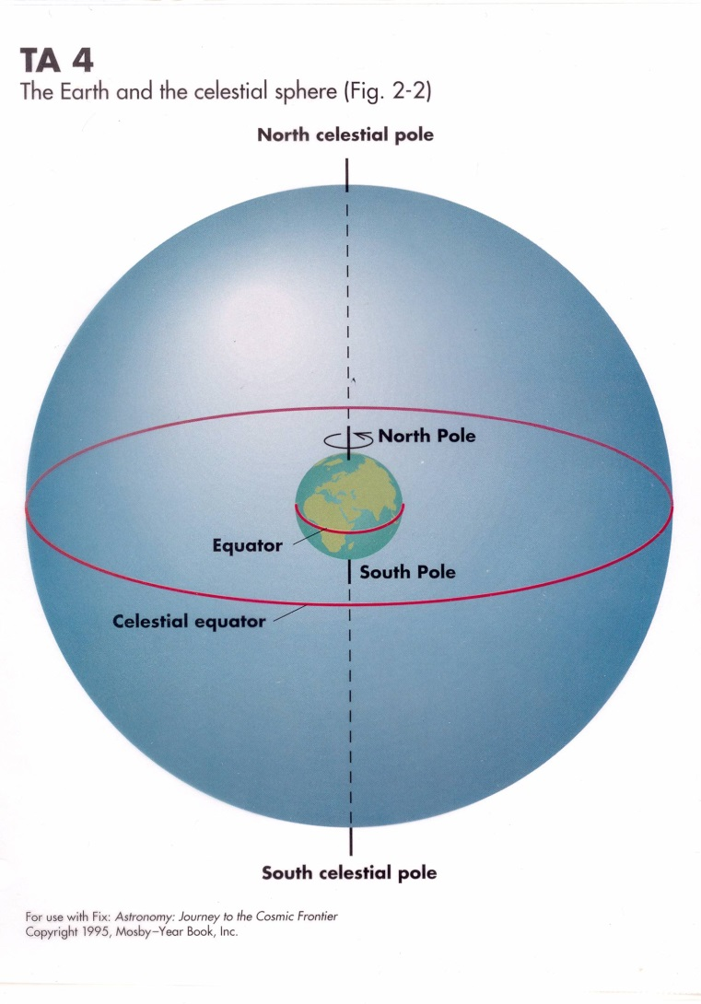

Slide 4
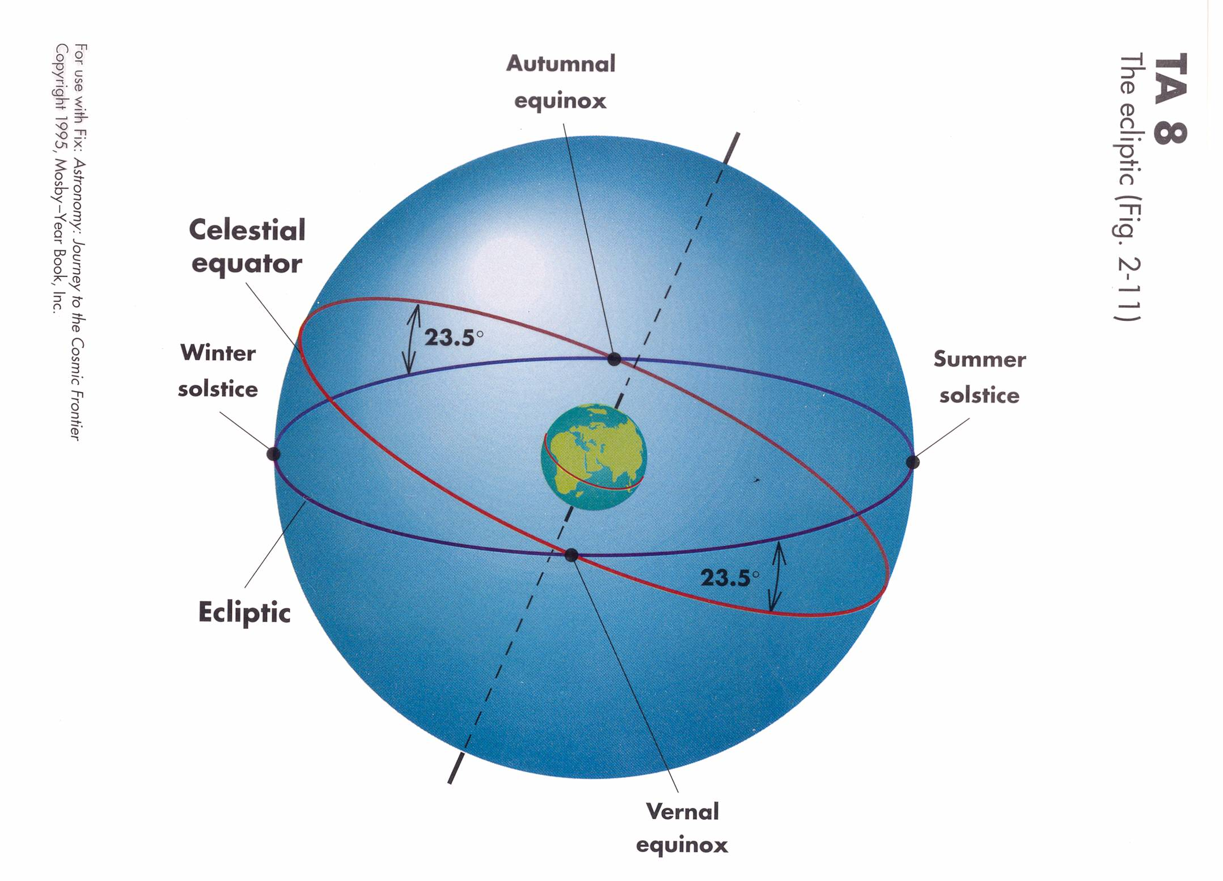

Slide 5
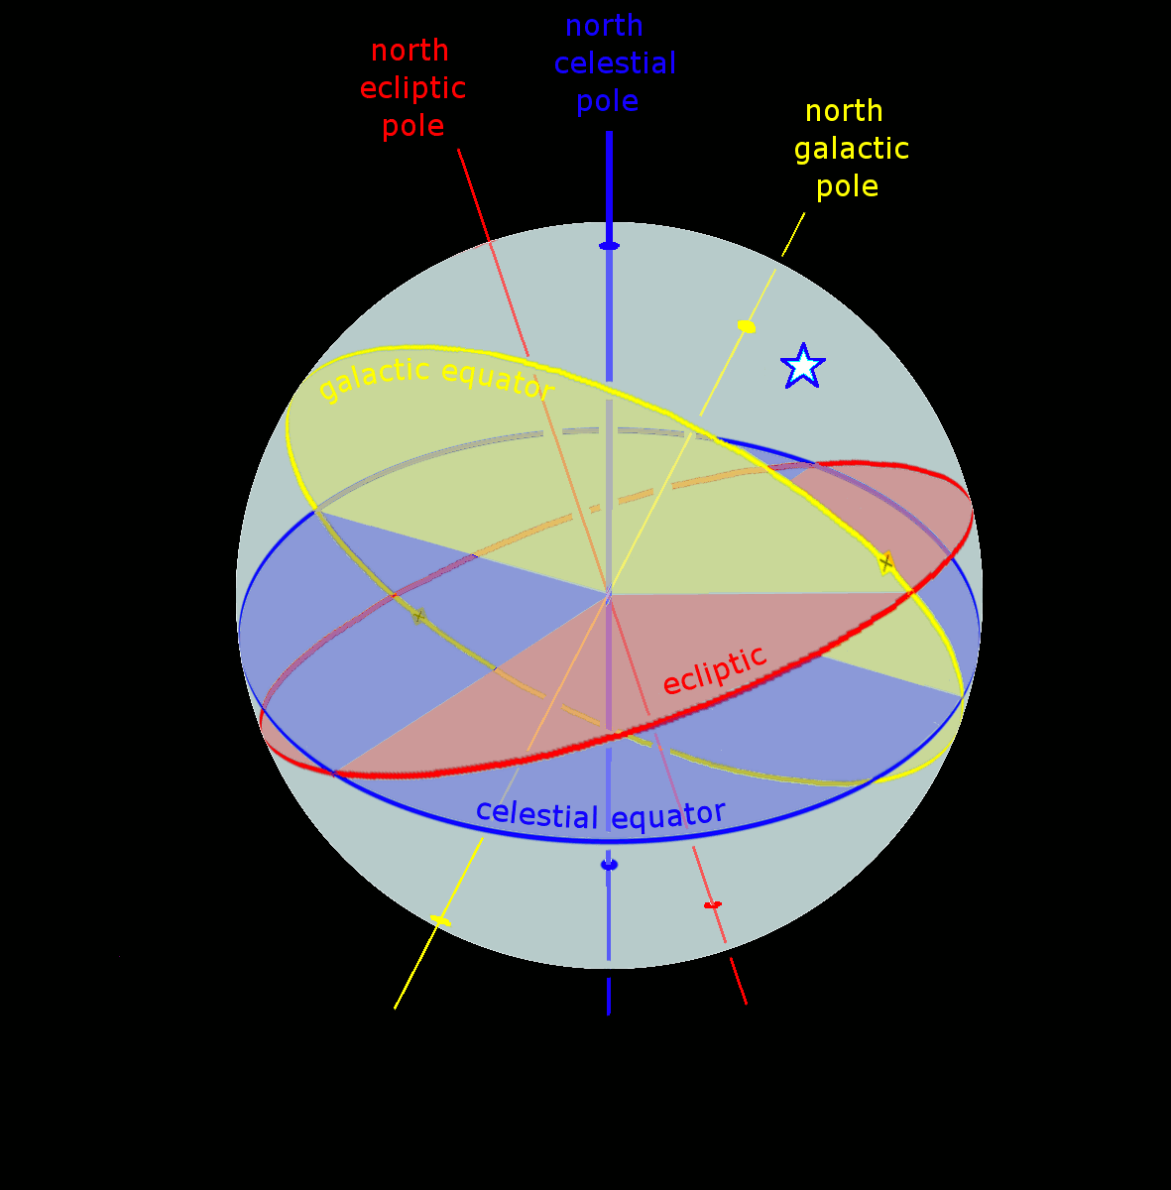

Slide 6
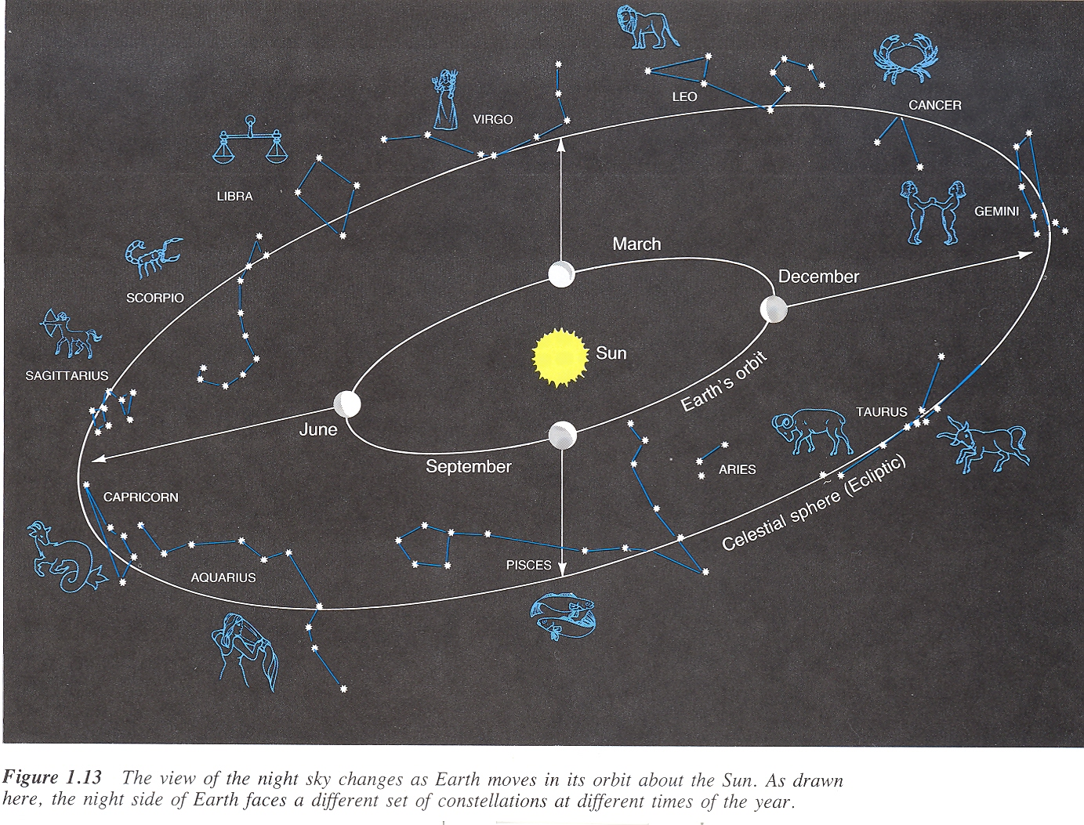
The zodiac is a band of the celestial sphere on either side of the ecliptic. The Sun and planets appear to go around the sky in the zodiac band. (But of course we are ones moving around the Sun, the Sun doesn’t move around us!)

Slide 7
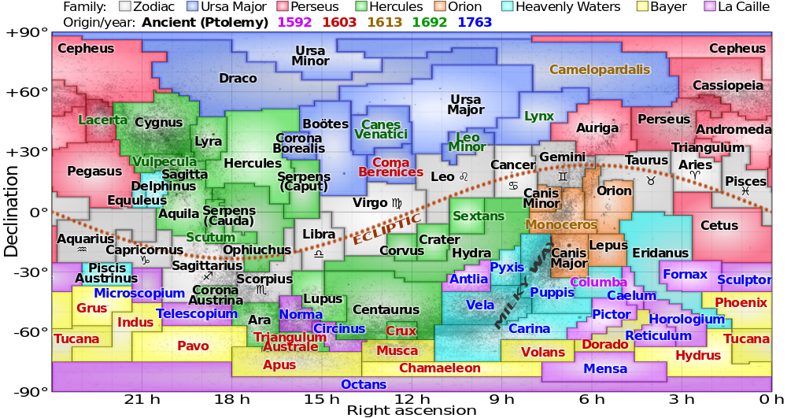
The entire celestial sphere (shown in equatorial coordinates) with the ecliptic shown. The colored boxes show the extent of the 88 constellations that the sky is divided into.

Slide 8
The next slide is an artists conception of what you might see from a spacecraft orbiting one of the moons of Pluto. For this talk, the important feature is the cloud of dust reflecting sunlight extending to either side of the Sun. The dust is actually in the shape of a pancake, with the Sun in the middle. It looks like a line here as we are looking at the disk “edge on”.
The dust disk lies in the ecliptic plane and is sometimes called the zodiacal dust cloud.
Sunlight reflecting from the dust particles is called the zodiacal light (ZL). The ZL is brightest near the Sun, but it is hard to see because of the Suns overpowering light. To see the ZL from the Earth, we have to look when the Sun is down, but a good part of the zodiacal cloud is above the horizon.

Slide 9
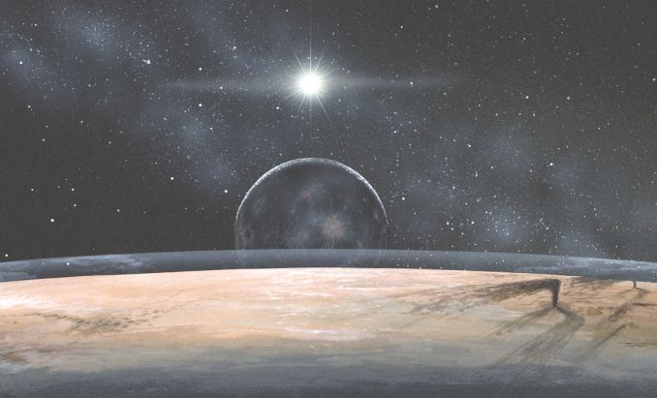

Slide 10
Seeing Zodiacal light:
From Earth (where I assume most of you will be observing!), ZL is
best seen after evening twilight ends or before morning twilight begins when the ecliptic is most perpendicular to the horizon
For continental U.S., that occurs after evening twilight during February/March time period and before morning twilight in September/October time period
So, you gotta stay up real late (or get up real early!) to see ZL in the fall!

Slide 11
The next slide is a diagram of the Sun and zodiacal cloud as seen several hours before
Sunrise (looking east). Of course, since the Earth isn’t transparent, anything below the line marked “horizon” would not be visible.
By looking at the right time, we can see a good part of the zodiacal dust cloud while the Sun is still well below horizon so that the sky is still very dark.
The photos after the next diagram are just some pretty pictures of the ZL I found on the internet. Many show the ZL and the Milky Way.

Slide 12
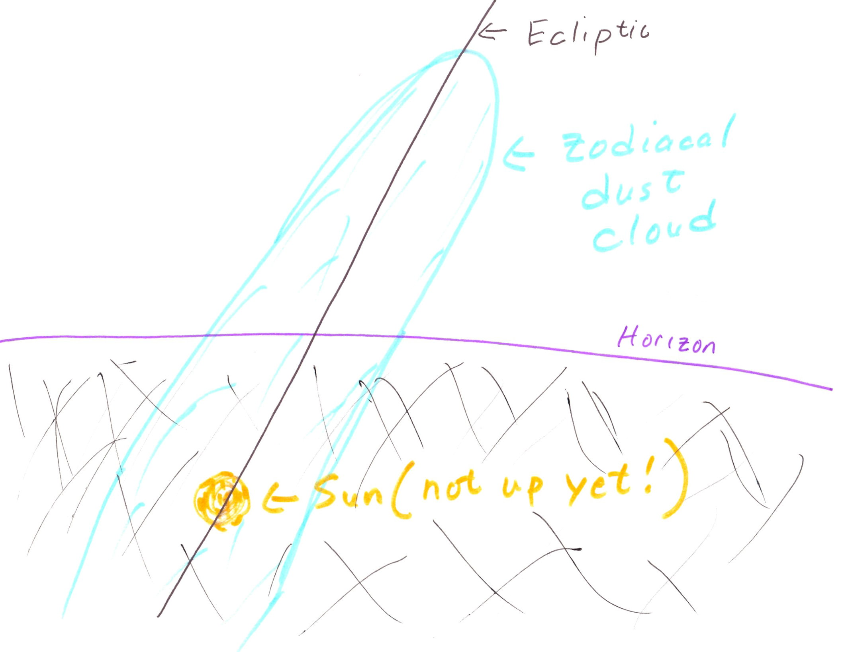

Slide 13
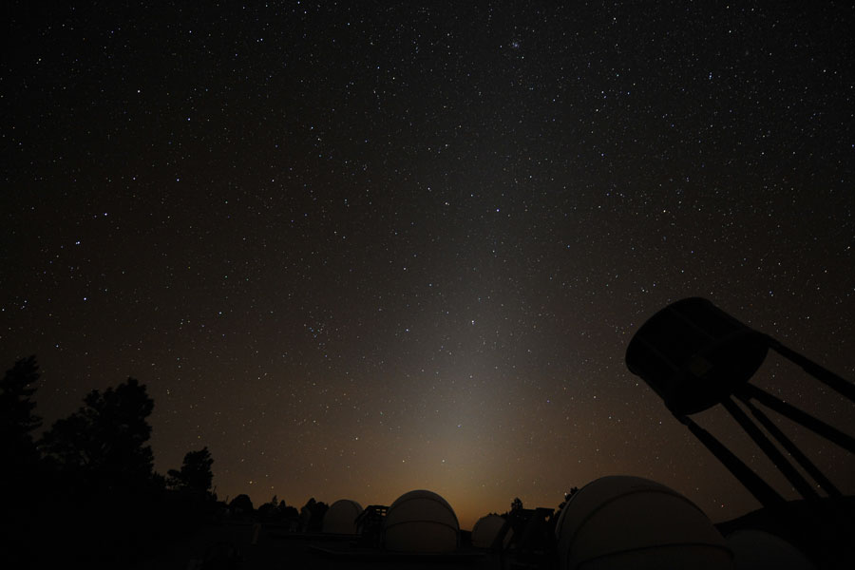

Slide 14
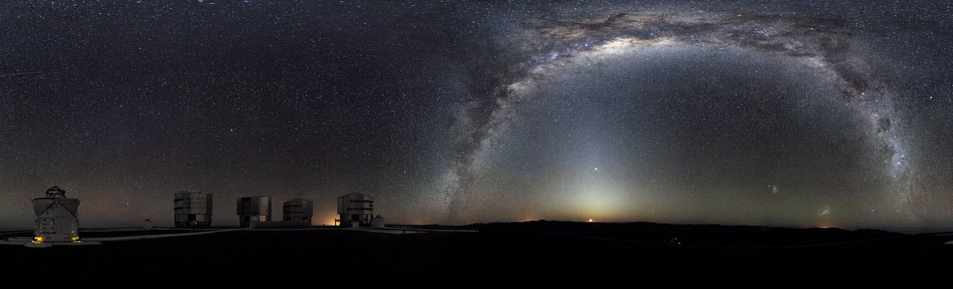

Slide 15
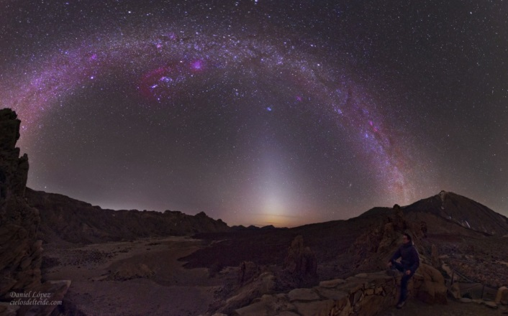

Slide 16
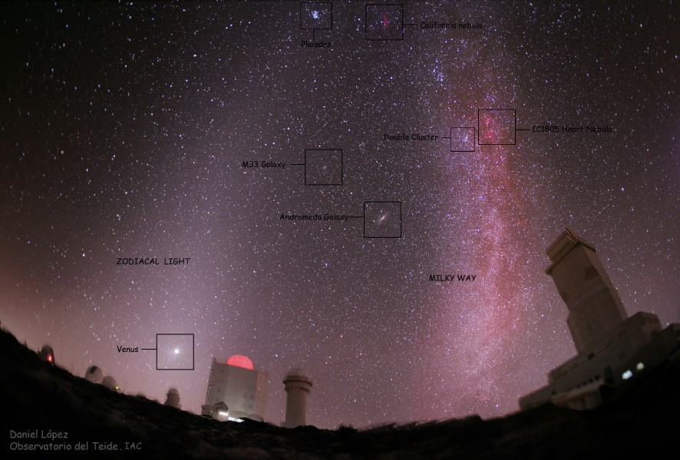

Slide 17
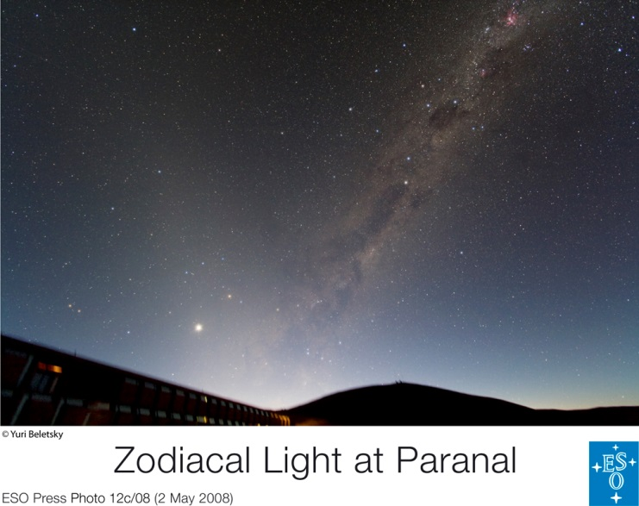

Slide 18
Observing morning Zodiacal light at Okie-Tex:
Think ahead about where and when to observe
BE CAREFUL MOVING ABOUT IN DARK!!
Pre-dawn sky must be CLEAR and DARK (no Moon- nites of Wed/Thu 2/3 Oct through Sat/Sun 5/6 Oct best during Okie-Tex )
Find (in daytime) place with clear view of eastern horizon
Best time to start looking is about 6AM (twilight starts 6:25AM)
Start getting DARK ADAPTED by ~5:30AM – NO lights! NO red LEDs!
NO iPhones! Good dark adaptation key to good view of ZL!
Set up a lawn chair, kick back, contemplate the universe, and just watch eastern horizon (and don’t fall asleep!)

Slide 19
The next slide shows an astronomical calendar specifically for the time and location of OkieTex in 2013. (NOTE: Times given in CDT, same time zone as Oklahoma City.)
The calendar gives various info about the Sun and moon.
For example, for the nite of Sat 28 Sep/Sun Sep 29 we see:
Sun sets at 19 39 ( or 7:39PM)
The Sun is 18 degrees below the horizon (astronomers definition of end of twilight) at 21 05 (9:05PM)
In the morning, the Sun reaches 18 degrees below horizon (and rising, of course) at 6 19
(6:19AM) , marking the beginning of morning twilight. The Sun rises at 7 46 (7:46AM).
The Moon is about 1/3 illuminated (31%) and rises at 2:36AM.
The last column shows that there are 9.2 hours between the end of evening twilight and the start of morning twilight, so there are 9.2 “dark” hours (ignoring the moon).
Such calendars for several Oklahoma sites can be found on my web site.

Slide 20
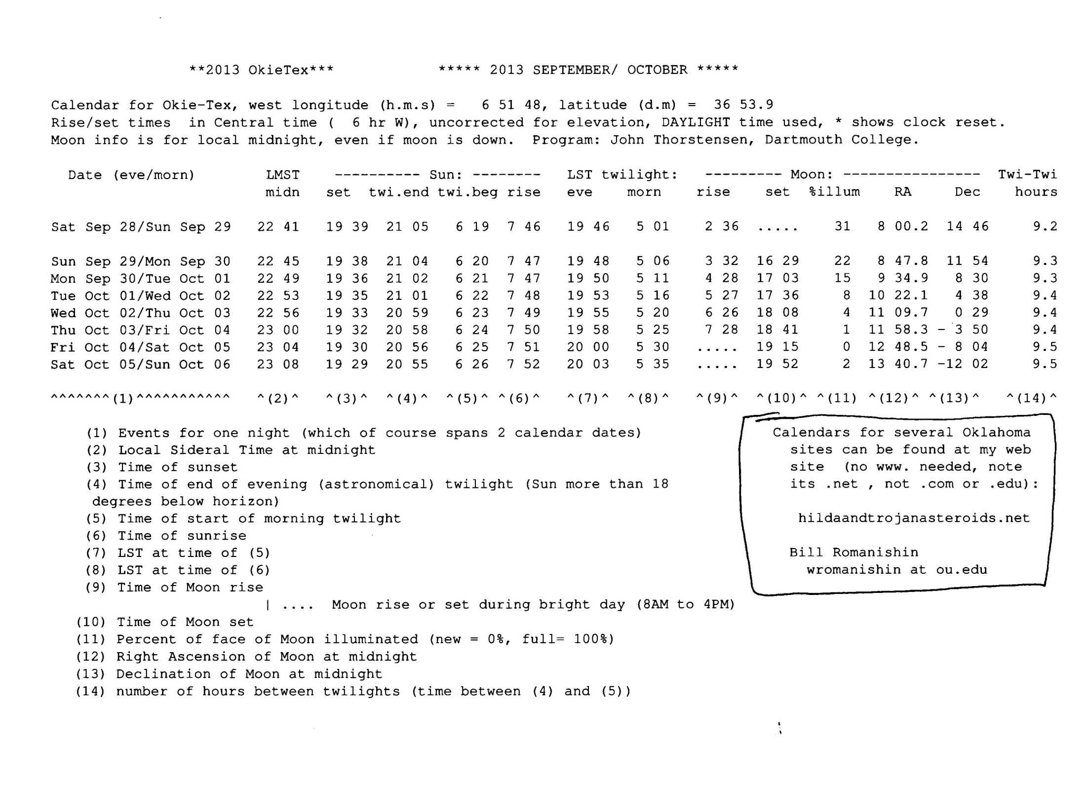

Slide 21
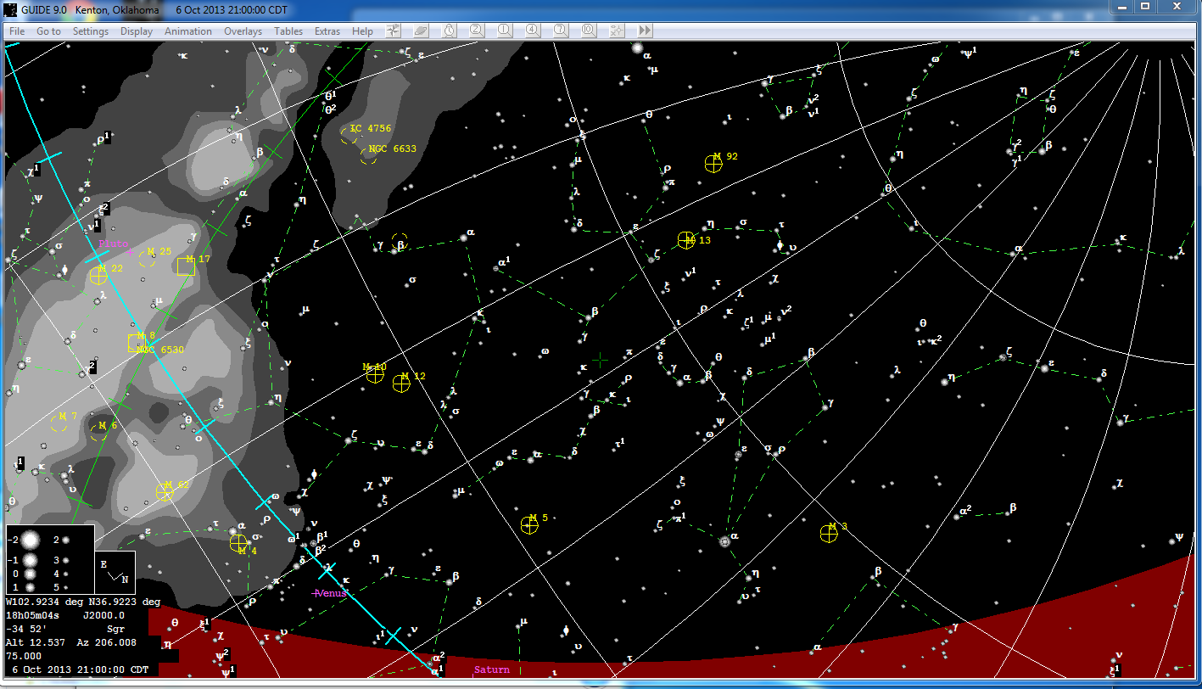
Sky looking west at 9PM 6 Oct 2013 from Kenton, OK- note the shallow angle of ecliptic (blue line) with the horizon (red area). This is NOT a good time to see ZL.

Slide 22
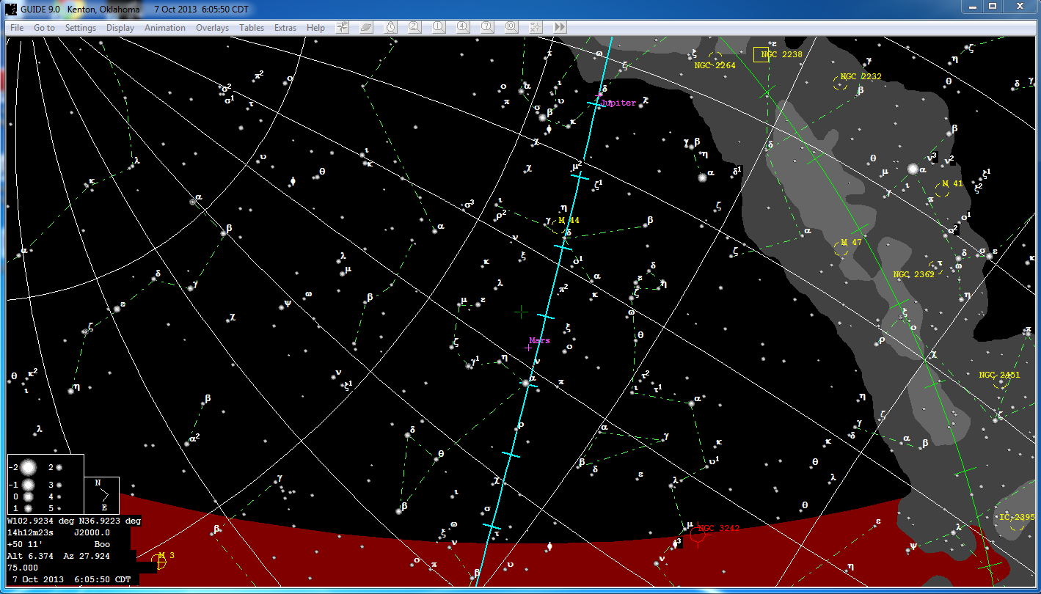
Sky looking east 6 AM 7 Oct 2013 from Kenton, OK- Note that the ecliptic stands almost perpendicular to the horizon. This would be a good time to see ZL.

Slide 23
There are a number of ways we study these interplanetary dust particles.
The larger dust particles (BB size and larger) are heated and destroyed when they hit the Earths atmosphere. You can see the destruction of such particles as meteors (shooting stars).
Some of the smaller dust particles can be slowed in the Earth’s upper atmosphere without being destroyed. These particles just drift around in the atmosphere. Some eventually reach the Earth’s surface (you are probably breathing some right now). Of course, most of the dust in this room is of terrestrial origin. By going to a high altitude in the atmosphere we can get above most of the common terrestrial dust and collect interplanetary dust particles (as seen in next few slides).
Dust particles can also be studied by spacecraft. Most of the time when a spacecraft and a dust particle collide, the dust is destroyed, but detectors on spacecraft can measure the mass and speed of the dust particles as they collide with the spacecraft.
One special spacecraft (Stardust) was designed to capture dust particles without damaging them and returned a sample to Earth. (I didn’t have time to talk about Stardust this talk, but you can google it.)

Slide 24
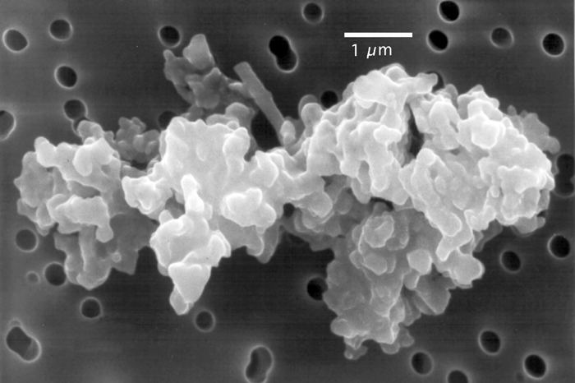
Photograph taken though a microscope of an interplanetary dust particle captured by a high altitude airplane. The dust particle is about the size of a bacteria.

Slide 25
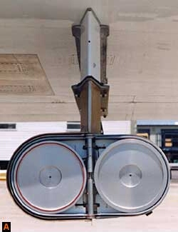
These are collecting plates that are extended from a research jet at high altitude. The plates are coated with oil, so that dust particles stick to the plates. The plates are closed most of the time (see central hinge) but the plates are opened at high altitude to capture dust particles drifting down from space.

Slide 26
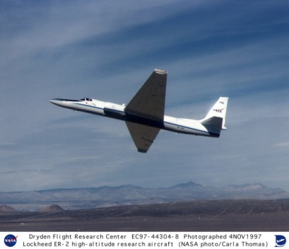
High altitude aircraft used to collect interplanetary dust in atmosphere, using collectors
as in previous image. The dust eventually drifts down to the ground, so why bother using an airplane?? Near the ground, there is a lot of dust from terrestrial sources, so the interplanetary dust particles are lost in the usual dust. At high altitudes, there is little terrestrial dust, so dust particles collected at high altitude contain a high proportion of interplanetary dust particles.

Slide 27
Lunar “microcraters” and interplanetary dust particles:
The tiny dust particles that make up the zodiacal cloud are either slowed or destroyed when the hit the Earth’s upper atmosphere, so none of them can hit the Earth at
high speed.
However, on an airless body, such as the Moon, the dust particles are not slowed and can hit the surface at high speed.
Moon rocks show microscopic craters created by the impact of small dust particles, as shown in the next two images.
Earth rocks do NOT show these “microcraters” because of the Earths atmosphere.

Slide 28
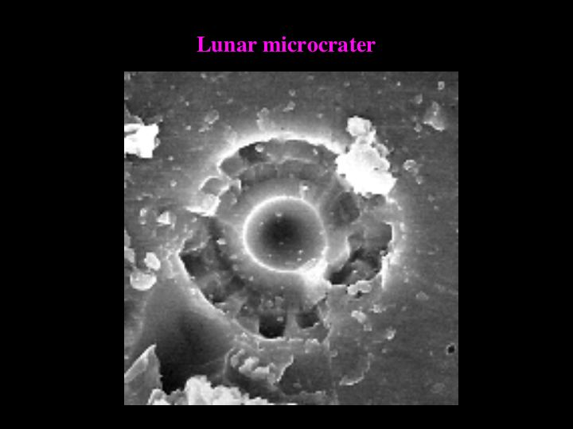
Photo taken through a microscope of a microcrater on a moon rock. This tiny pit would be too small to see with your unaided eye.

Slide 29
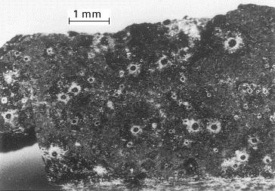
Moon rock showing numerous “microcraters”. Some of the larger microcraters here would be barely visible to unaided eye.

Slide 30
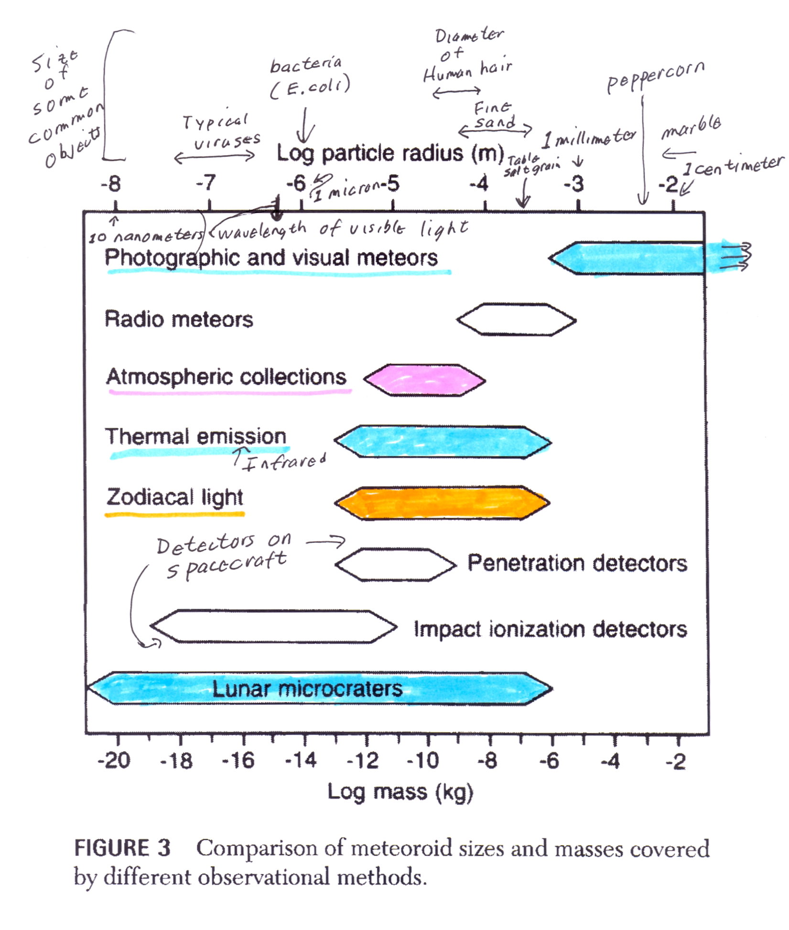

Slide 31
Origin of zodiacal dust particles:
Leftover from beginning of Solar System??
NO!!! Individual dust particles stay in cloud only a few
1000 years
Particles removed by 2 main processes:
Solar Radiation pressure – pushes smaller particles away from Sun
Poynting-Robertson drag- causes larger dust particles to
spiral into Sun
SO, zodiacal cloud must be continually replenished, mostly from
dust from comet tails

Slide 32
Gegenschein ( German for “counterglow”)
Directly opposite Sun is a *VERY* faint patch of light called the gegenschein
This is EXTREMELY difficult to see- very few people have seen
Gegenschein due to enhanced reflection at low phase angles
(opposition spike) - Same reason why full moon is much brighter
than moon a day before or after full
Connecting the “zodiacal light” and the gegenschein is an even fainter strip of light sometimes called the “zodiacal bridge”- this
is even harder to see than the gegenschein!!

Slide 33
The next slide shows the definition of “phase angle”. It is the angle between the sunlight that hits an object and the light that we see reflected from the object. For example, the full moon, which is almost exactly opposite the Sun in the sky, would have a phase angle near 0 degrees. The point in the sky exactly opposite the sky is called the anti-solar direction or the opposition point and would have a phase angle of exactly zero degrees.
Due to the properties of rocky surfaces , the brightness of objects seen at very low phase angle “spikes”, that is objects seen at very low phase angles are significantly brighter than the same object at slightly higher phase angle.
(This is why the full moon is brighter than the moon a day before or after full)
The gegenschein occurs when we are looking at dust past the Earth, near the opposition point. We see particles in this direction as a “bright” patch of the zodiacal dust cloud.
Following the diagram are several images of the gegenschein.

Slide 34
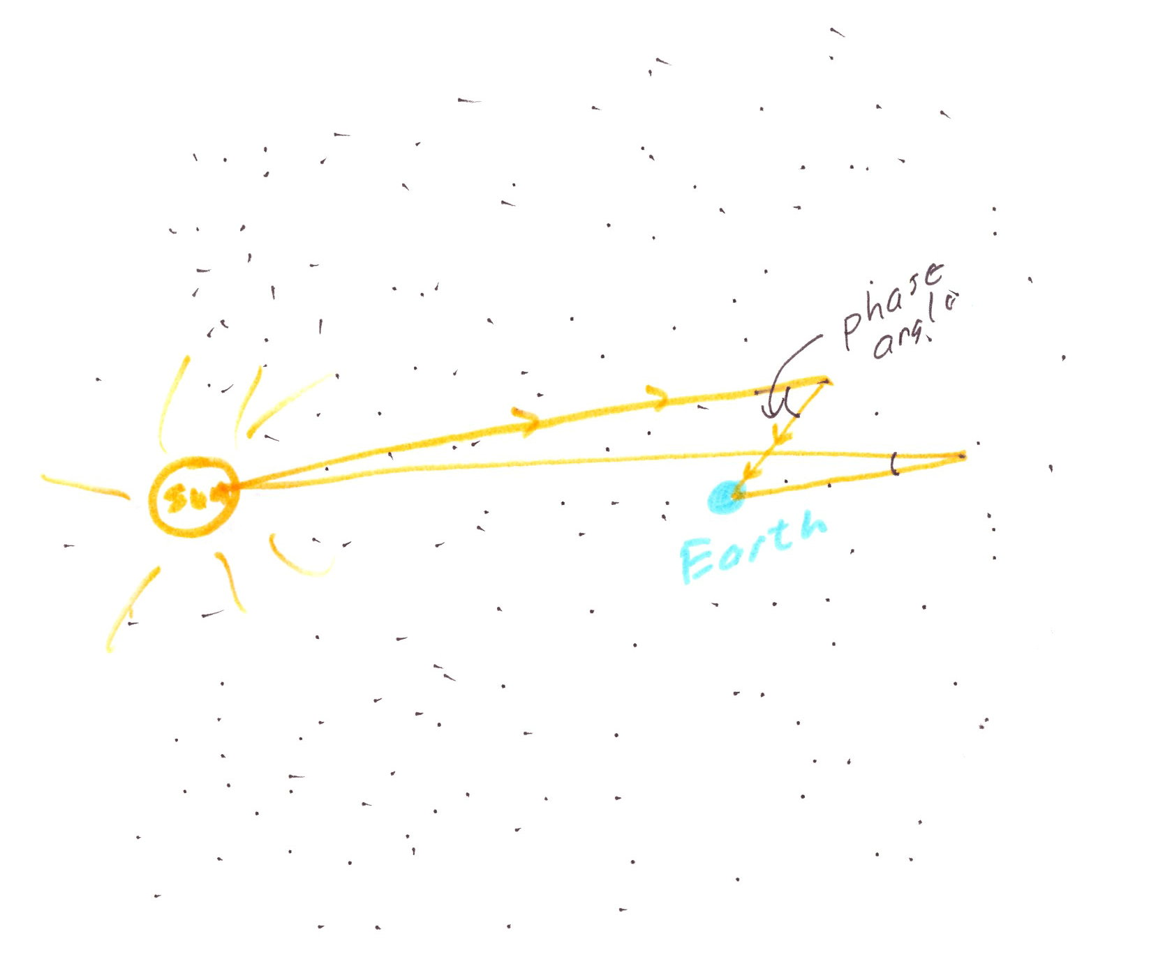

Slide 35
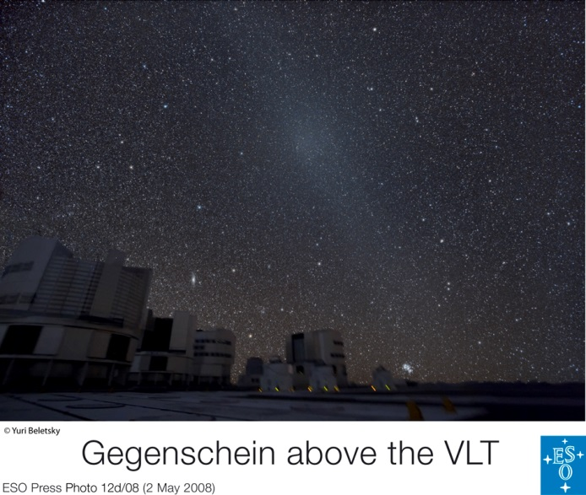

Slide 36
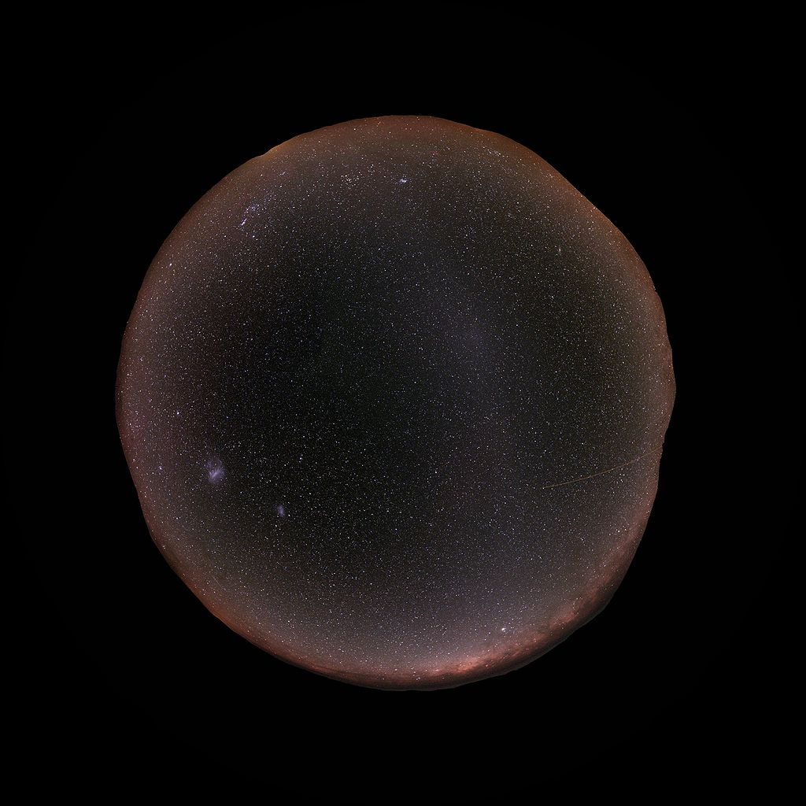
Gegenschein taken with a “fisheye” lens from a southern observatory. The Milky Way runs along the horizon in all directions.

Slide 37
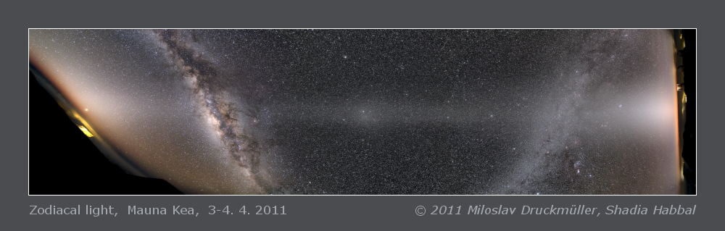
WOW! One of the most impressive images of the sky I have ever seen. This image, stitched together from a number of individual exposures over the course of a night,
shows more than half of the ecliptic, due to Earths rotation in night. The ecliptic runs horizontally across the center of the image. The gegenschein is in the very center of the image. At the left and right we see the evening and morning zodiacal light.

Slide 38
