Slide 1
Dancing with Jupiter- Hildas and Trojans
OkieTex Star Party 4 October 2013
Dr. Bill (Dr. William Romanishin)
This talk, along with astronomical calendars, university course materials, my free textbook on CCDs, and other junk can be found at my web site:
hildaandtrojanasteroids.net

Slide 2
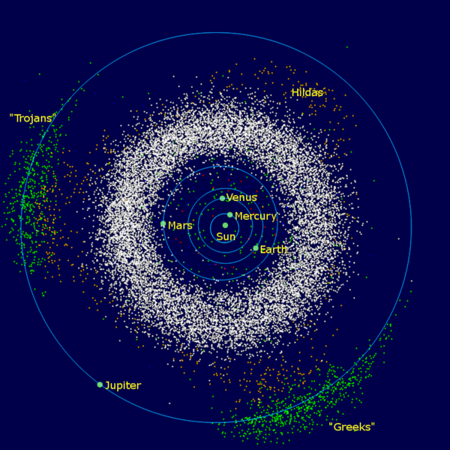

Slide 3
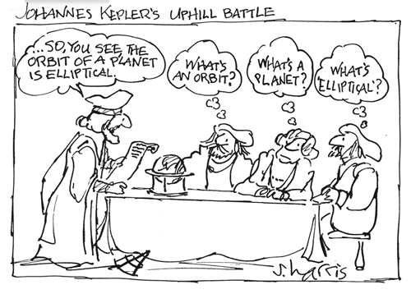

Slide 4
What is an orbit?
Path of two bodies in space determined by their gravitational attraction and their initial velocities
Q: If gravity is pulling bodies towards each other, why don’t bodies always just crash into each other?
A: Orbit is a balance between gravity (which tries to pull objects together) and object’s velocities (or more technically, their momenta) which works (almost always) to separate the bodies
Simplest orbit is a circular orbit of a low mass object around a much more massive object (like Earth around Sun, or satellite around Earth):

Slide 5
Balance of gravity and momentum keeps object in orbit
as it falls around Sun
Motion of object if Sun’s gravity
disappeared
Green arrows mark direction of instantaneous velocity of object
Pull of gravity of Sun

Slide 6
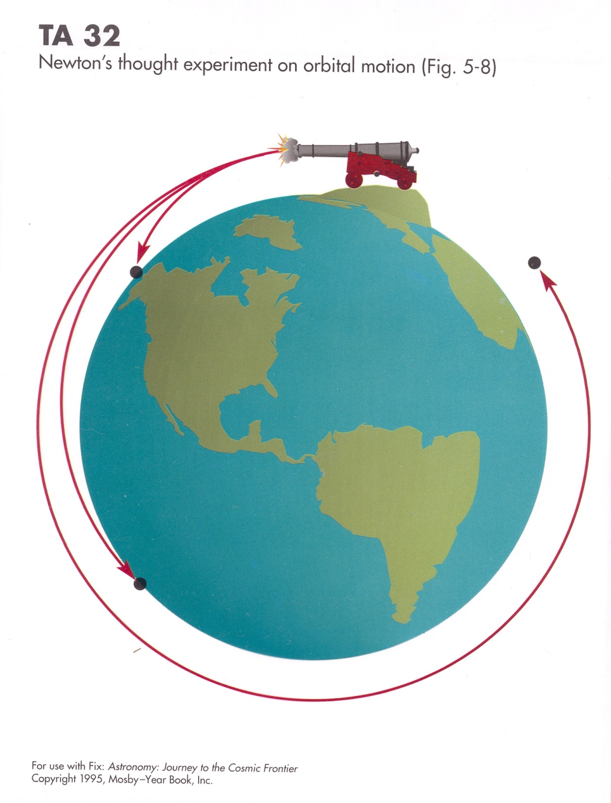
The projectile is NOT being powered around Earth, but is coasting from the initial velocity imparted by the gun. We say the projectile is in free fall. It is falling around the Earth. (But in a circular orbit it doesn’t get any closer to Earth, even though it is falling!!)

Slide 7
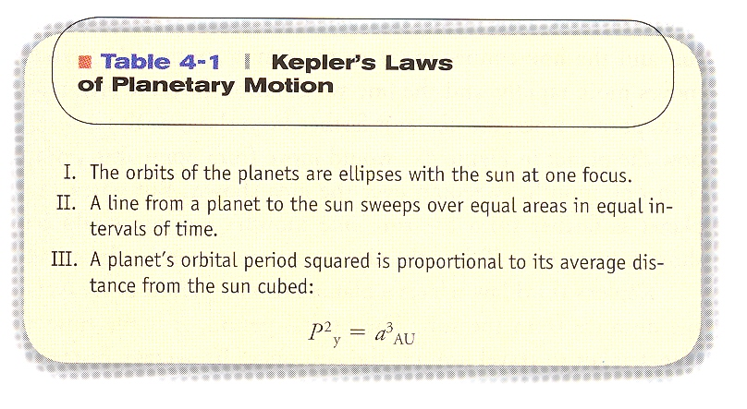
400 years ago!!!!

Slide 8
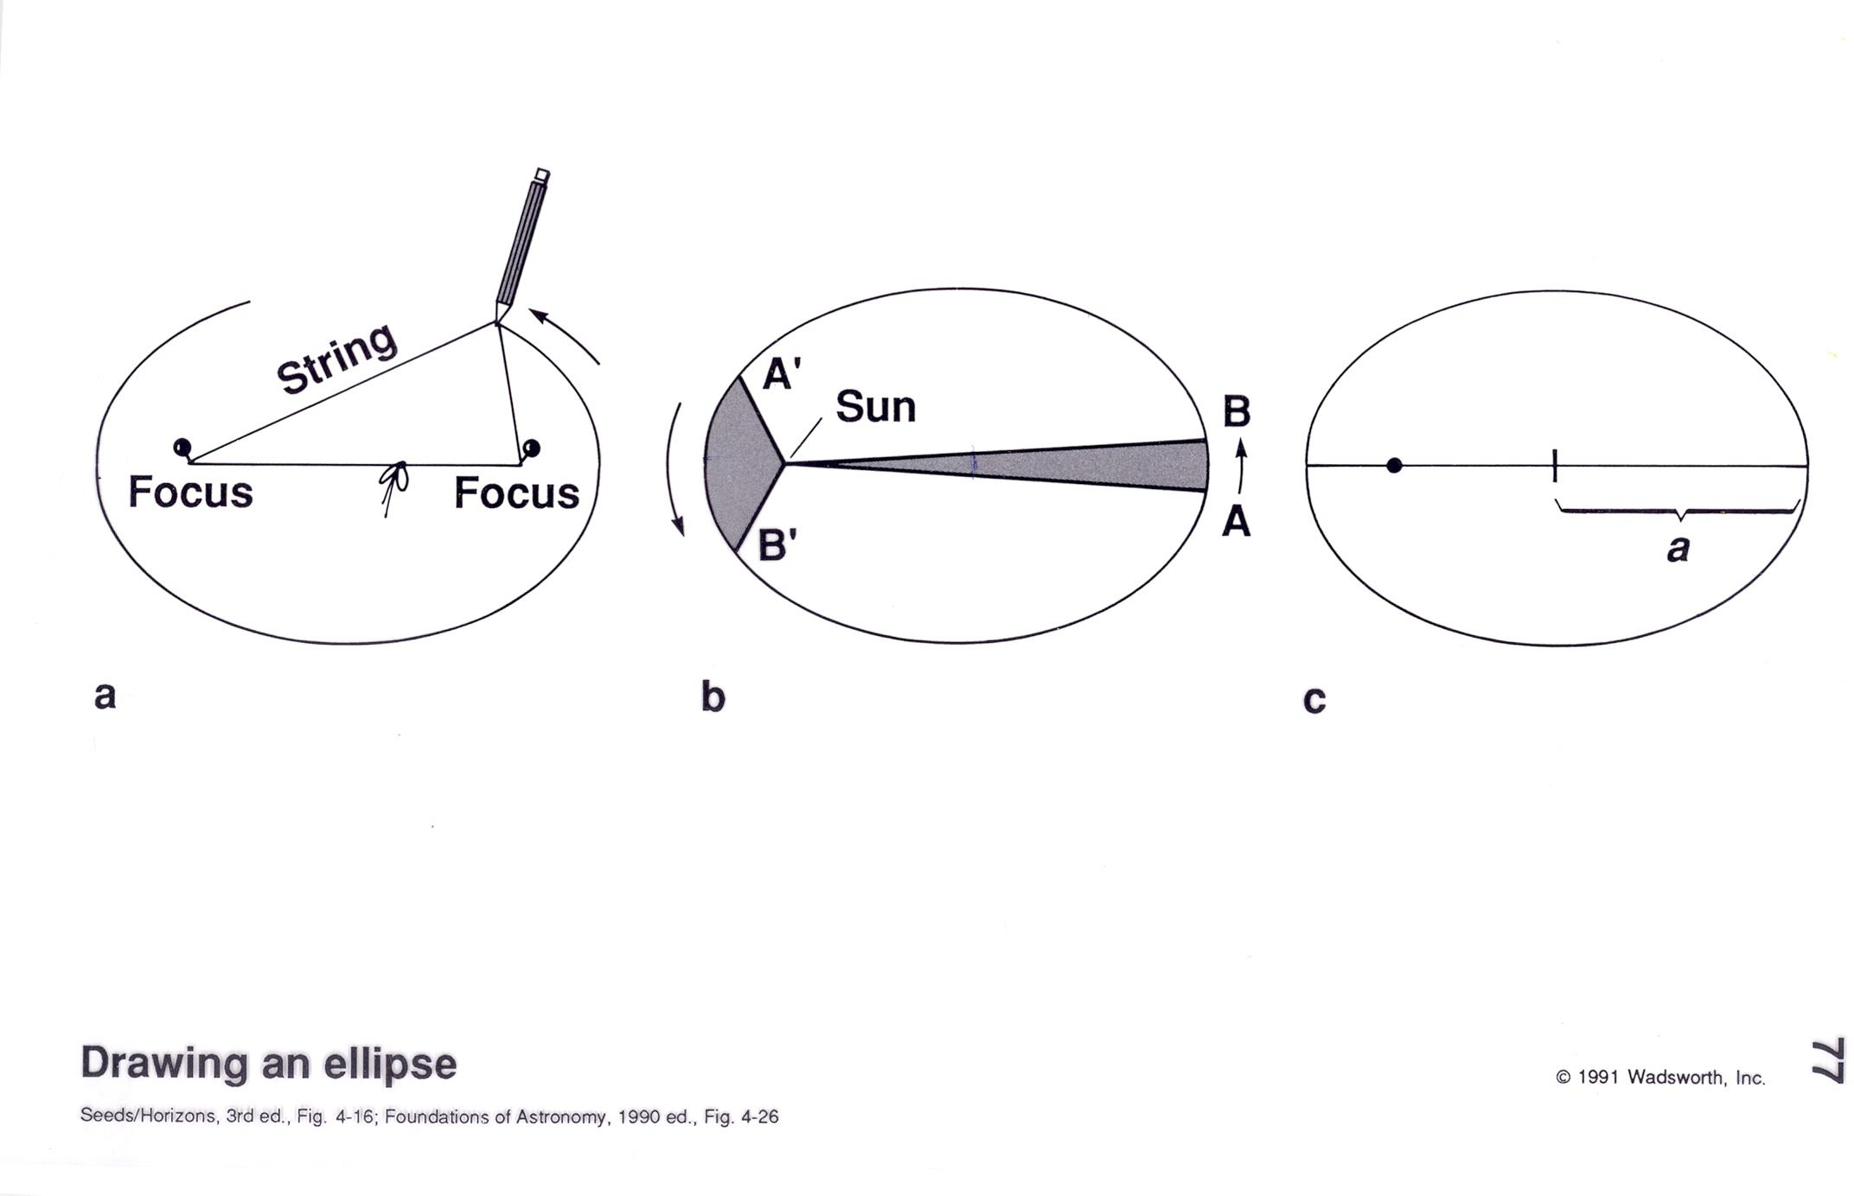
Sun is at one focal point of ellipse, NOT at center of ellipse
Half of length of long axis is called semimajor axis (a)

Slide 9
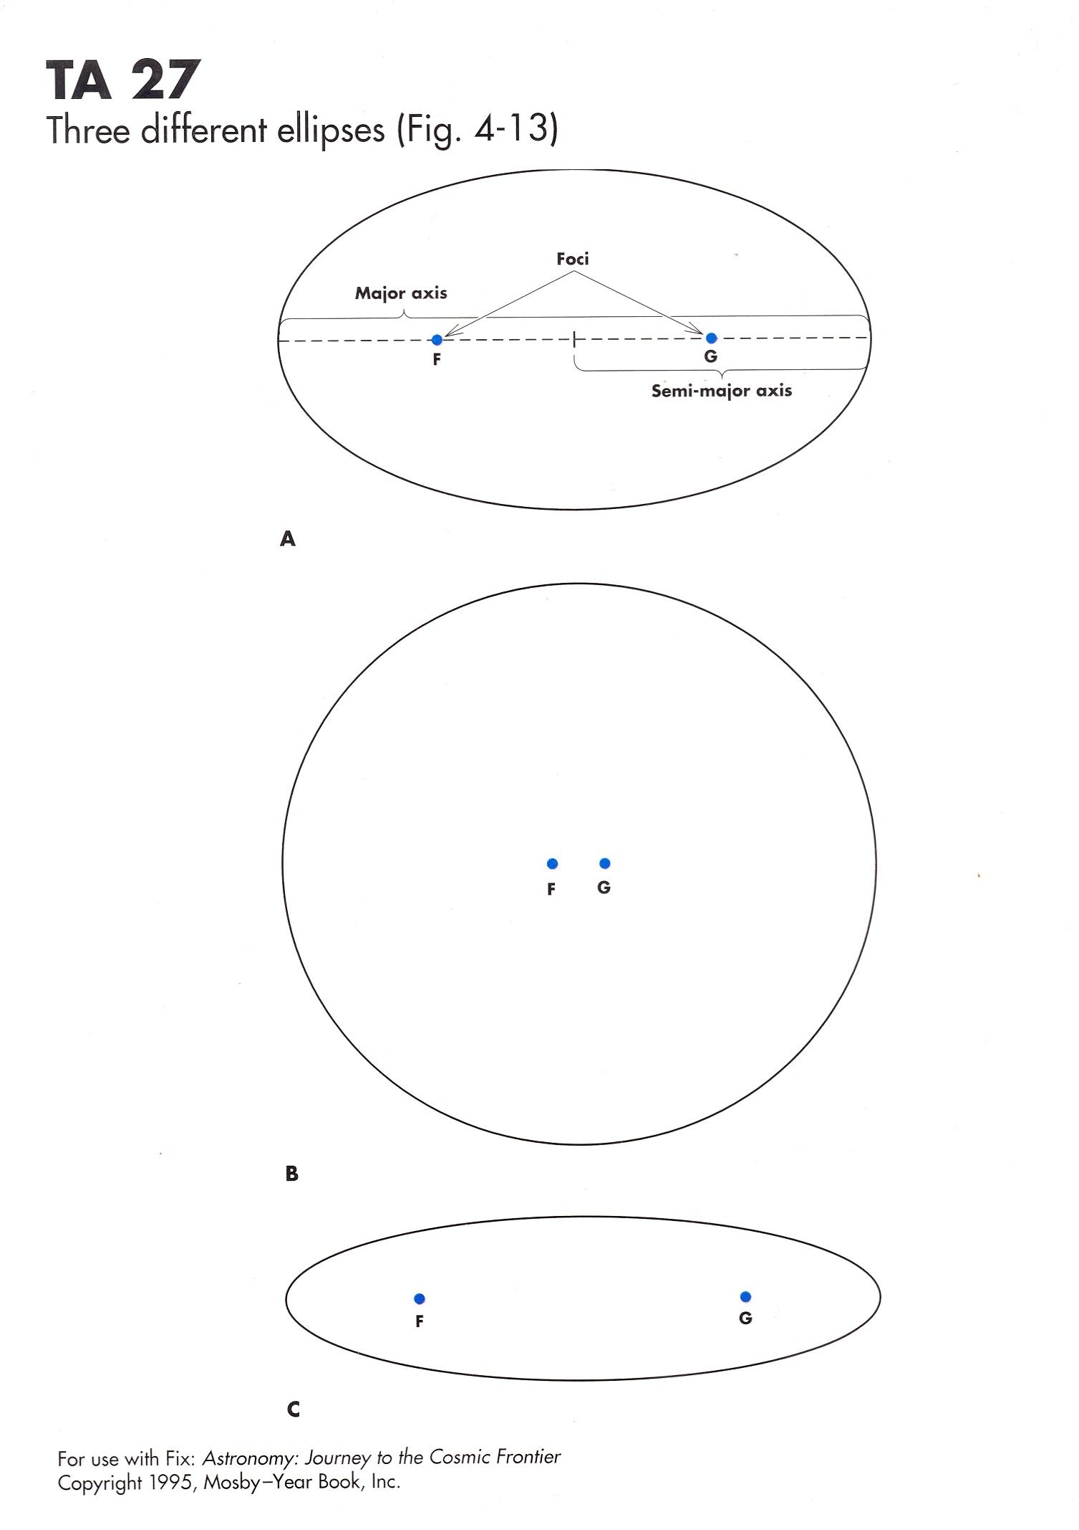
Unlike circles, ellipses can have different shapes. e.g. nearly circular or long and cigar-shaped.
“Out of roundness” described by a number called the eccentricity of the ellipse. Always abbreviated as “e”
(circle has e = 0 )
e = 0.43
All 3 ellipses have same semimajor axis size (a)
e = 0.06
e = 0.71

Slide 10
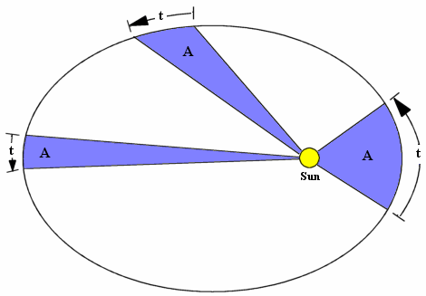
Keplers 2nd Law- The Diagram
t = equal time intervals
A = equal “swept out” areas

Slide 11
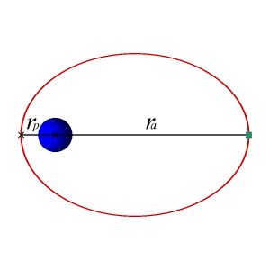
Keplers 2nd Law – The Movie! (rated G)
In this example, blue ball is Sun- green dot is orbiting body
r_{p} is the perihelion distance (closest to Sun)
r_{a} is the aphelion distance (farthest from Sun)
Falling towards sun
(upper half of
diagram)
Speeds up
---------------------
“Coasting uphill” away from Sun –
Slows down
(bottom half of diagram)

Slide 12
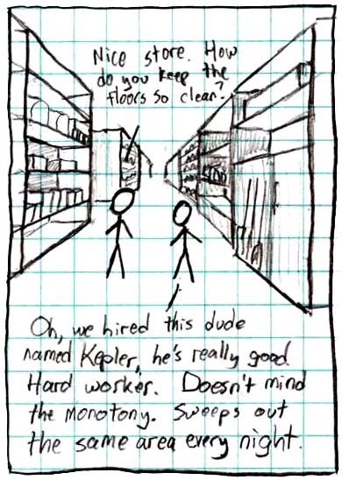
Kepler’s 2nd Law- the Nerdy Cartoon

Slide 13
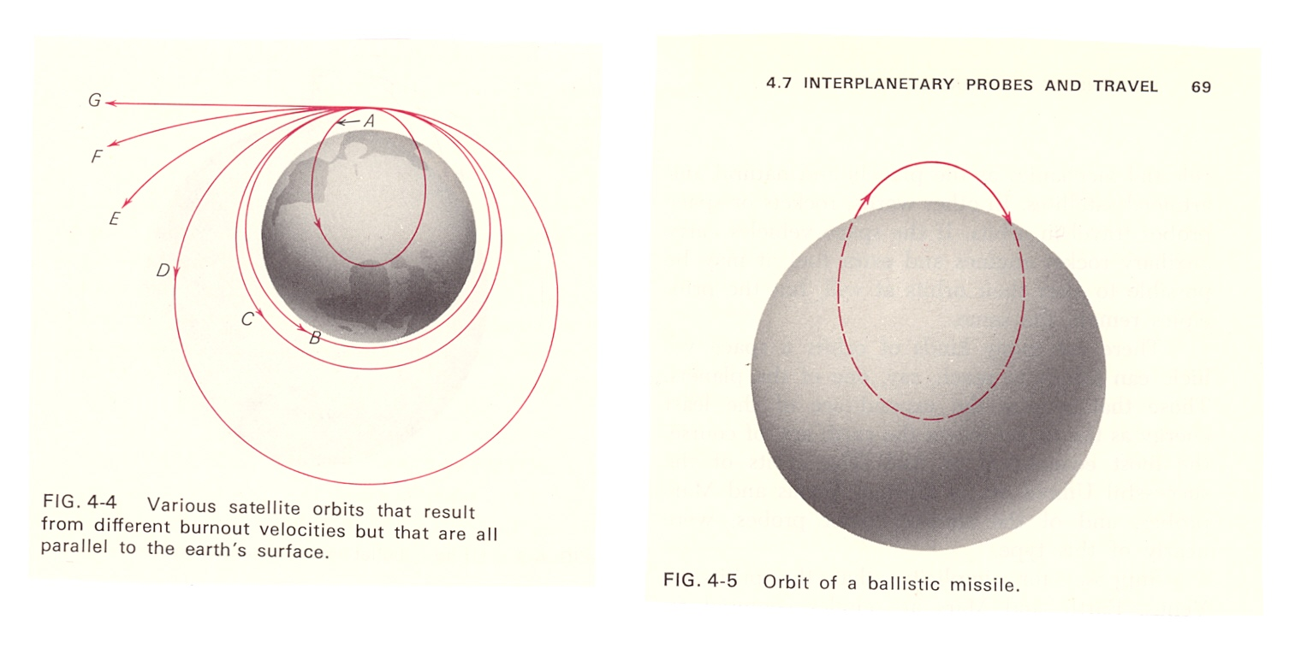
A,B,C,D: examples of bound orbits
E,F,G: examples of unbound orbits
Ballistic missle trajectory an example of an elliptical orbit. Earth center = one focal point

Slide 14
Orbital Mechanics
Study of orbits (shape, size, period, speed) and how to change
from one orbit to another
Uses mathematical description of Gravity (Newton) and Laws of Motion (Newton)
Modern techniques use Conservation of Energy idea
2 types of energy: kinetic energy (KE) = energy of motion and
potential energy (PE) = energy of position
In orbital mechanics, “common sense” often leads us to wrong answers!

Slide 15
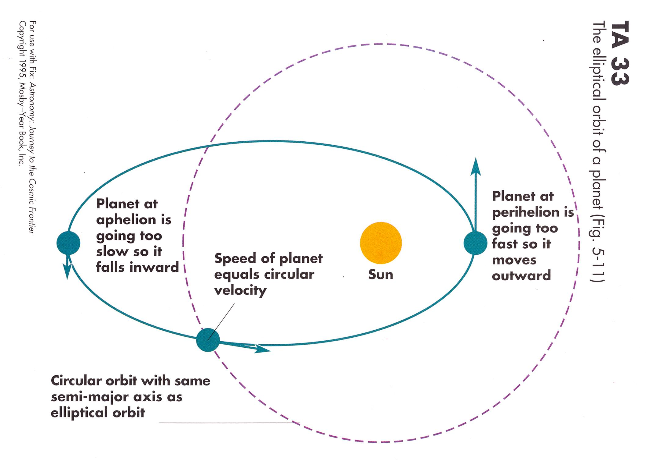
Circular orbit would have constant speed
Two orbits with same semimajor axis (a) and same period (P)
Elliptical orbit would have variable speed

Slide 16
Speed up to slow down!!
Circular orbit, a=1.0AU, P= 1.0 yr,
speed= 30 km/sec
Fire rocket,
Increasing
Speed from
30 to 33
km/sec-
Object MUST
move to new
orbit
New elliptical orbit , a=1.27 AU, P= 1.42 yr,
Max. speed=33 km/sec, minimum= 21.5,
Average speed= 26.4

Slide 17
Slow down to speed up!!
Dashed line= original circular orbit
Fire rocket opposite to direction of
motion (retrorocket)
To change speed from 30 to 27 km/sec- object starts
to fall towards Sun and speed up
New elliptical orbit has a= 0.84 AU P= 0.77yr
Maximum speed= 39.7 km/sec, minimum speed= 27 km/sec and average speed = 32.4 km/sec

Slide 18
And all this science, I don’t understand
Its just my job five days a week
A rocket man, a rocket man
Elton John “Rocket Man” (1972)
lyrics by Bernie Taupin

Slide 19
Hildas
The Hildas are a set of several thousand known (and many more not yet found) “asteroids” with similar orbital properties
in a special relationship to Jupiter’s orbit
Named after the asteroid (153) Hilda, discovered in 1875 by Johann Palisa, an Austrian astronomer.
Palisa discovered more asteroids visually (using his eye and a telescope, as opposed to photography or CCD imaging) than any other astronomer (And I assume he will hold this distinction forever as no one discovers asteroids visually now!)
Hilda was named for daughter of another Austrian astronomer

Slide 20
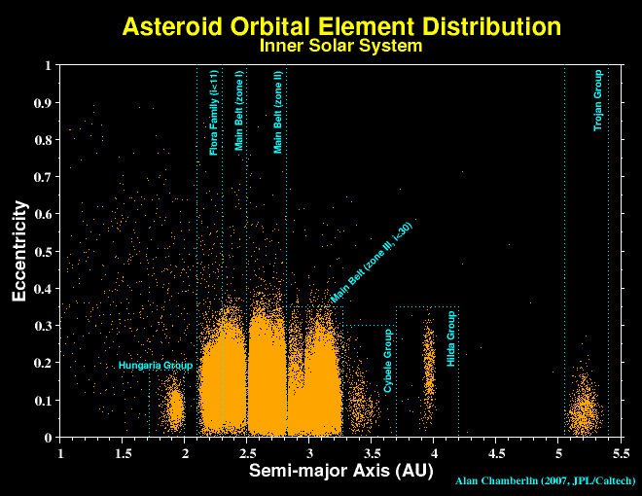

Slide 21
Orbital Resonance
Two objects are said to be in orbital resonance when the ratio of their periods or number of orbits in a given time is the ratio of 2 small integers
e.g. if one object has a period of 5 years and another a period of 10 years, they are in a 2:1 resonance, as first orbits exactly 2 times for every 1 orbit of second object
The Hildas have periods 2/3 that of Jupiter, so the Hildas are in a 3:2 resonance with Jupiter (orbit Sun 3 times to 2 for Jupiter)
Period of Jupiter is 11.86 yrs. Period of Hildas are (2/3)* 11.89=
7.91 years

Slide 22
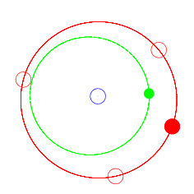
Solid RED dot= Jupiter
Red CIRCLES = L3,L4,L5 Lagrangian points
Green dot= Hilda
Arrows mark initial positions
Note that Hilda orbit significantly “out of round” (e ~ 0.2). Note that Hilda can ONLY pass Jupiter when Hilda is near perihelion in its orbit

Slide 23
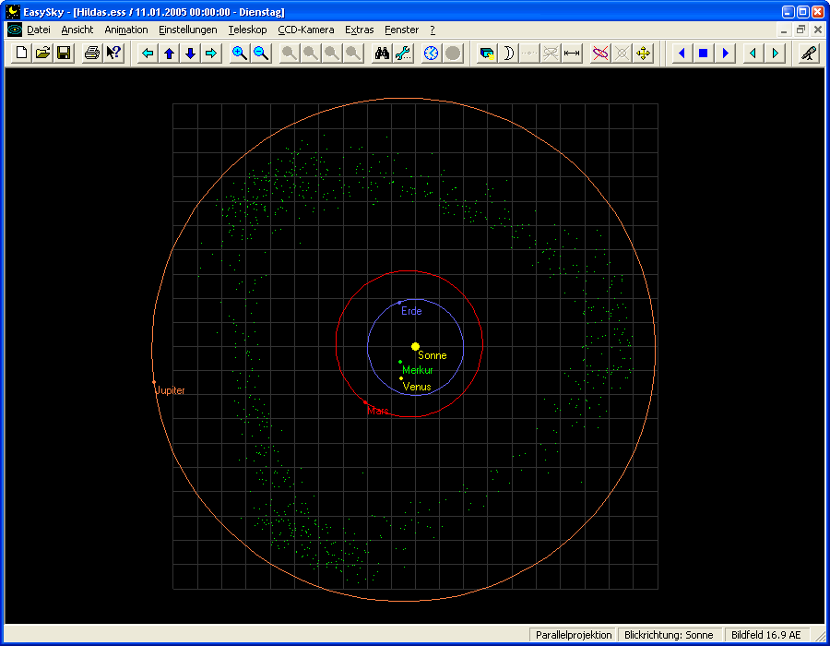

Slide 24
Hildas
Hildas all have about same Period (2/3 that of Jupiter)
Objects with a slightly different periods would not be in resonance with Jupiter. These objects would soon happen to get close to Jupiter and be scattered out of their orbits.
Hildas are in a protective resonance. They sometimes get near radius of Jupiter’s orbit, but the resonance ensures that Jupiter is someplace else in its orbit at that time!!!
Hildas are Survivors!! Objects with periods a little shorter or longer have long ago been eliminated from solar system!! (that’s why there are essentially no asteroids with a values between 3.6 and 3.9 AU and between 4 and 5 AU)

Slide 25
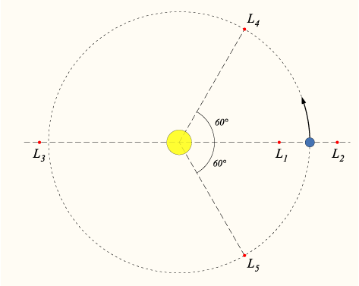
Trojans and Lagrangian points
Only 5 points where a low mass body can “co-rotate”
(have same orbital period or be in 1:1 resonance) with a much more massive body orbiting Sun

Slide 26
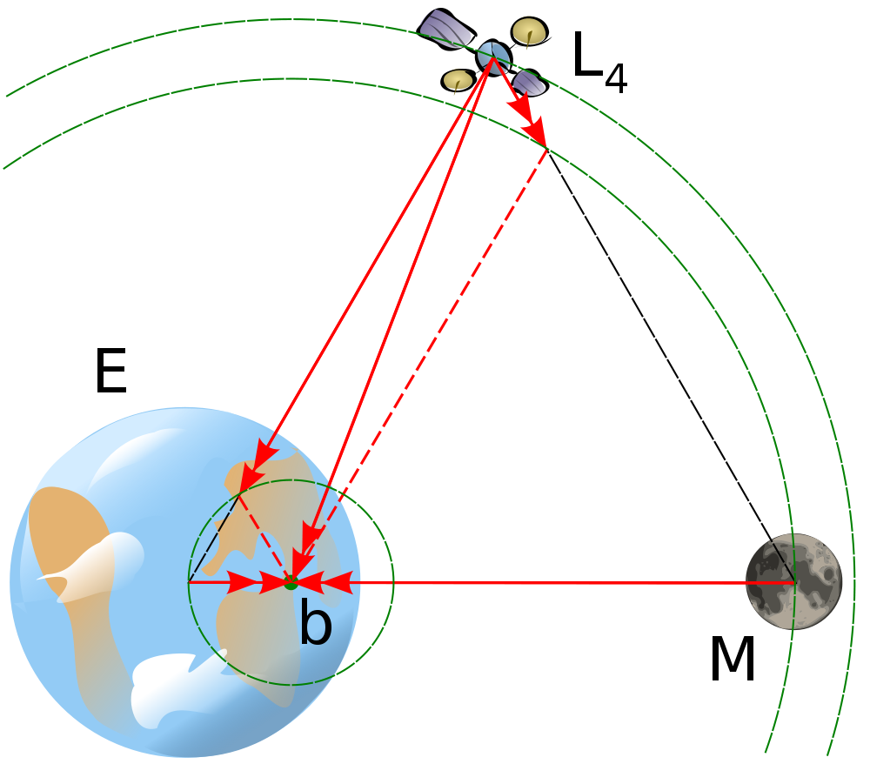

Slide 27
Jovian Trojans
The L4 and L5 “points” are stable. (Actually, there is a region around the L4 and L5 points in which objects can move around and stay – on average- at the same period as the massive object orbiting the Sun)
Objects near the L4 and L5 points of the Jupiter-Sun system are in 1:1 resonance with Jupiter
Thus, the Trojans “mill around” in two clouds (centered at L4 and L5 points), but never get very close to Jupiter

Slide 28
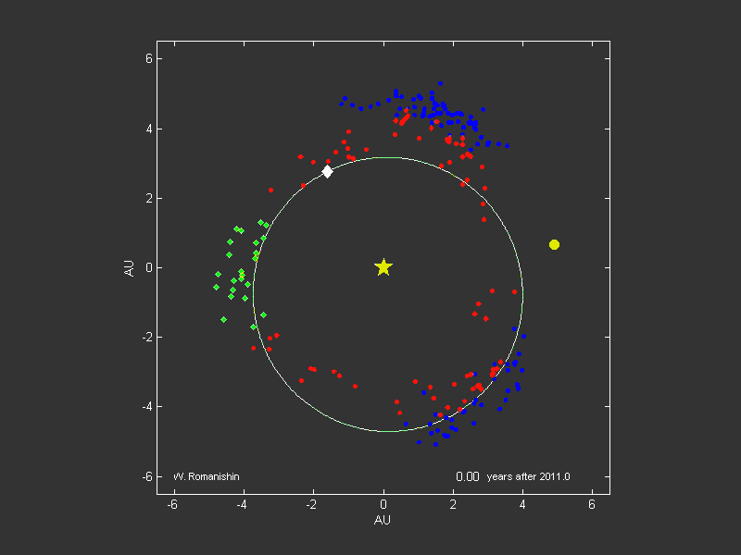
Blue= Trojans ; red & green= Hildas ; green= “clump” at apex

Slide 29
Origin of Hildas and Trojans
Did they form near their present orbits?
Maybe not!!
Nice Model of Giant Planets and outer solar system minor bodies: Giant planets started in much more compact configuration, then they moved into a resonance which
“shook up” a disk of small bodies outside Giant planet region. This idea can explain many features of the Kuiper Belt region. Also, the Trojans and Hildas may have been
“implanted” into inner solar system by this event.
Hilda and Trojans may be more like Kuiper Belt Objects
(lots of ice) compared with rocky asteroids in main belt

Slide 30
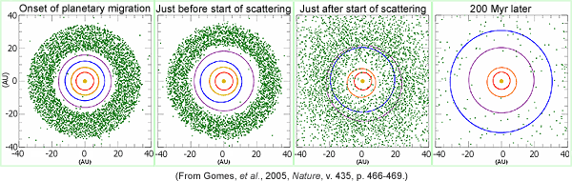
Main idea of Nice Model:
Initially compact Giant Planet configuration destabilized
by migration and Jupiter/Saturn resonance. This cause violent motions of Giant Planets which cause trillions of icy bodies
In outer solar system to fly all over the place!

Slide 31
In this scenario, the region between main belt and Jupiter would have been filled with many, many objects at all semimajor axes.
Due to interactions with Jupiter, most of these bodies have been destroyed (impacted Jupiter) or flung out of Solar System or into Sun.
HOWEVER, due to their being in protected resonances, the Hildas and Trojans survive!
Hildas and Trojans are Survivors!!

Slide 32
So, what are Hildas and Trojans made of? Mostly ices
like Kuiper Belt Objects? Or mostly rock, like Main Belt asteroids?
We don’t know!
May well be things that look like “partially burnt out comets”.
That is, an icy core surrounded by an insulating mantle of dust
and rock!
Stay tuned!!

