Slide 1
OBAFGKM – huh? Why not ABCDEFG or ABFGKMO?
An introduction to the spectra of stars.
W. Romanishin
9 January 2015- OKC Astro Club

Slide 2
Slides for this and other talks to amateur groups, along with slides from some of my University courses and other astronomy stuff (such as astronomical calendars customized for various sites in and out of Oklahoma) can be found on my website:
hildaandtrojanasteroids.net
I can be contacted by email at:
wromanishin@ou.edu
First, a picture of me with my new MFT (Most Favorite Telescope):

Slide 3

Lowell Observatory / Discovery Channel Telescope – Happy Jack AZ. 4.3meter diameter (170 inches). 5th largest optical telescope in continental US. Total cost ~ $50 million.

Slide 4
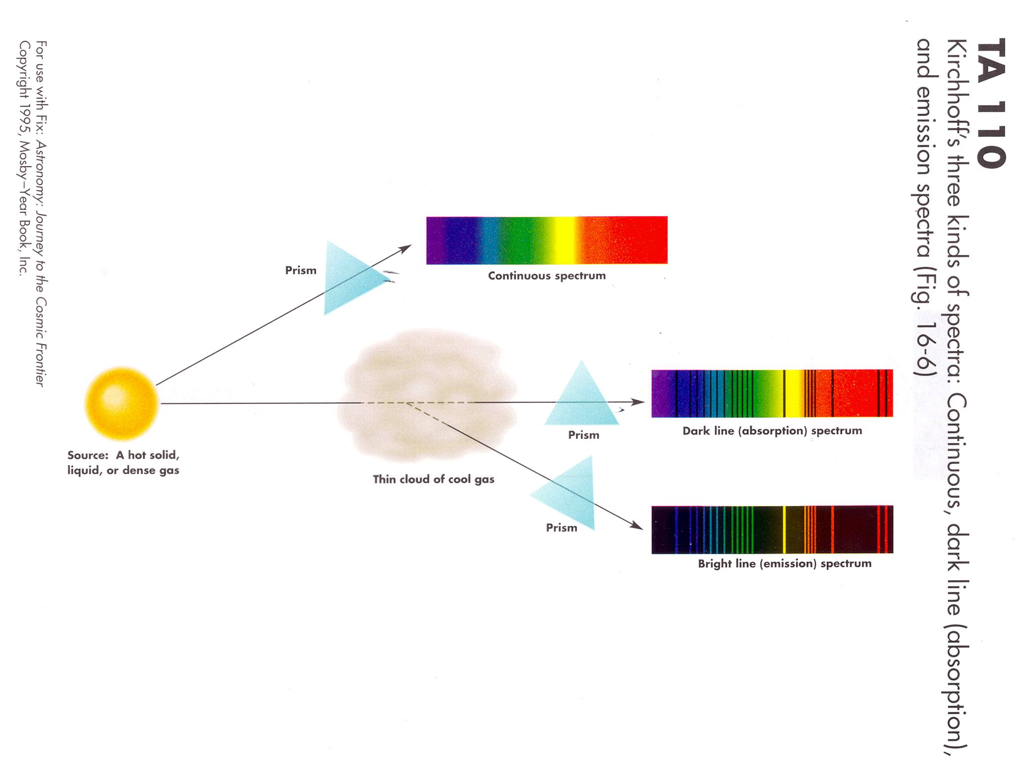

Slide 5
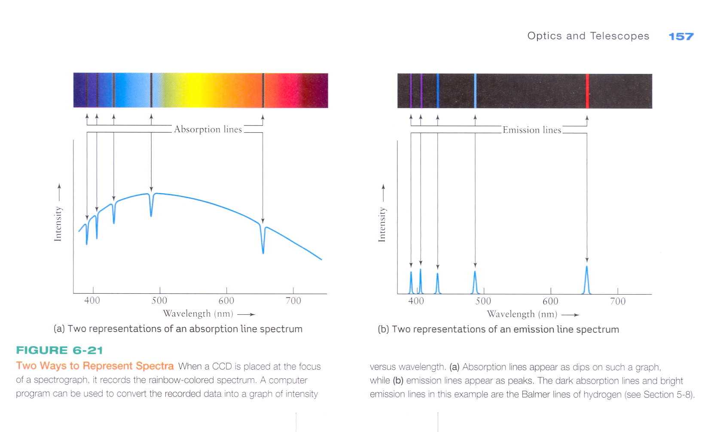

Slide 6
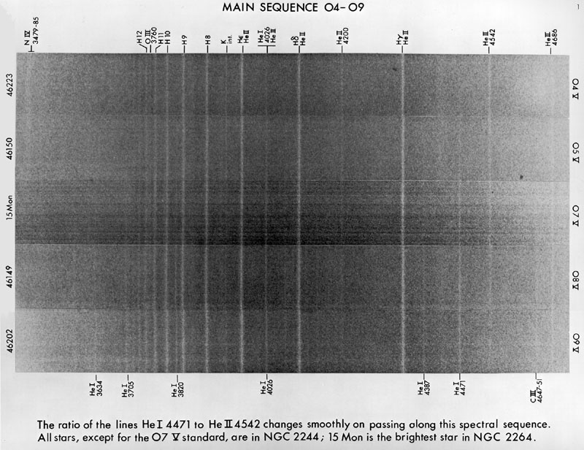
“Old school” spectra- taken on black and white photographic plates- Here shown as a negative (vertical white lines are actually dark (absorption) lines)

Slide 7
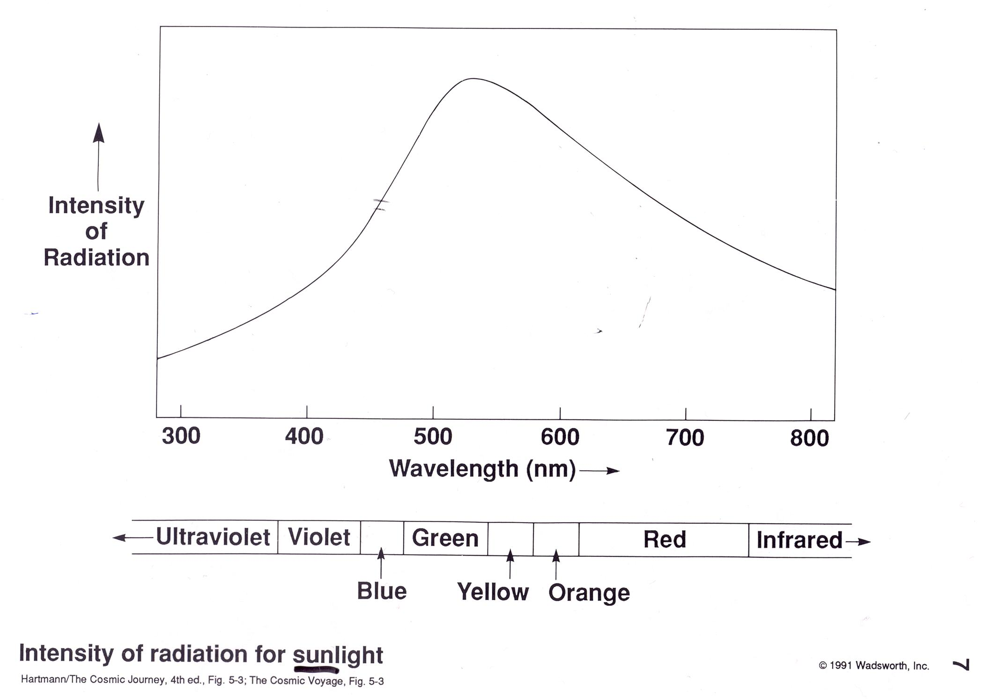
Spectrum of sunlight, showing distribution over visible wavelengths. This is a
very low resolution spectrum- it does not have the detail to show the many
absorption lines in the solar spectrum.

Slide 8
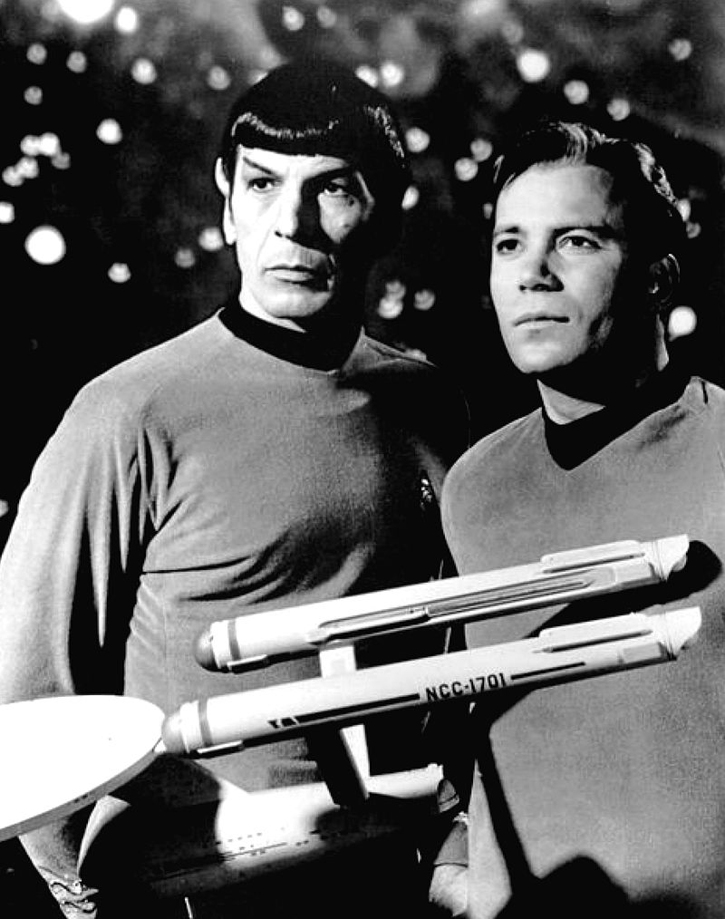
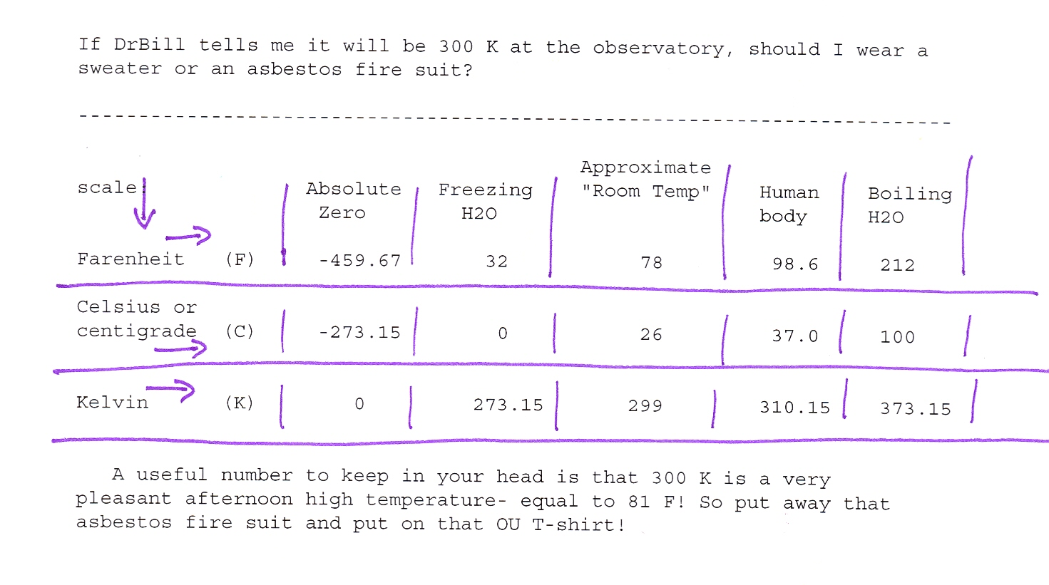
Astronomers use the Kelvin (K) temperature scale, which sets zero at Absolute zero. As Spock would say “It’s the only logical place to put zero!”

Slide 9
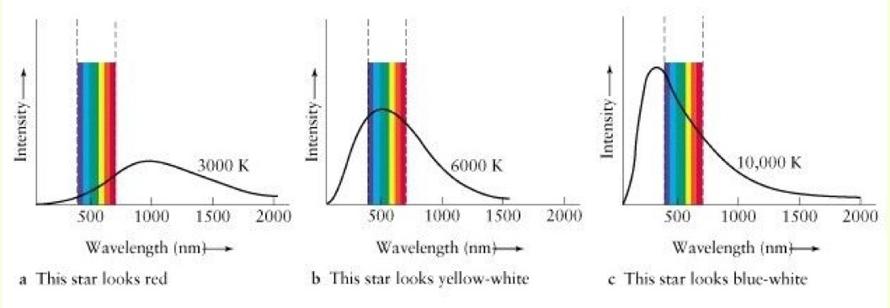
Relationship between spectrum of a star and its color as seen by human eye, which
is sensitive only to radiation of wavelength between about 450 and 650 nm. (A nm
is a nanometer, a unit of length equals to 1 billionth of a meter)

Slide 10
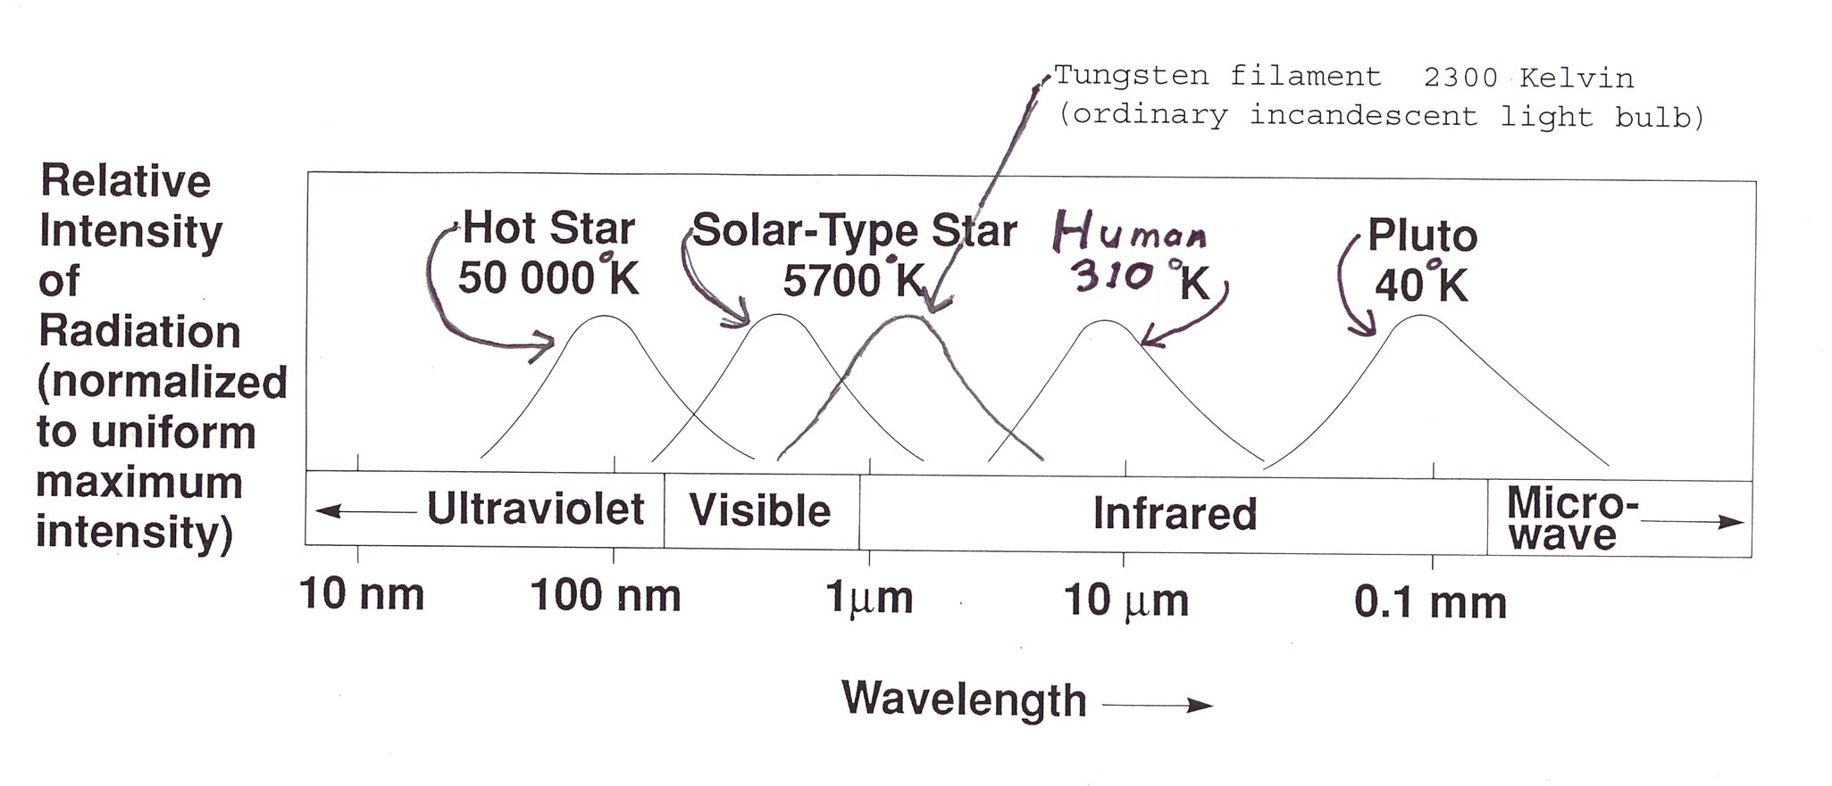
All solids or dense gases emit radiation called blackbody radiation. The peak
wavelength of the emission is related to the objects temperature. The hotter the
body, the shorter the wavelength of the radiation emitted.
Yes, this includes you and me! We have a body temperature of about 310 K
(98.6F) and we emit radiation primarily in the thermal infrared (wavelength
about 10 microns, about 20 times wavelength of visible light). Of course none
of us glow in the dark- at least not in visible wavelengths! (But if you could
“see” at 10 microns we would “glow in the dark”!) In everyday life we see things
by the light they reflect from hotter sources (Sun, light bulbs) rather than light they emit.

Slide 11
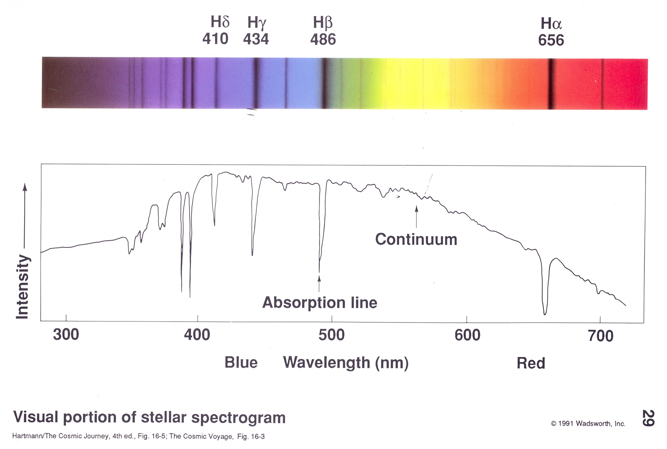
Example of a more detailed spectrum of a star, showing the continuum
and some absorption lines (dark lines).

Slide 12
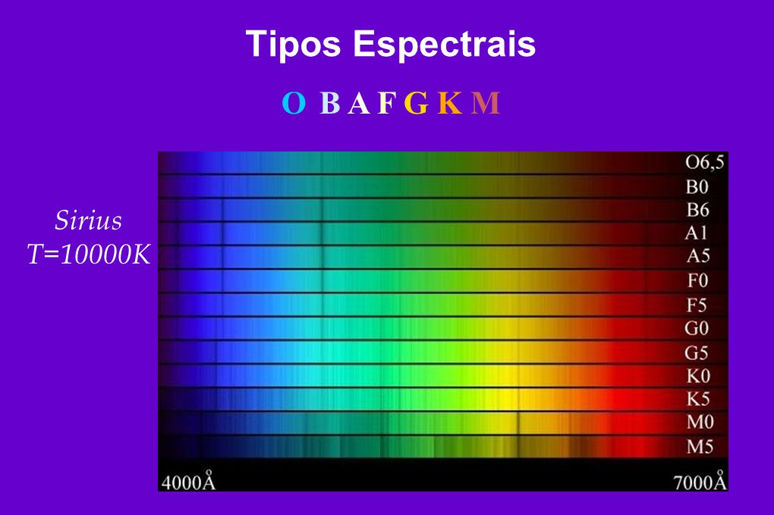

Slide 13
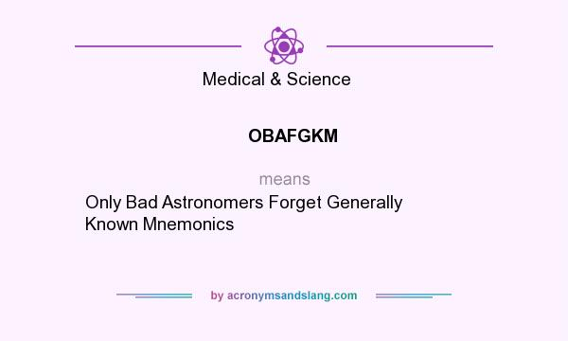

Slide 14
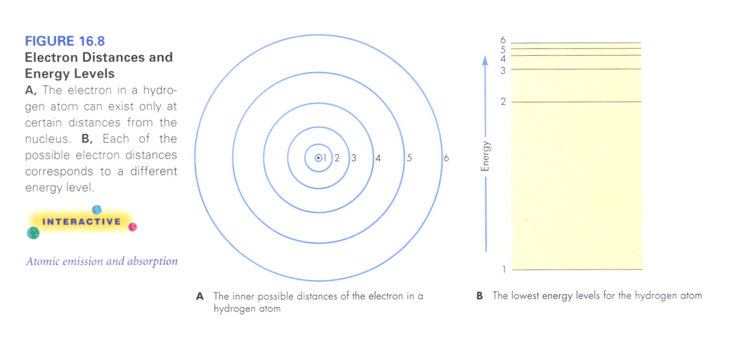
Simple cartoon model of a hydrogen atom. The key point (from Quantum Mechanics) is that the electron can only orbit the nucleus in certain orbits each with a certain energy. (Kind of like a ladder- you can stand on a step, but not between the steps.)

Slide 15
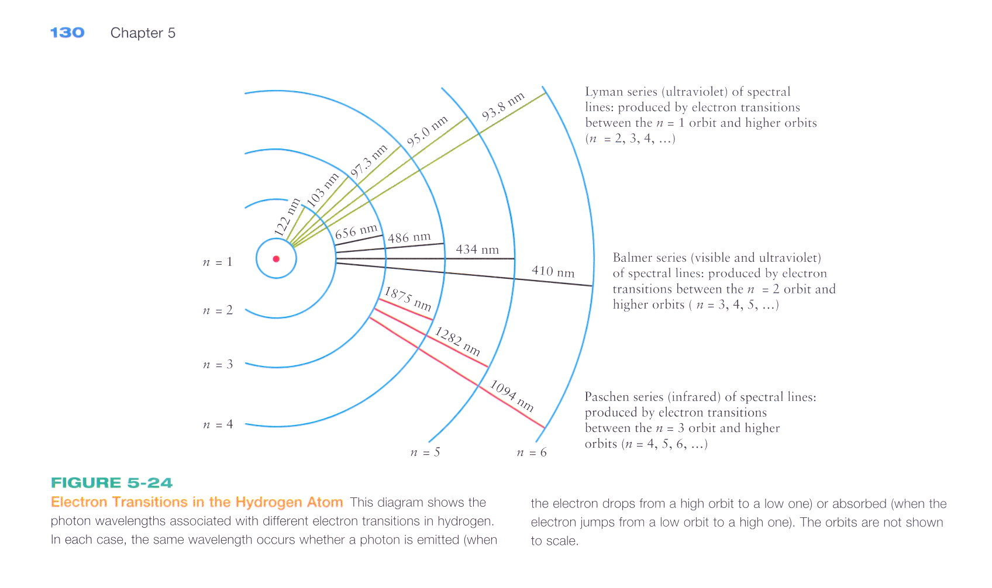
Hydrogen atom showing wavelengths of photons corresponding to jumps between
different energy levels. For example, a jump from the n=2 to n=4 level involves a
photon of 486 nm wavelength. This line, called “H-beta” is the most important
line in classifying stellar spectra. Balmer lines have n=2 as their lower level.

Slide 16
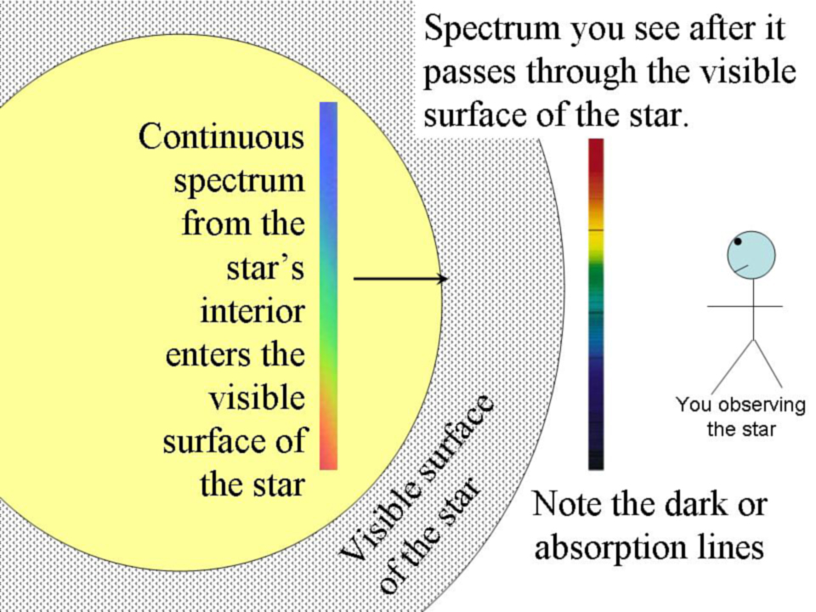
Very roughly, you can think of a star as a hot dense ball of gas (yellow circle) emitting a
continuous spectrum, completely covered by a cooler (but still hot!) layer of gas
(dotted stuff) that can produce dark or absorption lines in the continuous spectrum from the underlying hotter, denser gas.

Slide 17
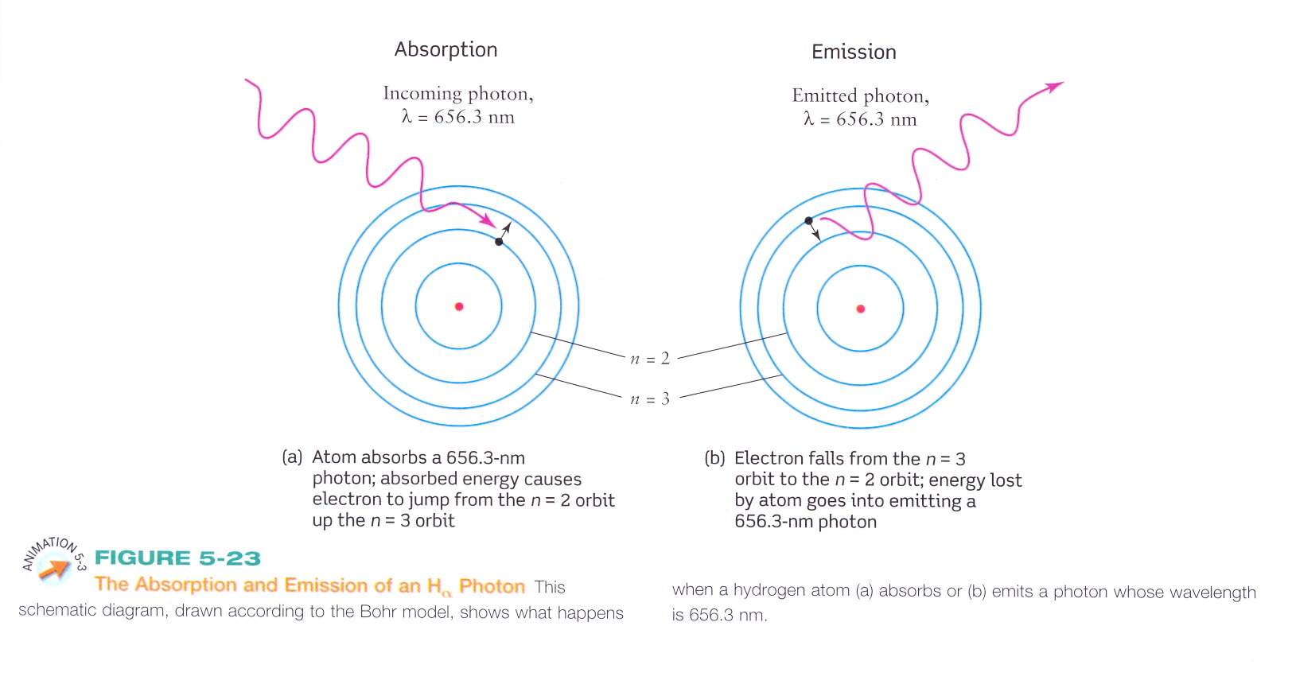
Radiative excitation – energy of photon excites electron to higher
Energy level- photon destroyed
Radiative deexcitation (or spontaneous emission)- electron loses energy- photon created

Slide 18
Electrons can also be excited or deexcited by collisions with other atoms or electrons.
If electron gains energy in collision, we have collisional excitation. The energy
comes from the kinetic energy of the colliding particles, so one or both of them slows down.
In a collision, the electron can also lose energy (collisional deexcitation). In this case the energy of the excited electron goes into speeding up one or both of the colliding particles.
So, the electrons in an atom can gain or lose energy by destroying or creating photons OR by collisions.

Slide 19
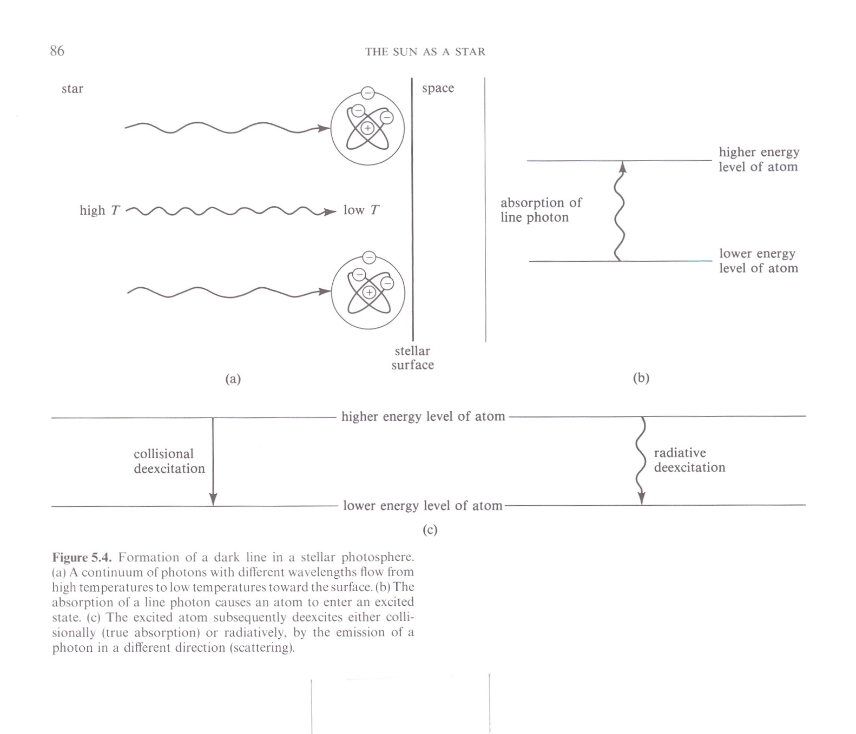
To get a true absorption line in a star, the absorbed photon must be destroyed, not just scattered off in a different direction. This happens
when an atom excited by absorbing a photon is deexcited by a collision
rather than by emission of a new photon.

Slide 20
Back to the original Q- why are the letters in sequence OBAFGKM? Originally, back in the 1920s, astronomers started classifying spectra into classes based
primarily on the prominence of the H-beta Balmer absorption line. Those with most prominent H-beta were called class “A”, next “B” etc, up to O.
Later, people figured out that the prominence of the H-beta line was most related to the temperature in the absorbing layer. To get an H-beta absorption line, you must start with an excited H atom- one with an electron in the n=2 level. As the temperature of a gas increases, collisions become more energetic, and a greater fraction of the H atoms are excited, so there are more H-beta absorptions.
BUT if the temperature becomes too high, an increasing fraction of the H atoms
are ripped apart by collisions (atoms are collisionally ionized) and the fraction of excited atoms (electrons still attached) *decreases* with increasing temperature.
So, the A stars are at the “just right” temperature for H-beta absorption- lots of excited atoms, but not too many “ripped apart” atoms. At both lower AND higher
temperatures the n=2 fraction of total atoms (still together and ripped apart)
is lower, so H-beta is weaker.

Slide 21
Thus, the sequence OBAFGKM is arranged that way because it forms a temperature sequence. O stars have the hottest surface temperature.
The surface temperature smoothly decreases from O to M.
The next 2 slides show the above argument in graphical form. The 3rd slide shows that atoms other than Hydrogen (HI = neutral hydrogen) show a similar pattern of absorption line strength with temperature, but with each different atom having a different “just right” temperature where its absorption peaks.
(What happened to the “missing” classes? (e.g. C and D stars). Basically, they
were too close to other classes and were simply dropped to simplify the
system.)
The 4th slide (spectrum of Sun) shows many 1000s of absorption lines from many
different elements. By studying these lines, astronomers can tell a lot about
a star- what elements are present, the relative abundance of the elements, the
pressure in the absorbing layer, the ionization state of different elements, how fast the gas is swirling around etc etc.
(The Sun is a G star. A G2 star, in fact. But you probably already knew that.)

Slide 22
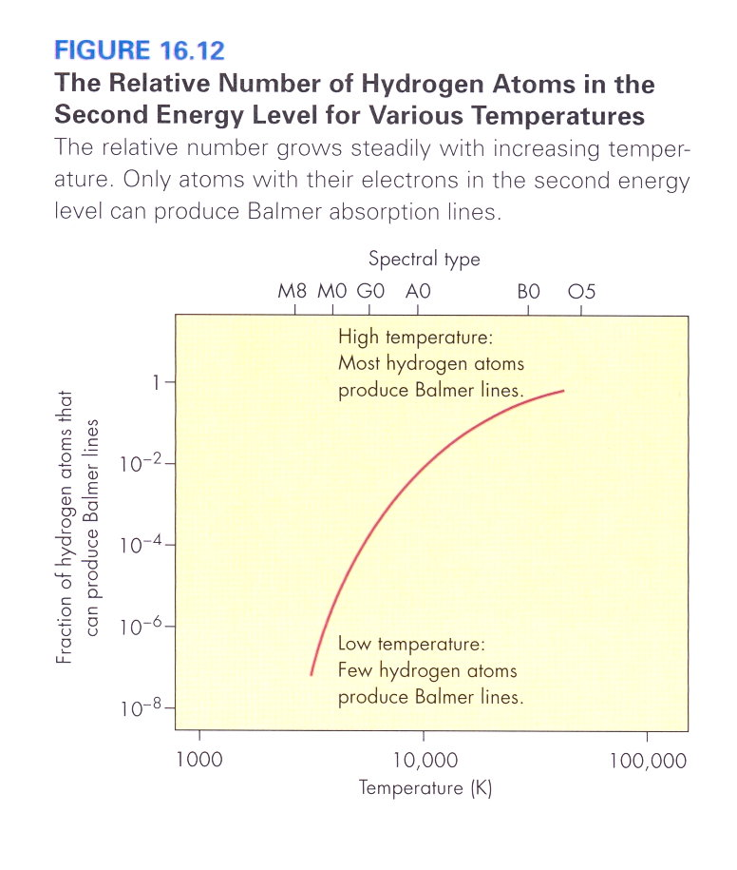

Slide 23
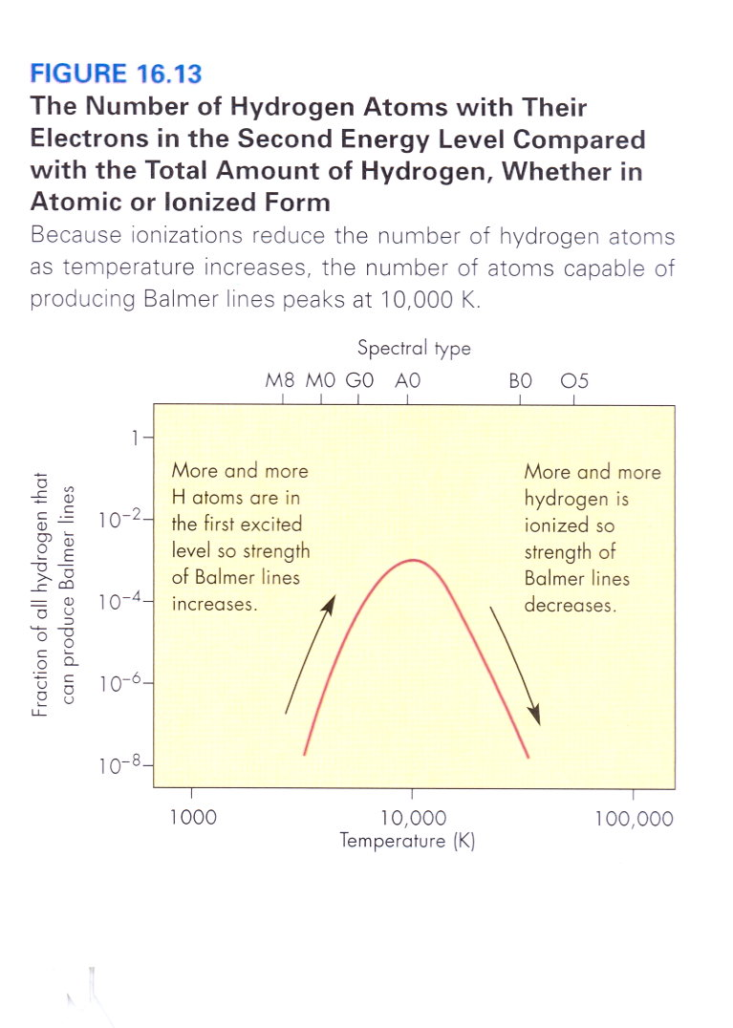

Slide 24
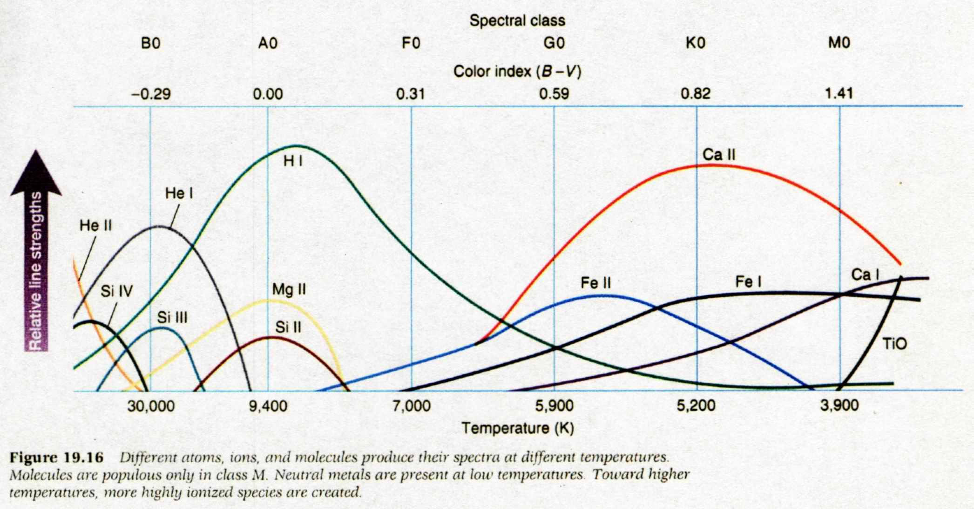

Slide 25
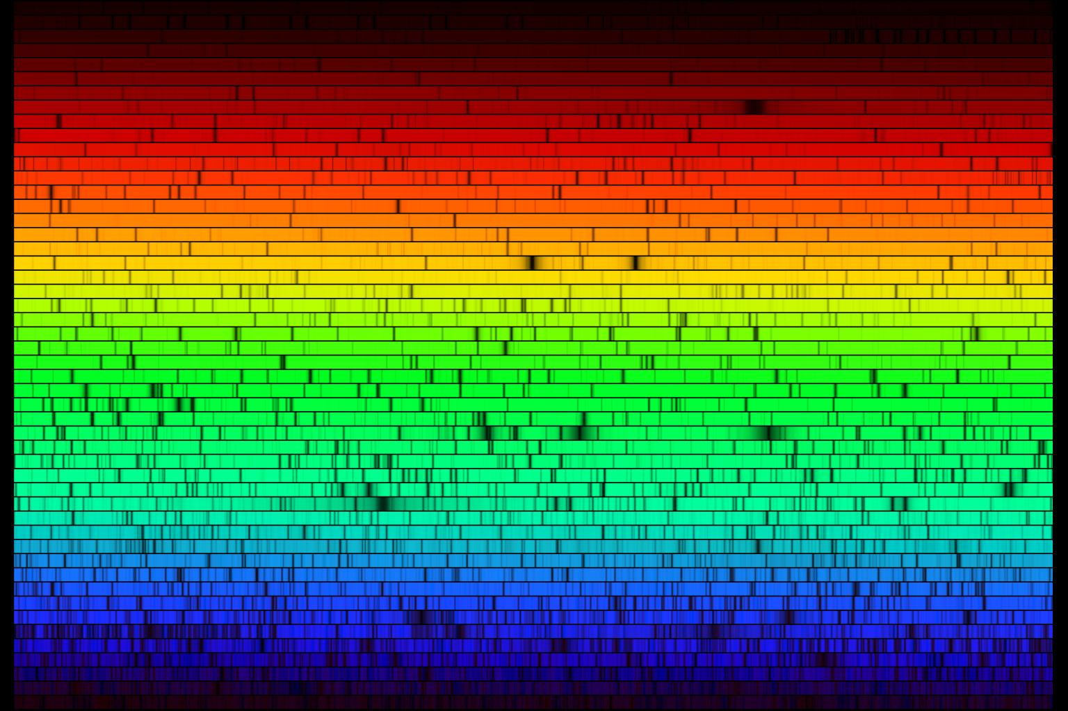
A medium resolution visible spectrum of the Sun (a G2 star)

Slide 26
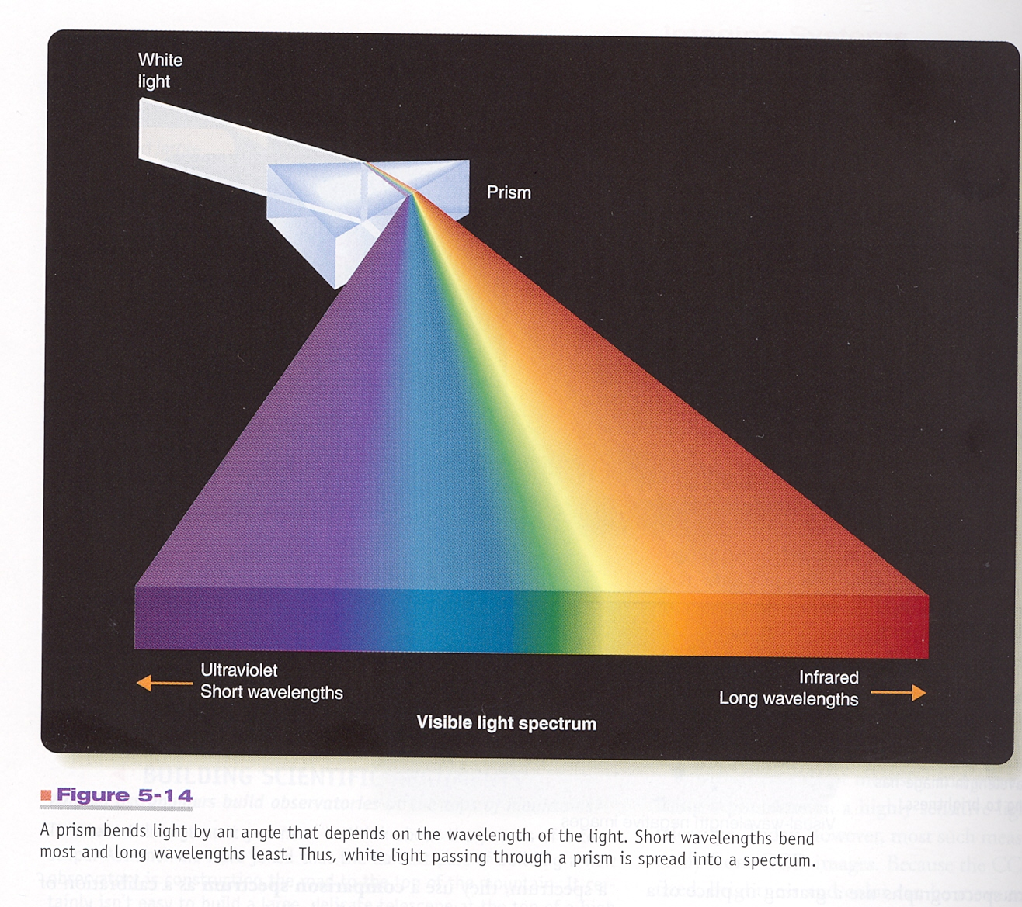
The key component in a spectrograph is the dispersing element, which sorts the incoming light by wavelength. In optical spectrographs, prisms or diffraction gratings are used to disperse the light.

Slide 27
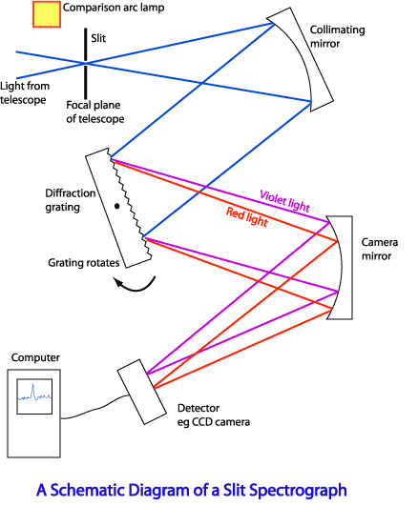

Slide 28
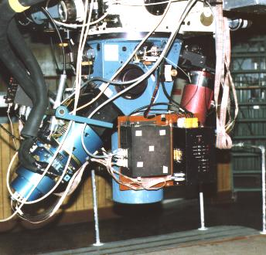

Slide 29
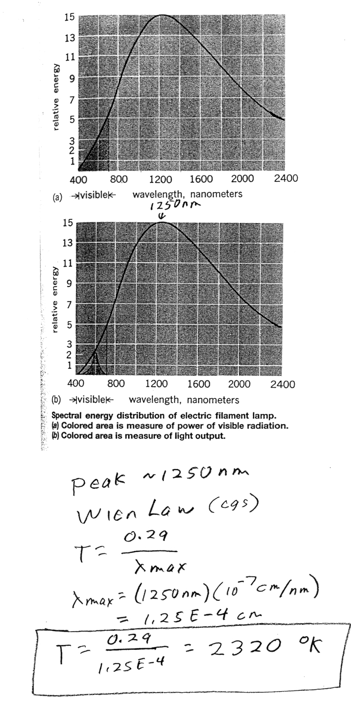
Incandescent light bulb
Emits continuous spectrum.
Tungsten filament heated to about 2300 K by passing electric current through it. Peak of spectrum in near IR- only a few percent of power goes into visible light.
(running hotter would be more efficient, but would burn out filament)

Slide 30

“Neon” light. Light is created by passing an electric current through a tube of gas. The moving electrons collisionally excite atoms, which then radiatively deexcite giving off an emission line spectrum. Different gases= different emission lines= different colors. Much more efficient than incandescent bulb.

Slide 31
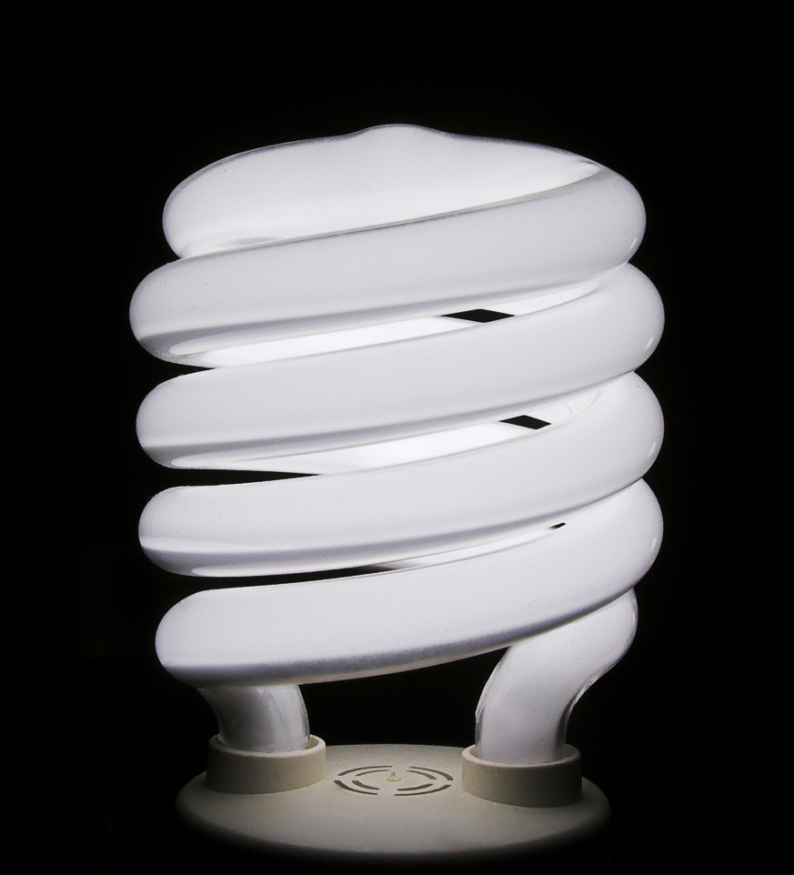
Fluorescent bulb. Produces emission line spectrum using same idea as “neon” light, but with mercury vapor. Inside
of tube is coated with a phosphor, which glows with a
whitish glow when struck with
emission line photons.
So, spectrum is combination of
emission line plus “continuous”
(from phosphor glow).
Much more efficient than incandescent bulbs.

Slide 32
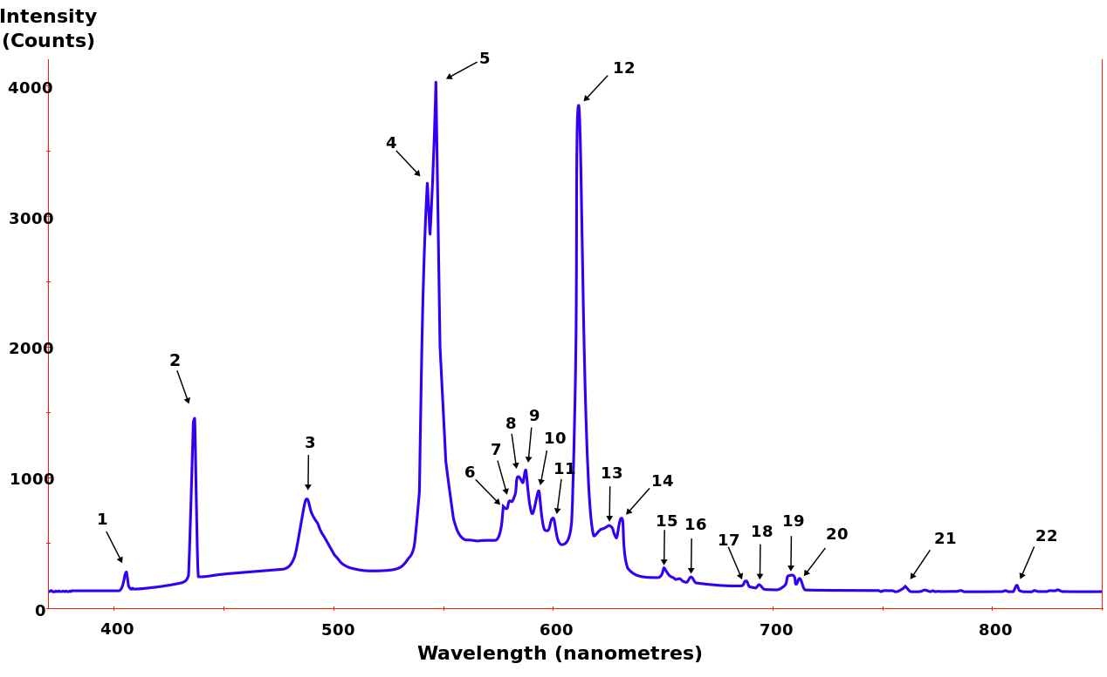
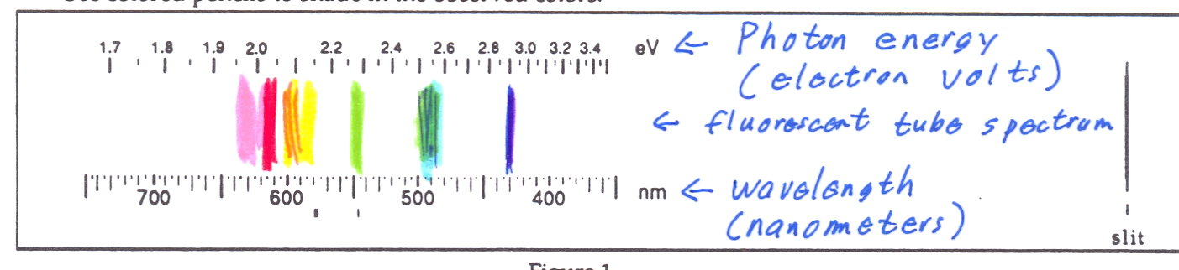
Spectrum of everyday fluorescent bulb. Your eye sees this as “white” light.
View of fluorescent tube through spectrometer:

Slide 33
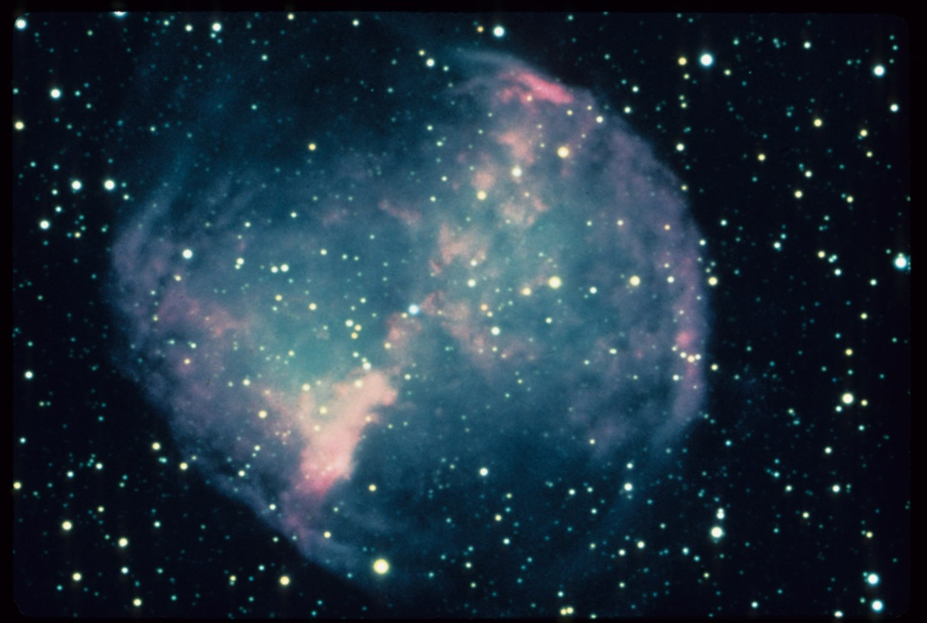
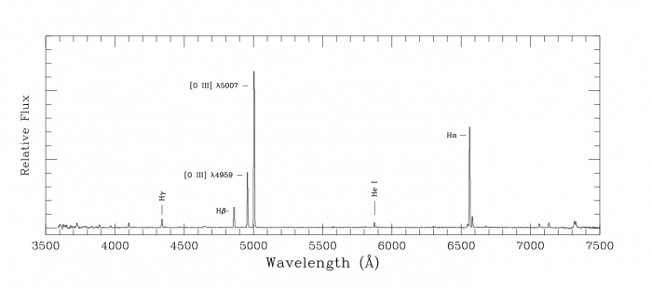
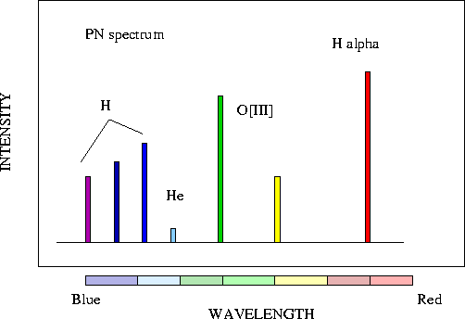
Planetary nebula- This cloud
of gas emits an emission line
spectrum, somewhat like
a “neon” light. But in this
case the electrons are
excited not by an electrical
current but by energetic
photons from the hot central
star. The reddish glow is mostly H-alpha (656.3 nm). The greenish
glow is mostly oxygen (501 nm)

