Slide 1
Binary Asteroids
(or why 2 rocks are Much better than 1)
DrBill (20361) Romanishin
U. Of Oklahoma and Oklahoma City Astronomy Club
Cape Cod June 2014

Slide 2
Slides for this and other talks to amateur groups, along with slides from some of my University courses and other astronomy stuff can be found on my website:
hildaandtrojanasteroids.net
Info on Oklahoma City Astronomy club and the OkieTex
Star party can be found at:
okcastroclub.com

Slide 3
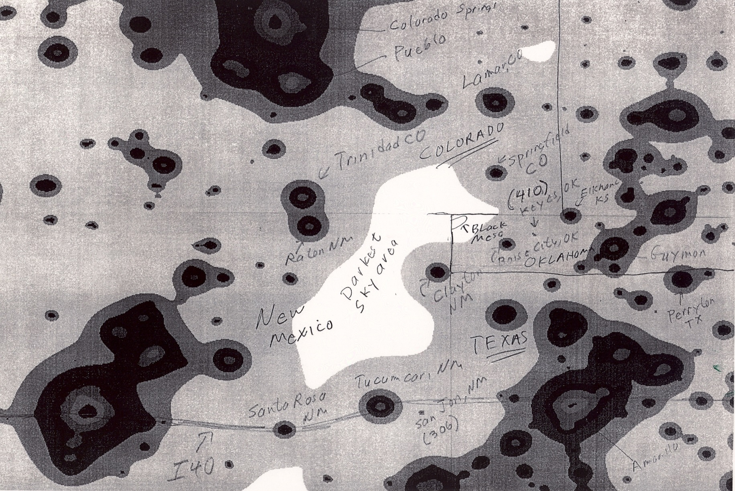
Okie Tex Star Party 22-28 September 2014

Slide 4
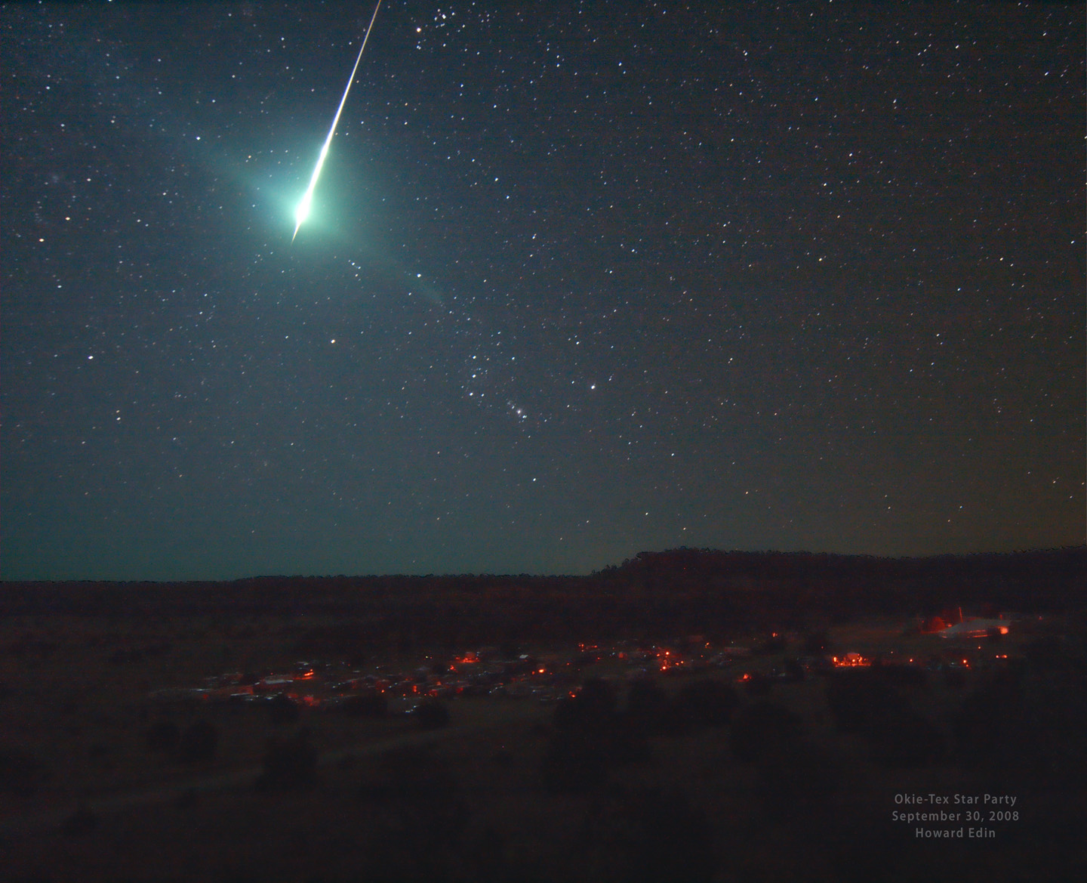

Slide 5
Brief Intro to Asteroids
Most orbit in main asteroid belt between Mars and Jupiter- made of rock and iron
Some cross paths with Earth (ALWAYS
Wear a helmet!)
Range in size from pebbles to 1000 km across (about size of Texas)
Over 640,000 asteroids cataloged (So Far!)
Probably ~1 million larger than 1 km (0.6mile across) exist. ~1 billion larger than 0.1km (football-field sized)

Slide 6
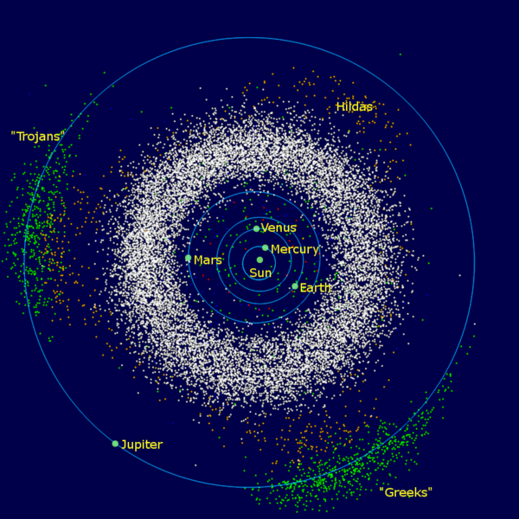

Slide 7
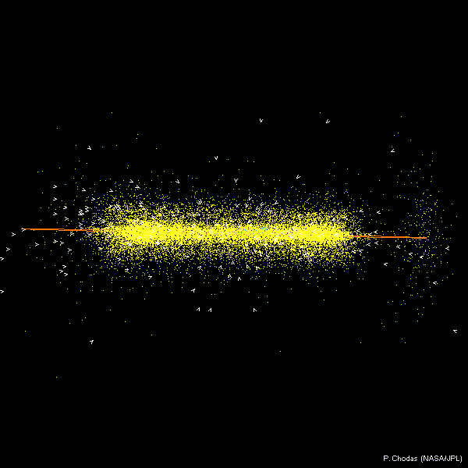

Slide 8
What do asteroids look like?
From groundbased telescope, just a dot of light, like a star , but it MOVES
We have closeup images of ~ten asteroids from spacecraft flybys
Sometimes, pieces of asteroids hit the Earth- these are asteroids you can hold in your hand

Slide 9
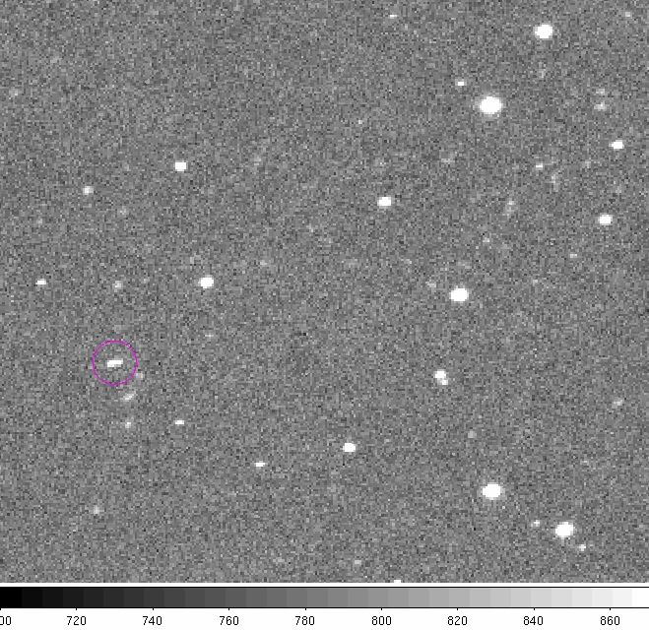
4 frame “movie” of 2010 RX30

Slide 10
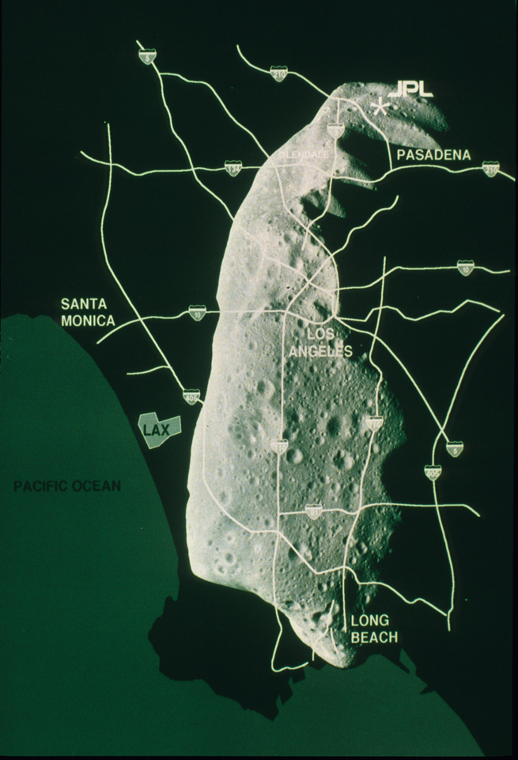

Slide 11
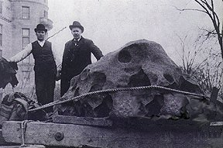

Slide 12
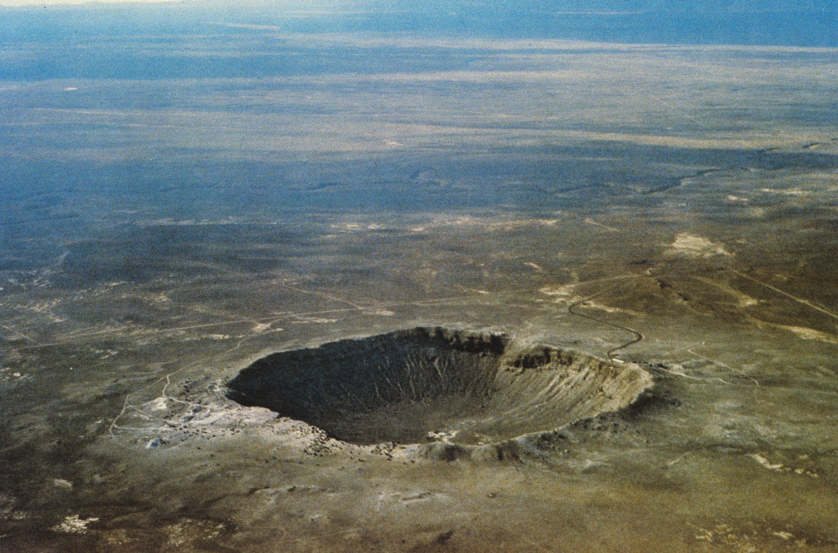

Slide 13
Asteroid Nomenclature
Each asteroid can have up to 3 (or more!) designations:
Provisional designation e.g. 1998 WH24
Permanent number – assigned after good orbit determined e.g. (19521)
Some objects with numbers also given names e.g. Chaos
1998 WH24 , (19521) and Chaos all refer to same object
Minor Planet Center (Harvard/Smithsonian) keeps track
of asteroids:
www.minorplanetcenter.net/mpc/summary for latest number of objects known

Slide 14
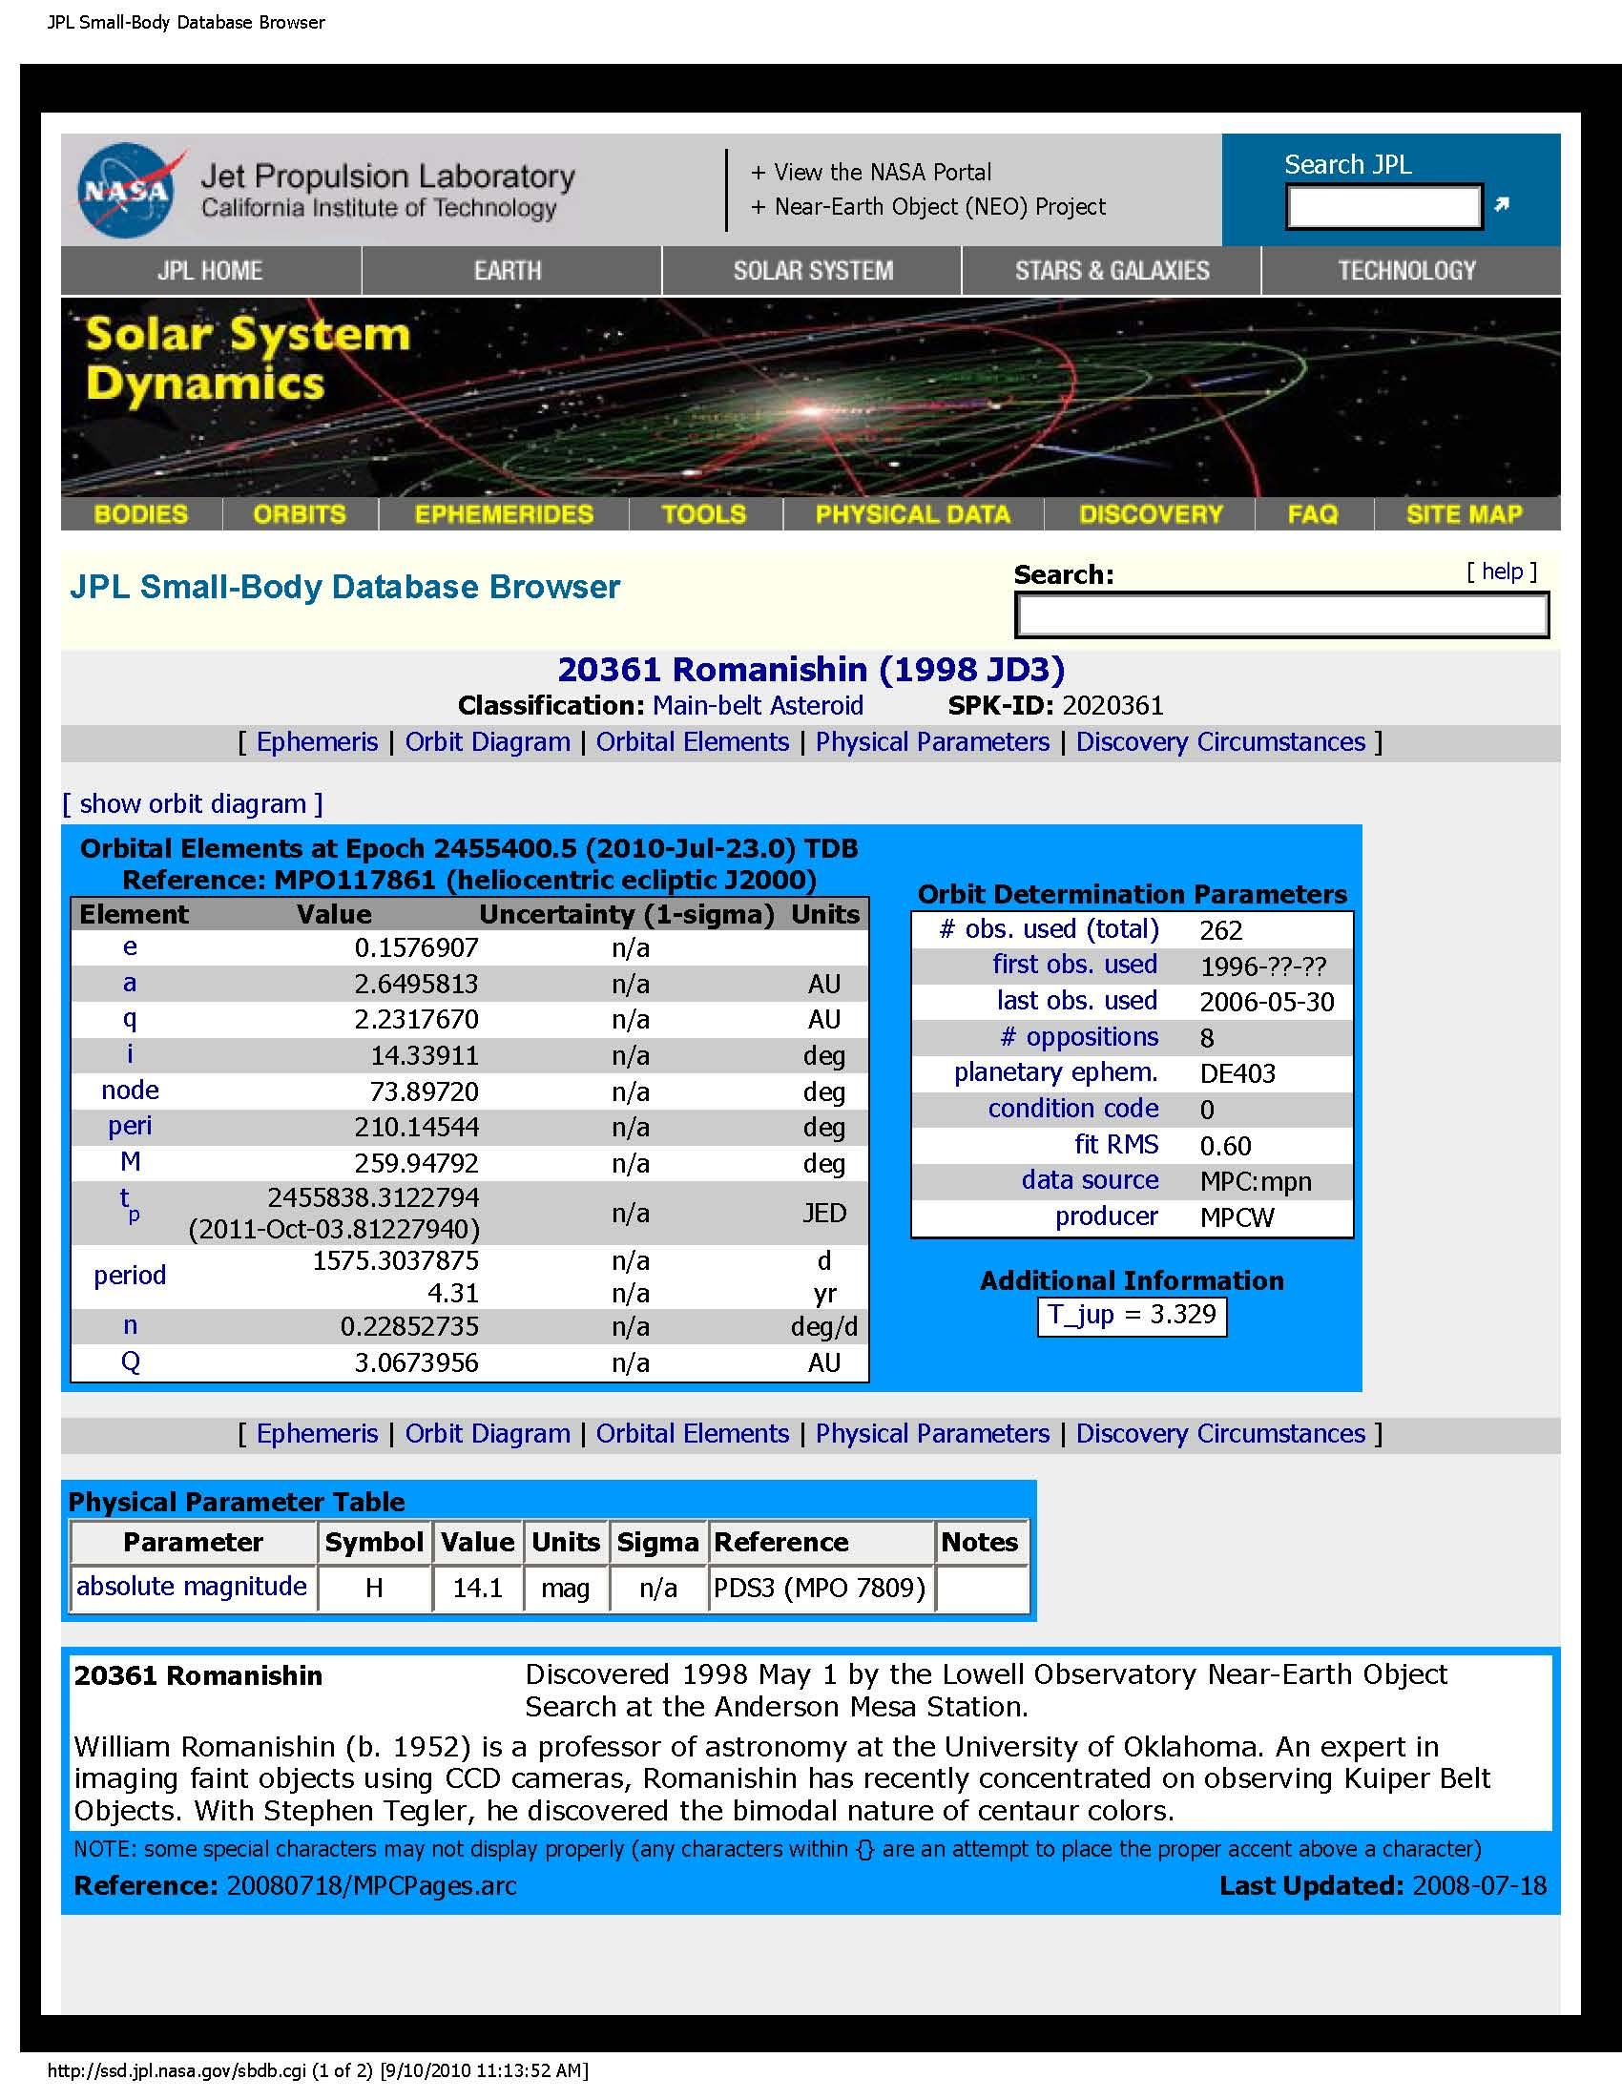
My Favorite
Asteroid!

Slide 15
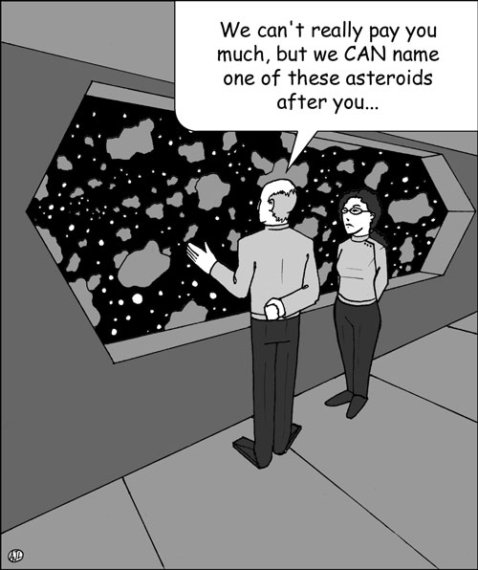

Slide 16
Binary or Double Objects
Binary objects (stars, galaxies, asteroids) are 2 objects orbiting their common center of mass
Binaries are of extreme importance as the separation and speeds of objects are related to their mass – how heavy they are
Mass is one of the most fundamental and important numbers for any object

Slide 17
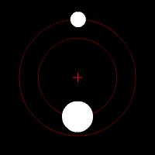

Slide 18
I will talk about 4 different techniques to discover or study Binary Asteroids
(1) Spacecraft closeup images
(2) Adaptive optics on large telescopes
on ground
Radar
Lightcurves using (small) telescopes

Slide 19
Are all asteroids loners?
By early 1990s, astronomers knew of tens of thousands of asteroids, but all appeared as single objects in sky photographs
Maybe asteroids unsociable and travel
alone?
In 1993, the first binary asteroid found, in a rather unexpected way (serendipitously)
Galileo spacecraft, on way to Jupiter, flew by asteroid (243) Ida and this is what it saw:

Slide 20
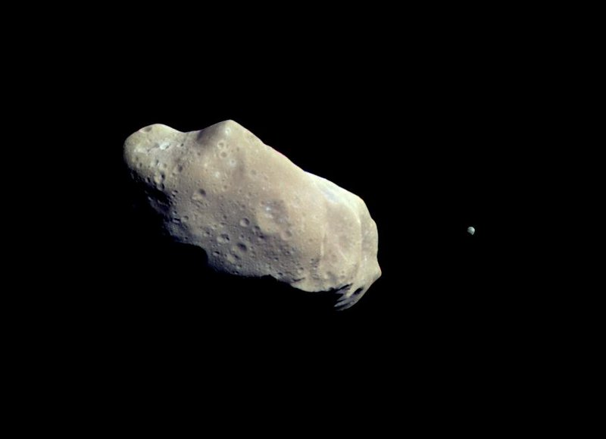
(243) Ida and companion Dactyl from Galileo 1993

Slide 21
Galileo closeup photos of (243) Ida proved that binary asteroids do indeed exist!
Why weren’t seen from ground-based telescopes?
Angular separation of asteroid pairs less than 1 arcsec in sky- atmospheric seeing prevents easy detection of binaries

Slide 22
Adaptive optics
Seeing or “fuzziness” is caused by light rays being bent by different air blobs
Adaptive optics is a technology that tries to “unbend” the light and lessen effects of seeing
Main idea: measure how atmosphere bends light, then use deformable mirror to correct for the bends
Hard part- the atmosphere changes 100s times per second, so must measure and correct very fast- difficult technical problem

Slide 23
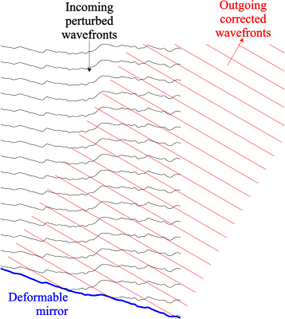

Slide 24
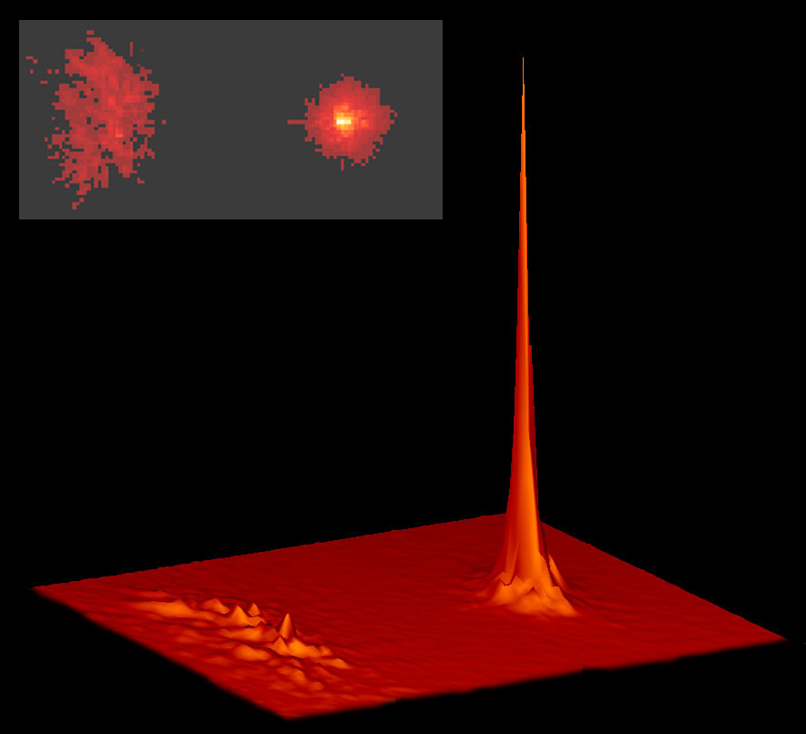

Slide 25
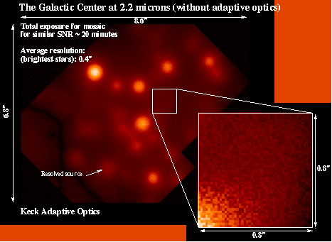

Slide 26
Binary asteroids from ground
Using adaptive optics on large telescopes, astronomers started to discover binary asteroids from the ground in mid-1990s
Following slide is a “movie” of (90) Antiope, as taken with adaptive optics (AO) on Keck 10 meter in 2000
Angular separation is only about 0.12 arcsec- without AO, would just see a single “blob” about as big as whole frame
Orbital period is about 16.5 hours – objects are each about 90 km across, separated by 170 km

Slide 27
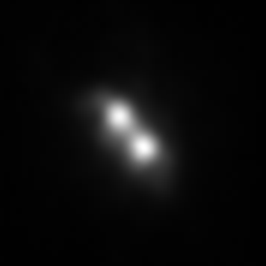

Slide 28
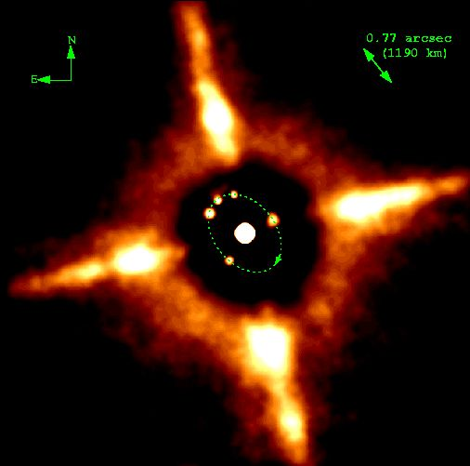
(45) Eugenia – adaptive optics on CFHT 3.6m

Slide 29
Radar Astronomy
Observational astronomy almost entirely passive – we observe light/radio waves/ x-rays etc nature sends us
Radar astronomy is different- *WE* send signals and listen for an “echo”
Time for echo return + speed of light= *Very* accurate distances to objects
Only useful for nearby solar system objects

Slide 30
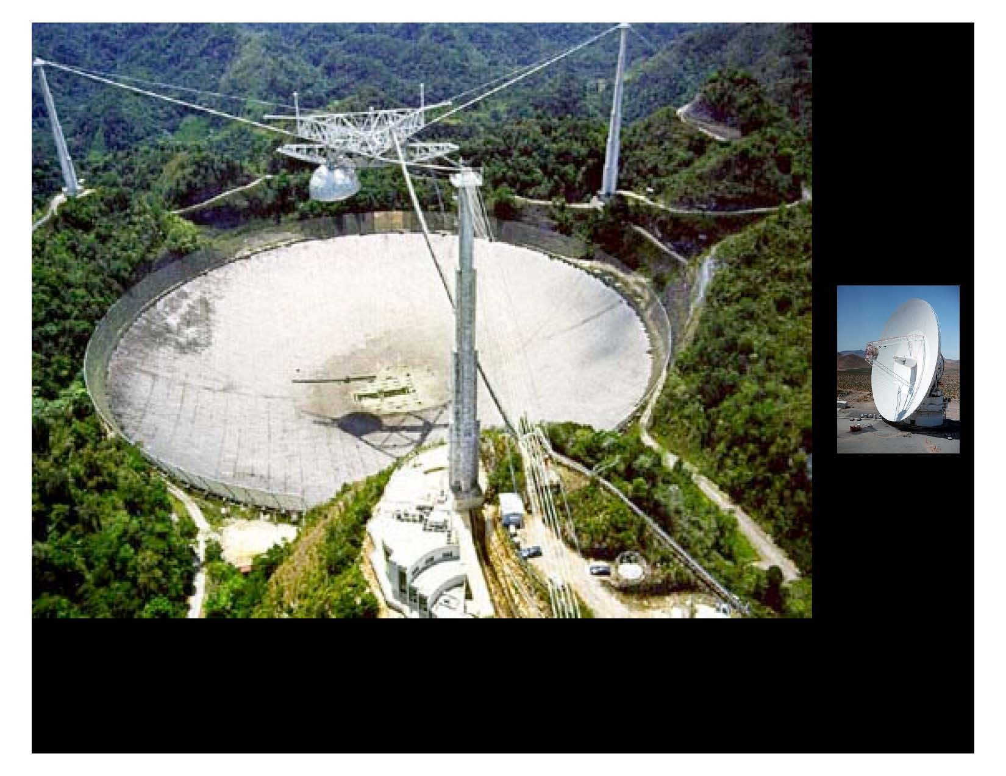
Arecibo 300meter radio/radar dish (large image)
Goldstone 70meter dish (small image)

Slide 31
Radar shows a Triple NEA!
The next slide shows radar observations of asteroid 2001 SN263 revealing it to be a TRIPLE asteroid!
In the slide “up and down” is the range (distance from Earth) – side to side is the Doppler shift- speed. The larger echo is extended side-to-side, showing the object is spinning
The 3 separate “echos” show 3 distinct bodies
Motion (in range) is clear from 12 Feb to 13 Feb

Slide 32
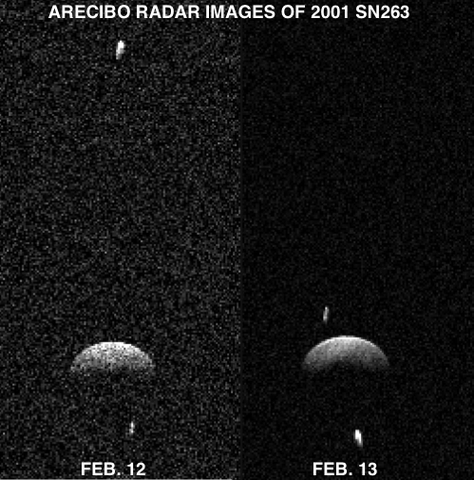

Slide 33
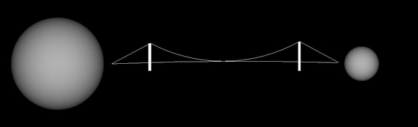
Radar is particularly good at observing Near Earth Asteroids as they are close enough to give good “echos”
This is model of NEA 2000 DP107 and Golden Gate bridge for scale is derived from radar observations

Slide 34
Lightcurves of asteroids
Asteroids spin (typically in 8 hours) and as they spin, they change brightness as we see more or less reflected sunlight
By measuring lightcurves (brightness vs time) from different viewing angles, can get 3dim shape of asteroid
Binary asteroids show additional “bumps and wiggles” in lightcurves due to eclipses/occultation

Slide 35
Lightcurve of a Binary Star
The following animation is an example of a lightcurve (brightness vs time) produced by an eclipsing binary star.
Binary star lightcurves reveal much fundamental information about stars- e.g. sizes, shapes, temperatures, orbital speeds (used to get masses)

Slide 36
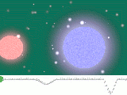

Slide 37
Lightcurve of Asteroid
The following slides show the relationship between the shape of an asteroid and its lightcurve as asteroid spins
Lightcurve of (5587) shows it to be a potato shaped object, here seen as it spins around its short axis perpendicular to our line of sight

Slide 38
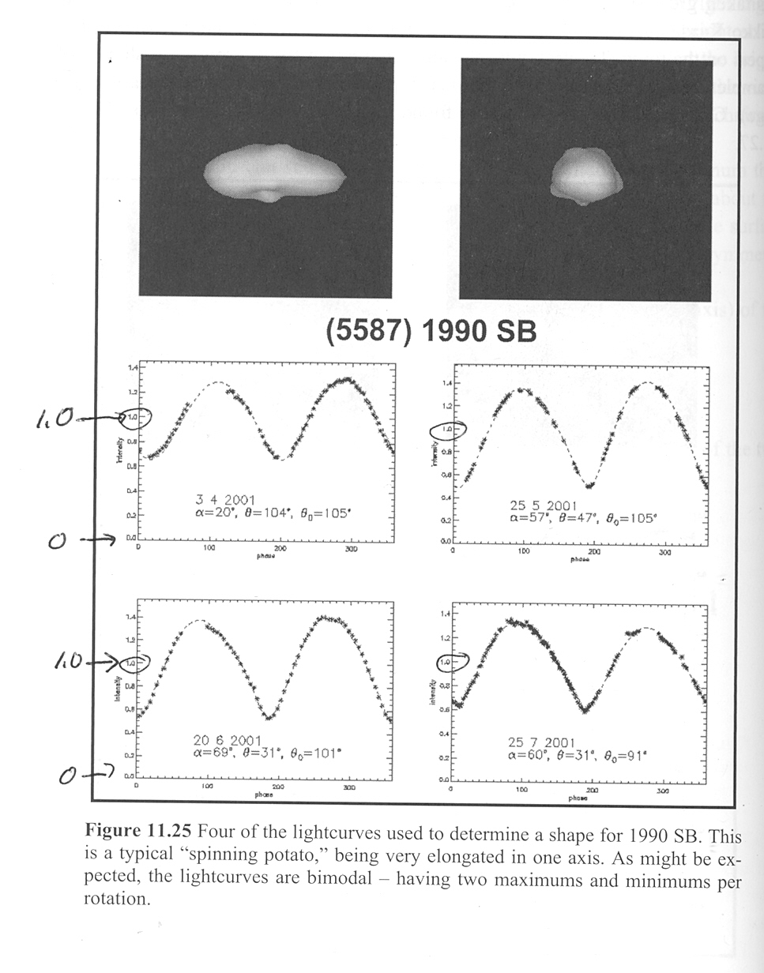

Slide 39
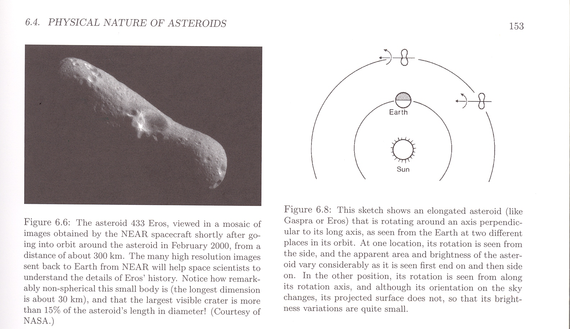
3D shapes from Lightcurves

Slide 40
Lightcurves of asteroids (cont.)
At OU, several students and I observed lightcurves of (22) Kalliope and its companion Linus during eclipses
By combining lightcurves taken by a number of astronomers (some amateurs) the sizes, masses and densities of objects were refined

Slide 41
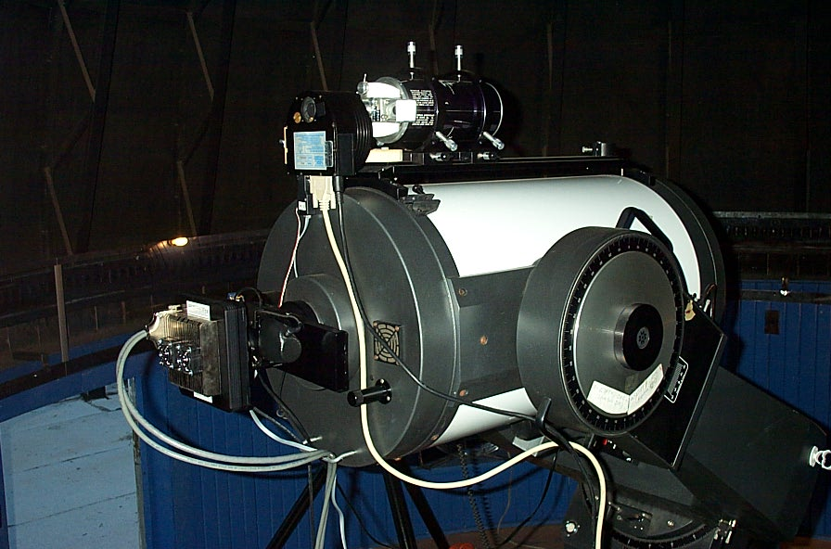

Slide 42
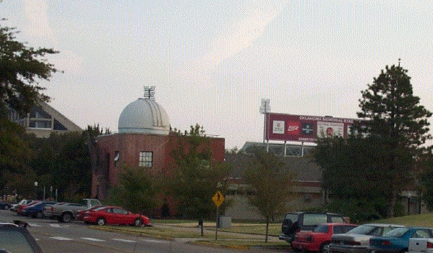

Slide 43
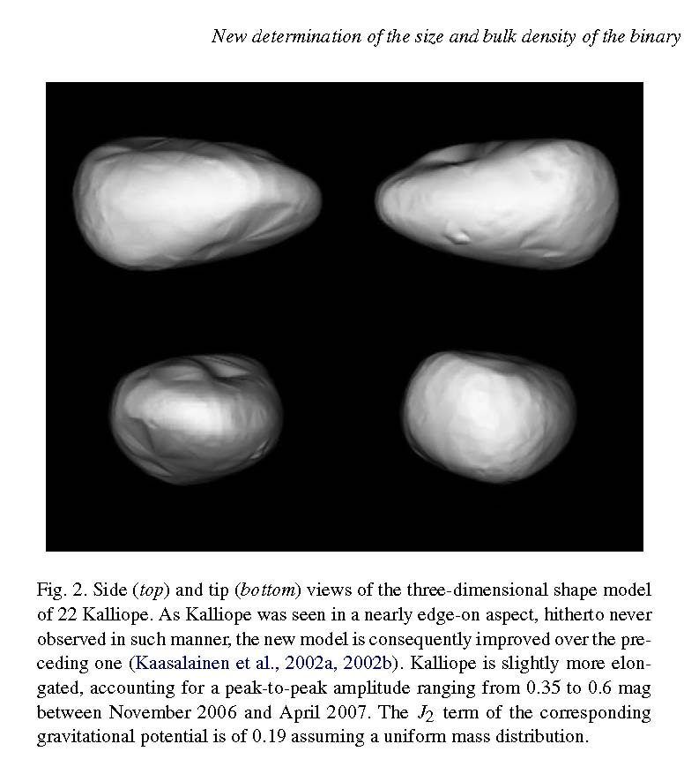

Slide 44
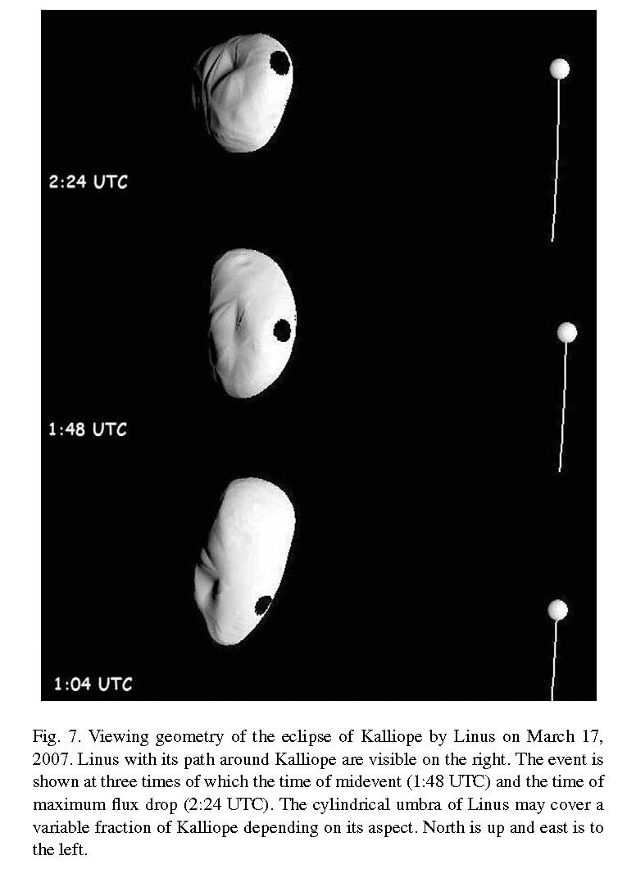

Slide 45
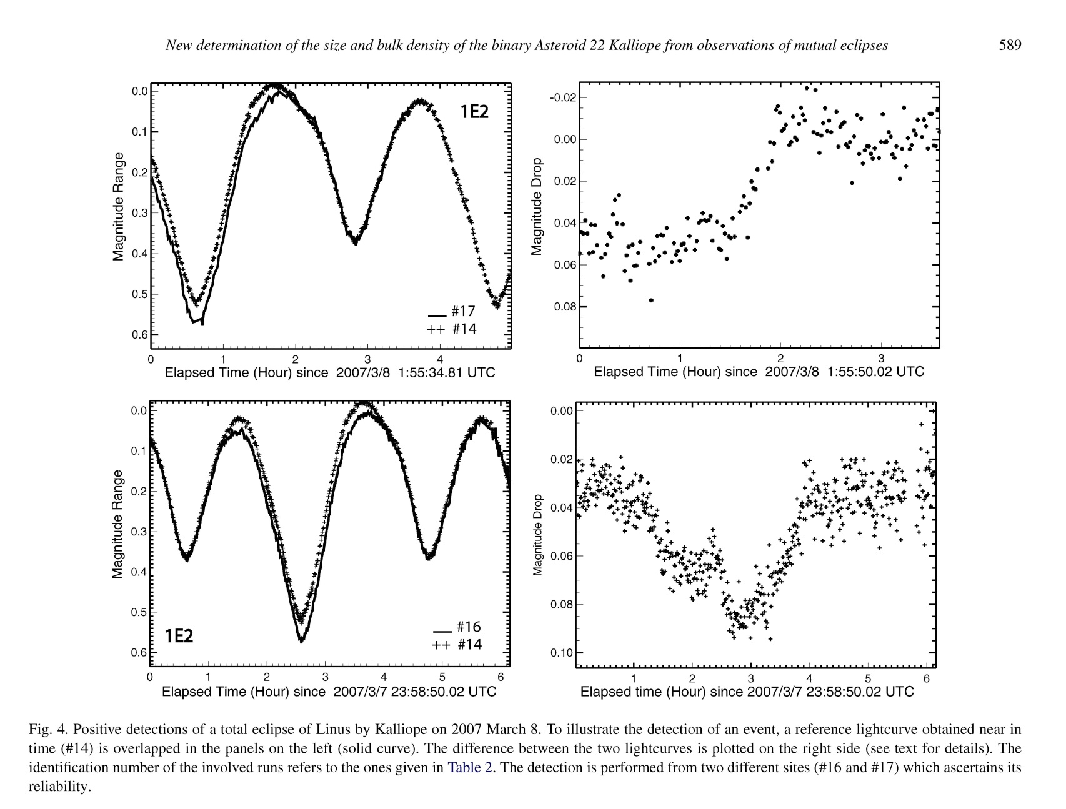

Slide 46
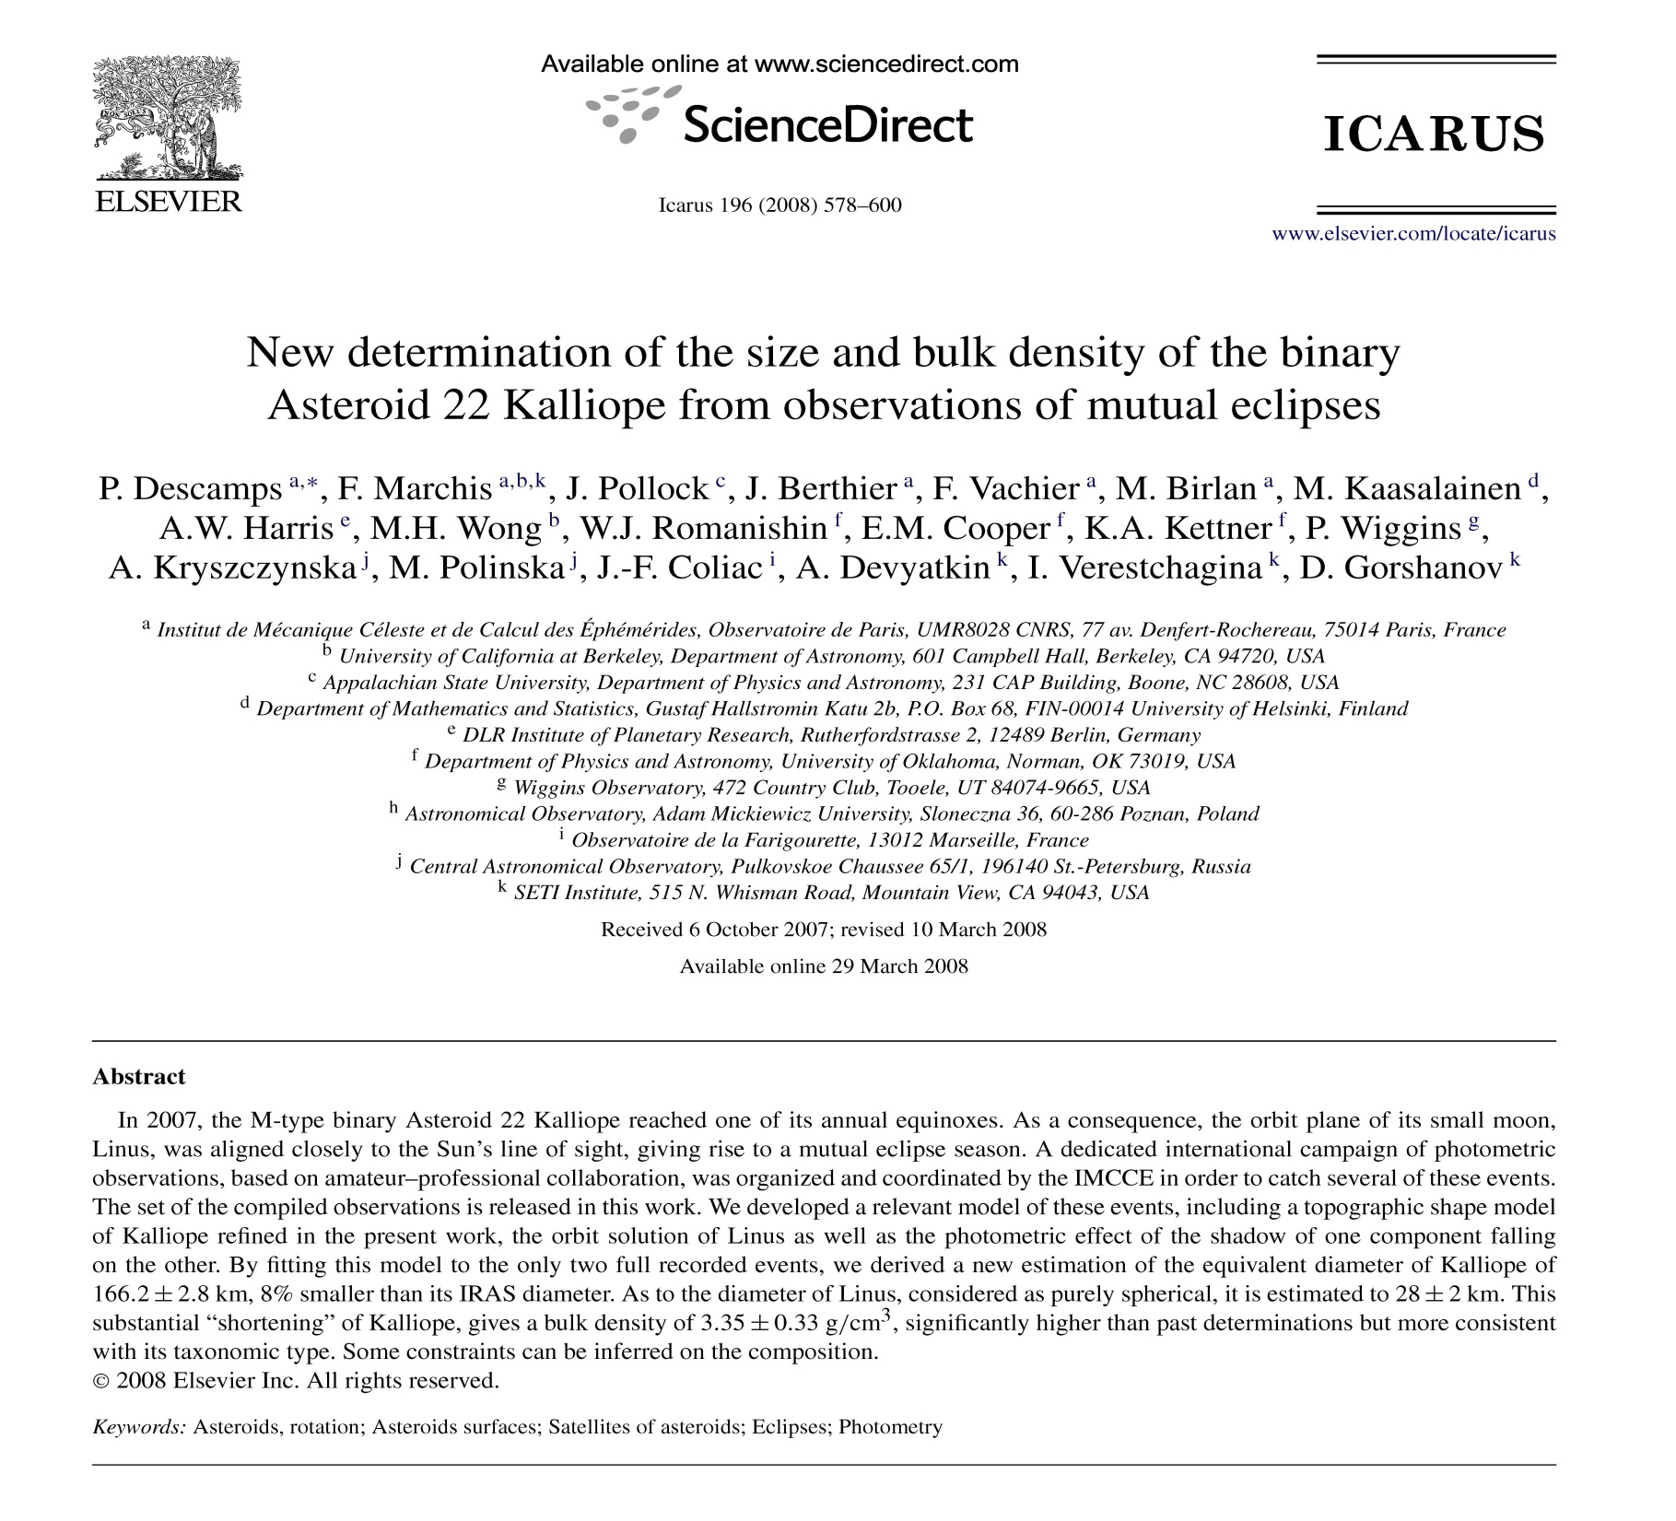

Slide 47
Summary: binary asteroids
Since mid 1990s, dozens of binary asteroids have been discovered and our knowledge of asteroid masses and densities greatly increased
I showed 4 different techniques to study these objects:

Slide 48
Spacecraft flybys ($$$$$$$$)
Adaptive optics on large telescopes ($$$$$$)
Radar ($$$$$$)
4) Lightcurves with small telescopes ($$$)
Number (4) is an area where amateurs are making valuable contributions!

Slide 49
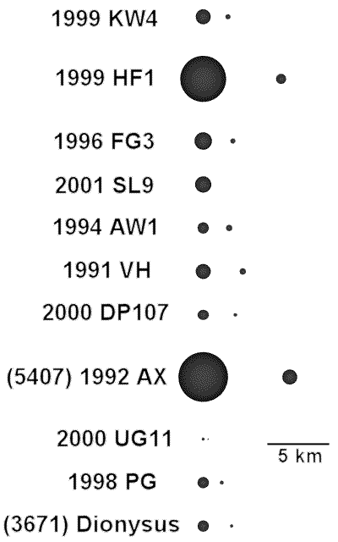
Some NEA binaries- note size scale
(most from radar)

Slide 50
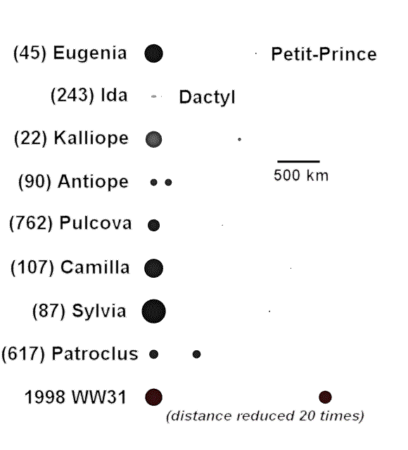
Some main belt binaries- note much larger sizes

Slide 51

Clearwater Lakes, Canada – a binary asteroid strike ~290 million years ago (?)
~16 miles

