Slide 1
Measuring the Sizes of Asteroids
DrBill (20361) Romanishin
Emeritus Professor, U. Of Oklahoma
Oklahoma City Astronomy Club
10 February 2017

Slide 2
Slides for this and other talks to amateur groups, along with slides from some of my University courses and other astronomy junk can be found on my personal website:
hildaandtrojanasteroids.net
My email address:
wromanishin@ou.edu

Slide 3
Brief Intro to Asteroids
Most orbit the Sun in main asteroid belt between Mars and Jupiter- made of rock and iron and (sometimes) ice
Some cross paths with Earth (ALWAYS
wear a helmet when outdoors!)
Range in size from pebbles to ~1000 km across (about size of Texas)
Over 729,000 asteroids cataloged (So Far!)
Probably ~2 million larger than 1 km (0.6 mile across) and ~1 billion larger than 0.1km (football-field sized) exist in our SS

Slide 4
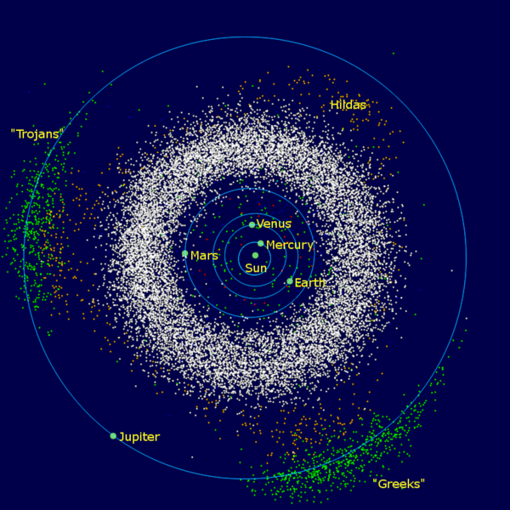

Slide 5
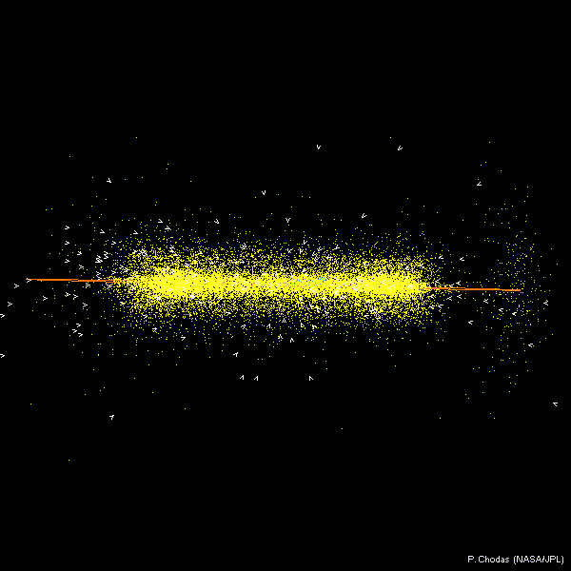

Slide 6
What do asteroids look like?
From groundbased telescope, just a dot of light, like a star (asteroid= “star like”), but dot MOVES relative to starry background
We have closeup images of ~10 asteroids from spacecraft flybys
Sometimes, pieces of asteroids hit the Earth- these are asteroids you can hold in your hand

Slide 7
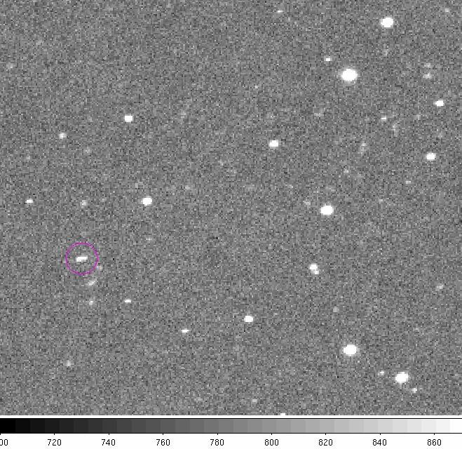
4 frame “movie” of 2010 RX30

Slide 8
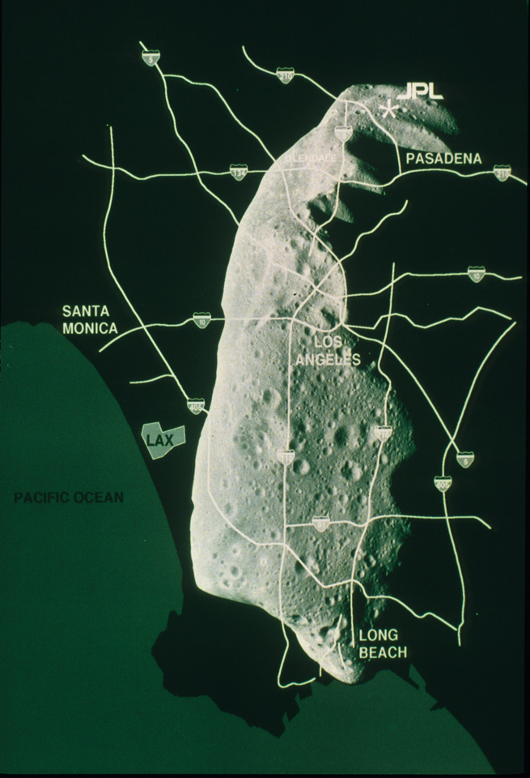

Slide 9
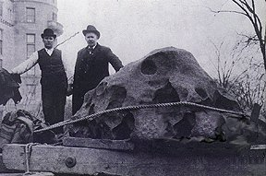

Slide 10
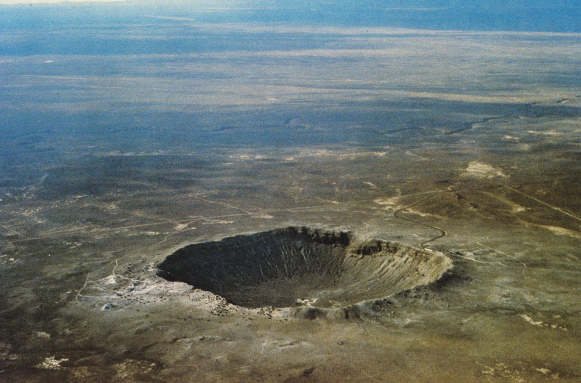

Slide 11
Asteroid Nomenclature
Each asteroid can have up to 3 designations:
Provisional designation e.g. 1998 WH24
Permanent number – assigned after good orbit determined e.g. (19521)
Some objects with numbers also given names e.g. Chaos
1998 WH24 , (19521) and Chaos all refer to same object
Minor Planet Center (Harvard/Smithsonian) keeps track
of asteroids:
www.minorplanetcenter.net/mpc/summary for latest number of objects known

Slide 12
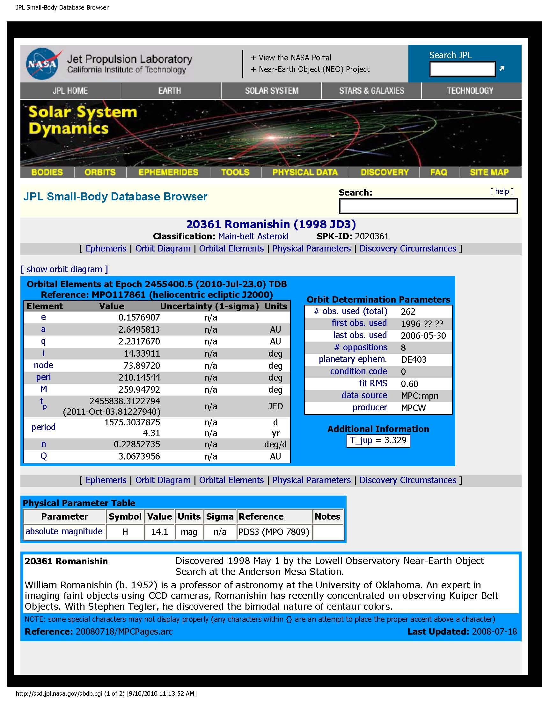
My Favorite
Asteroid!
Info on asteroid (20361) Romanishin from NASA/JPL
Small-Body database, which contains info on all asteroids known
(as well as comets).

Slide 13
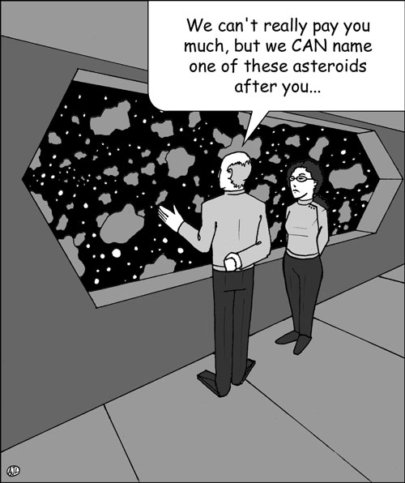

Slide 14
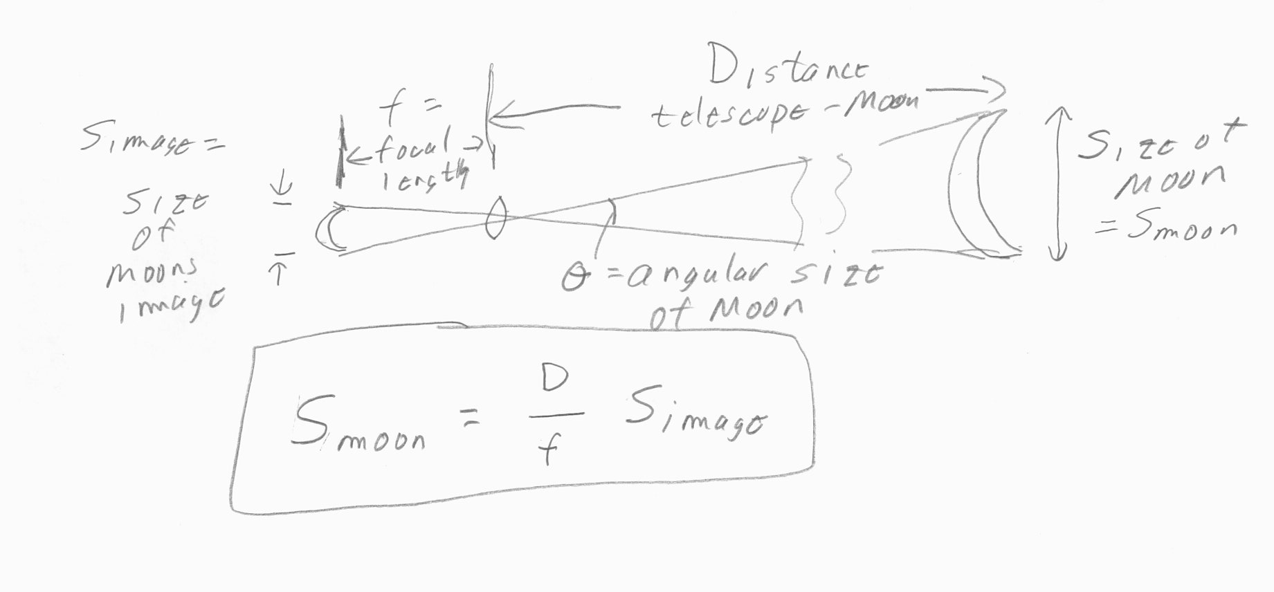
Measuring size of a RESOLVED object whose distance we know.
For example, the Moon. The image in your telescope is just a “scale model” of actual object. The “scale factor” is just:
(focal length of telescope) / (distance to object)

Slide 15
How big are asteroids?
From earth, almost all are UNRESOLVED.
That is, they just look like a dot – no disk
can be seen. So we can’t measure size as we do for Moon.
One way to measure size (and projected shape) is to use stellar occultations to essentially measure size of asteroids shadow. Amateur astronomers make many crucial occultation observations!

Slide 16
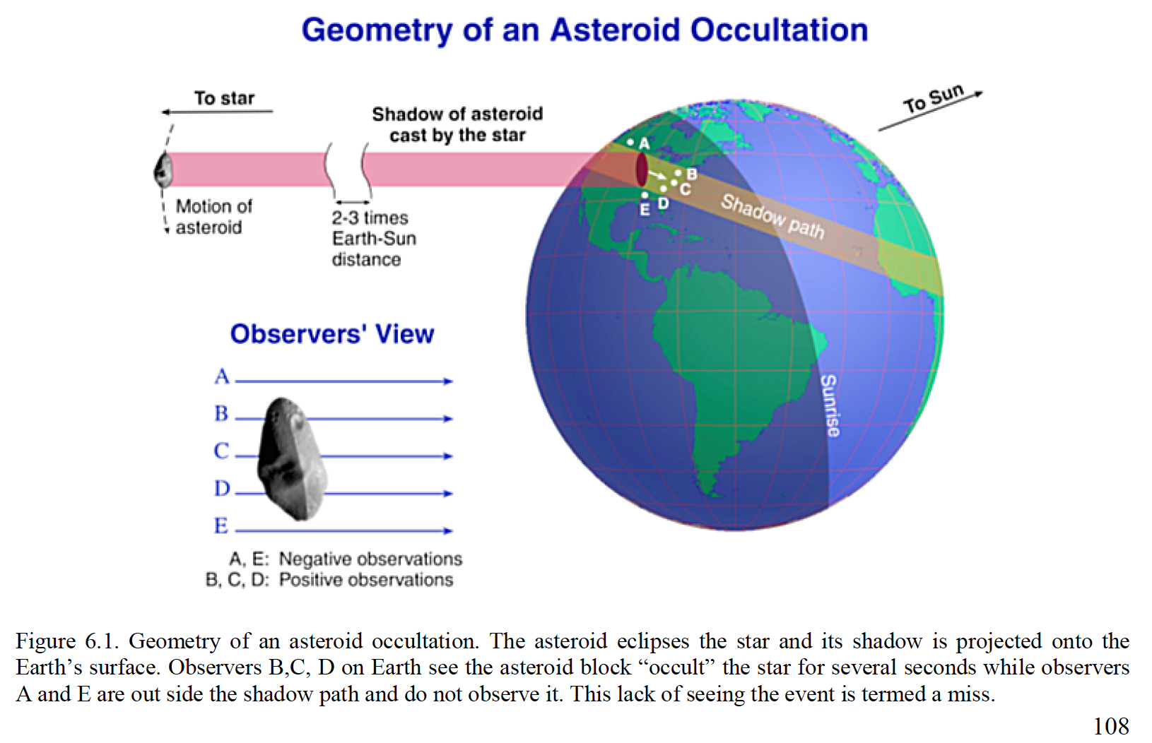

Slide 17
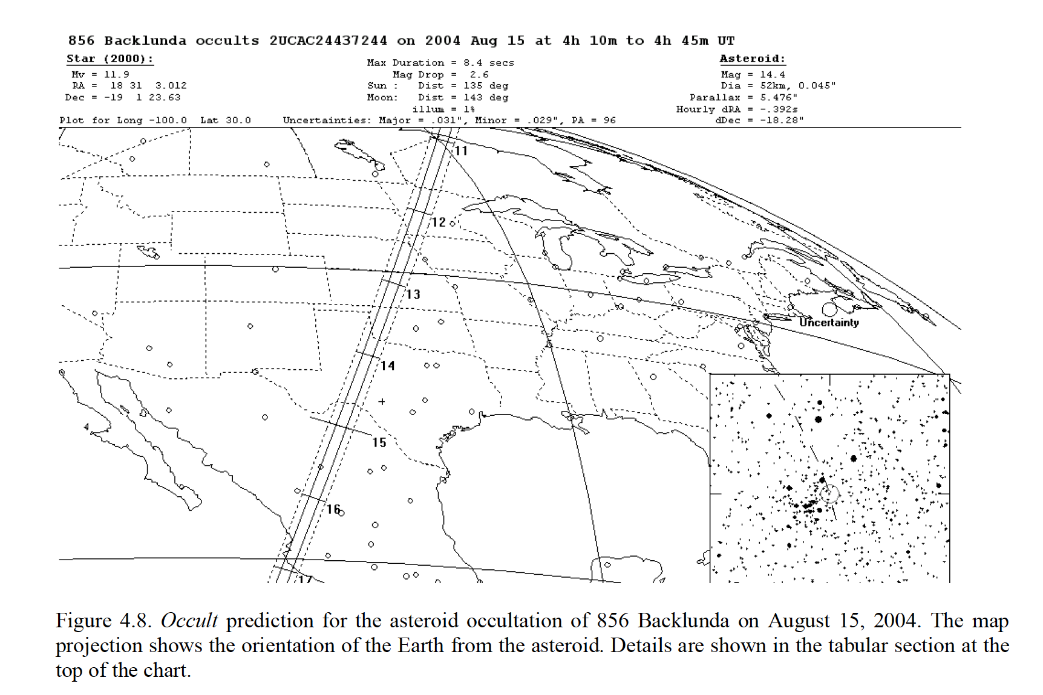
Several free software packages are available to make occultation predictions for anywhere on earth. Here is an example prediction that happened to cross OK in 2004.

Slide 18
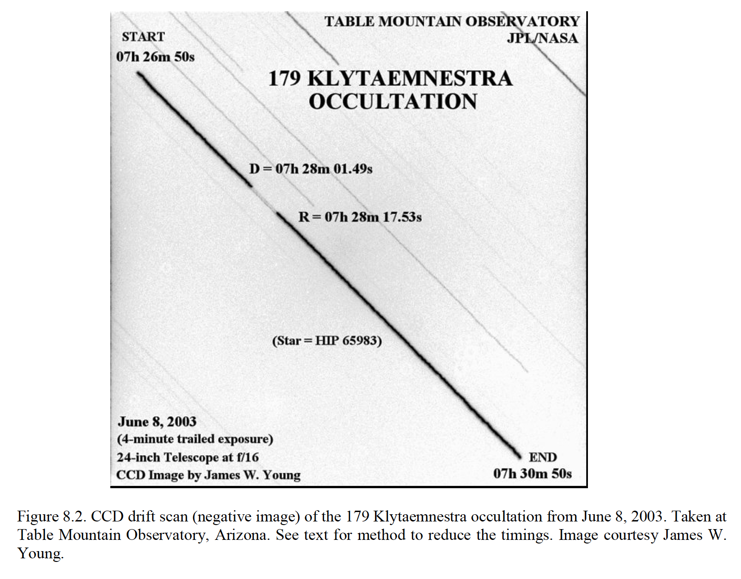
Here, stars were allowed to trail over CCD. When asteroid passed over star, there is a “gap” in starlight. Gap lasted about 16 seconds.
From speed of shadow (accurately known from orbits of asteroid and earth), one can convert time span of gap to size (length) of chord across asteroid.

Slide 19
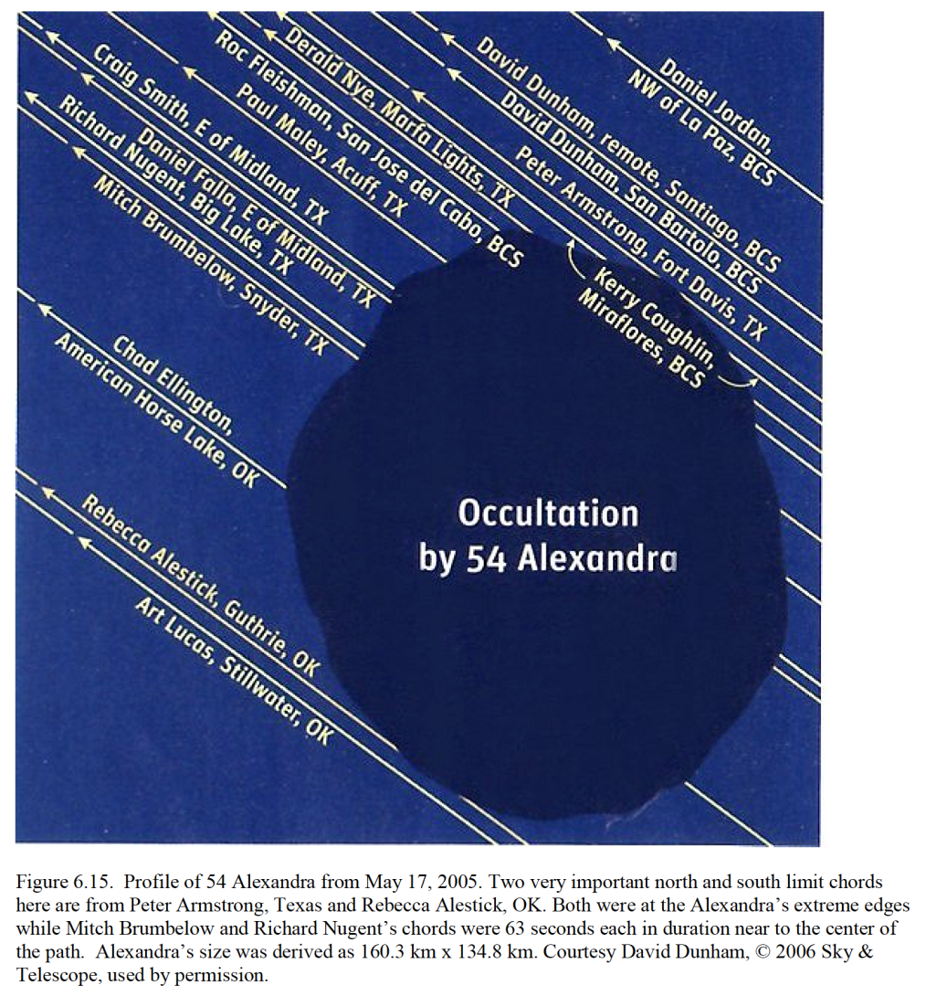
Occultation of a
~100 mile diameter
asteroid, observed from OK, TX, Baja.
(from Sky and Telescope June 2006)
One telescope = only one chord. Need multiple telescopes across path to get shape and size.

Slide 20
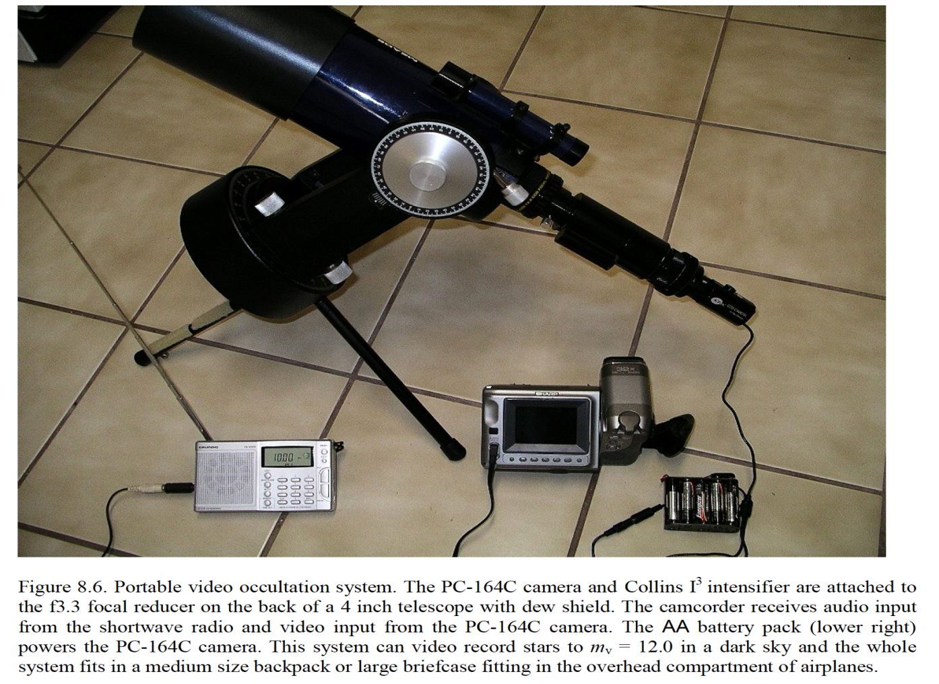
Observing occultations requires a portable telescope system, as shadow paths very seldomly pass over your observatory! System must provide accurate timing of star brightness to sub-second accuracy. Nowadays, video cameras and GPS units (no more WWV and stopwatches!) are readily available to do the job. (As my dear father says- “All you need is money”)
Small telescopes can be very useful, as you do NOT need to detect the asteroid, only the STAR being occulted!!
(Naked eye occultation?)
Some amateurs have developed automated
“strings” of systems they set up across shadow path!!!!

Slide 21
Stellar occultations- the Good and the Bad
Good: Can use small telescopes to measure size of objects millions of miles away!!! (Actually, not only good but AMAZING! ) With proper equipment and technique (precise timing) can make very accurate size measurements!
Amateur astronomers with (relatively) simple equipment and willingness to PLAN and (probably) TRAVEL can make a scientific contribution.
Occultations can also probe atmospheres of planets (e.g. Pluto) or discover planet rings (e.g. Uranus) and satellites and rings of asteroids
Bad: Observations are extremely time and position critical. Get delayed by a speeding ticket on your way to set up? Your dog knock over your telescope at time of occultation? Path prediction wrong? Clouds appear at wrong time? Miss your airline connection to Timbuktu? You often get nothing no matter how far you travel! There are NO “do overs”!
Even if everything works, need LOTS of coordinated effort to get even one good asteroid size (need multiple chords). There are a million asteroids!! Only ~few dozen have good occultation sizes measured!

Slide 22
Bottom line: Occultations are a great way to find asteroid sizes, but only for a few asteroids.
The second method of finding asteroid sizes uses their brightnesses. But to fully understand this, we need to understand some ideas about visible light and infrared “light” and about “reflected” and “emitted” “light”.

Slide 23
Emitted vs. Reflected Visible Light
In everyday life, we have sources of visible light (e.g. Sun, light bulbs, LEDs). These create and emit light.
Everything else our eyes see by visible light that objects reflect from a source of light.
Go into a sealed room with no sources of
light and your eyes see- NOTHING.

Slide 24
... BUT EVERYTHING EMITS some form of electromagnetic radiation!
You and I create and emit infrared radiation with a wavelength of about 10 microns (about 20 times wavelength of visible light).
Our eyes cannot detect 10 micron radiation, but we now have detectors that do. They are sometimes called “thermal IR cameras”, as people call IR “heat radiation” but that is not
a very good term.

Slide 25
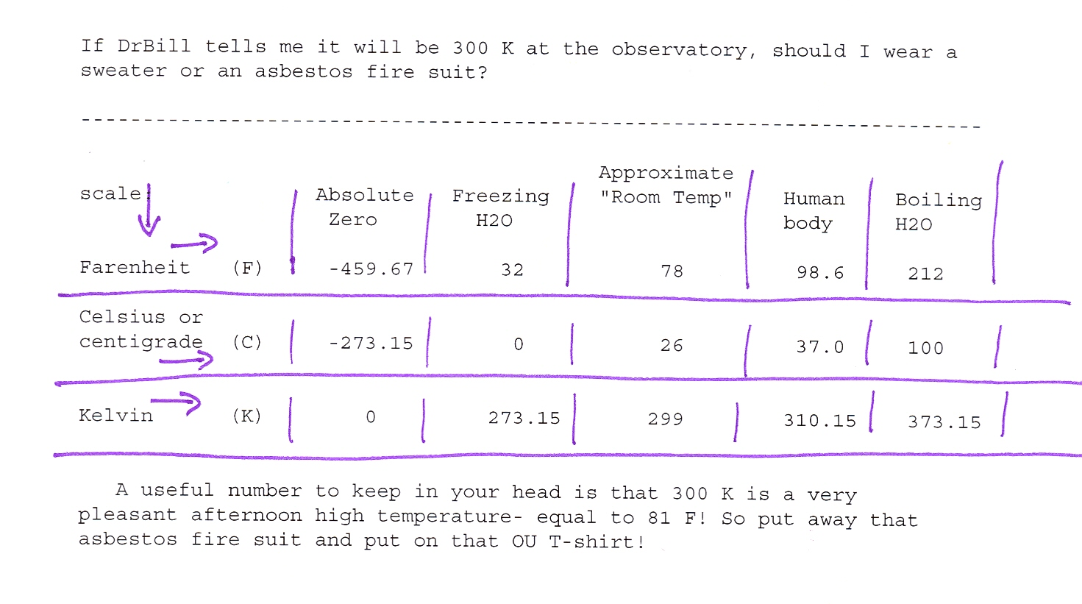
Kelvin temperature scale

Slide 26
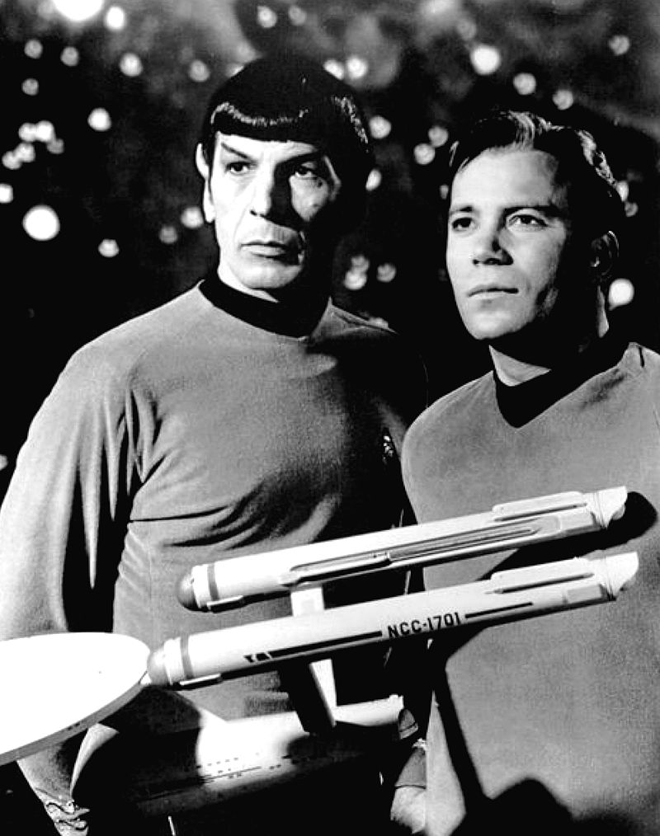
“Dr. Bill, tell your students that it is only logical to put the zeropoint of the temperature scale at absolute zero”
(Wow, Shatner has eaten a lot of donuts since this picture was taken!)

Slide 27
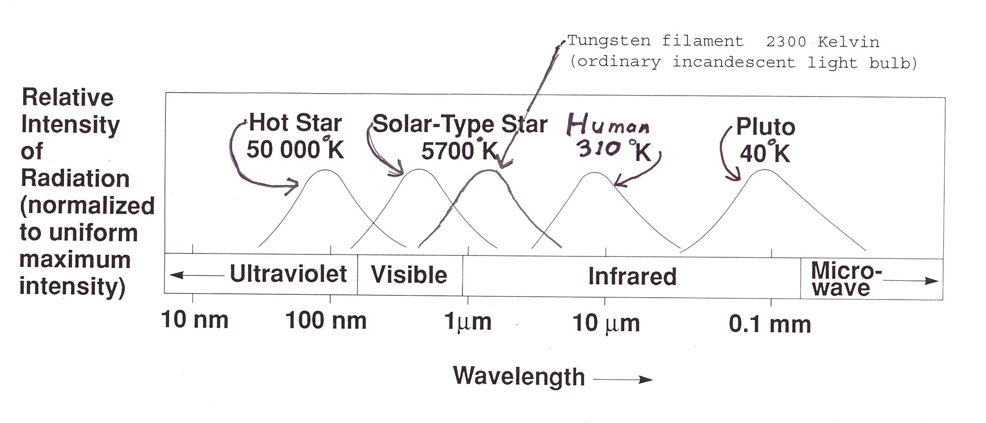
Everything emits electromagnetic radiation. The hotter the body, the shorter the peak of the emitted radiation.

Slide 28
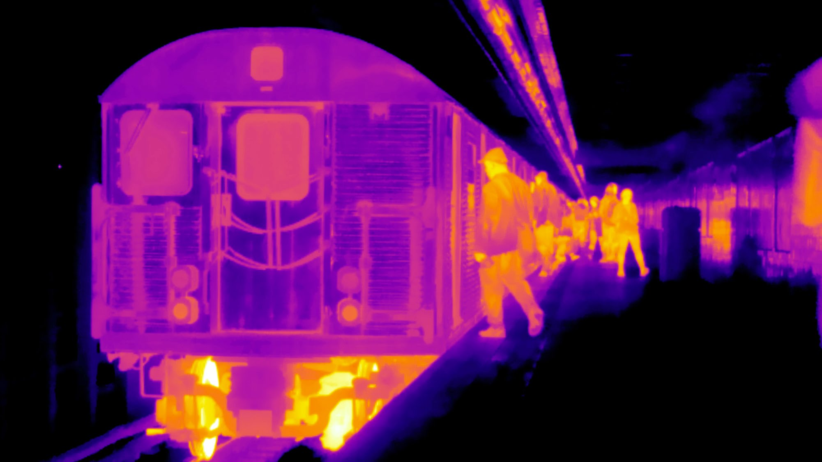
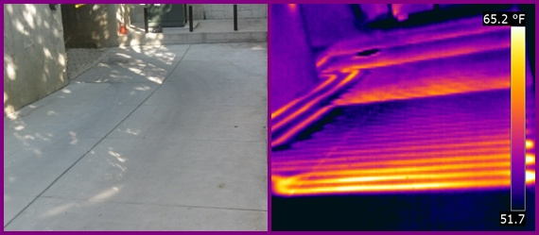
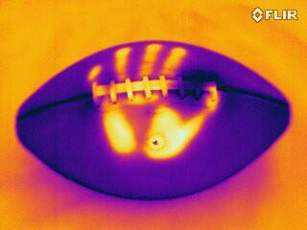
Examples of images taken using thermal IR cameras, which image using wavelengths much longer than our eyes do.
(false color images- color related to intensity of “light”)

Slide 29
Back to asteroid sizes. Since we know how bright Sun is, and we know distance from Sun to asteroid, we can calculate how much visible wavelength sunlight hits asteroid, depending on its size. If we measure how much light we get from asteroid, knowing distance from asteroid to our telescope, we should be able to calculate the size of asteroid. (Bigger asteroid= more reflecting surface area= more reflected sunlight= brighter as seen with our telescope.)
Sounds good!! But there is one big problem. Not all visible sunlight that hits an asteroid is reflected. Some is absorbed. The percentage reflected is called the reflectivity or the albedo.
This messes up our size measurement. An asteroid with a certain brightness can be a small one with high albedo (bright surface) –OR- a much larger one with a low albedo (dark surface).

Slide 30
One way around this is to measure the radiation the asteroid *emits* rather than the visible sunlight the asteroid *reflects*. As asteroids are mostly farther from Sun than earth, they have cooler temperatures, usually 100 to 200 K. Thus, they emit radiation in the 10 - 30 micron wavelength range.
This emitted infrared radiation is very difficult to observe from the earth. The atmosphere (at T ~ 280 K) itself glows, so trying to observe 10 micron
radiation from surface of earth is like looking for stars in the daytime using visible light! People have observed infrared radiation from asteroids from the ground, but only the brighter objects.
Putting a telescope in space, above atmosphere, helps immensely, but we are still left with “glow” of telescope itself. Answer- put your telescope in
space and cool the telescope structure to a low temperature. (Space is NEITHER cold or hot! Objects in sunlight heat up, objects in shadow cool down)
One important cooled infrared space telescope is called WISE. This telescope has observed infrared radiation from many 10,000s of asteroids

Slide 31
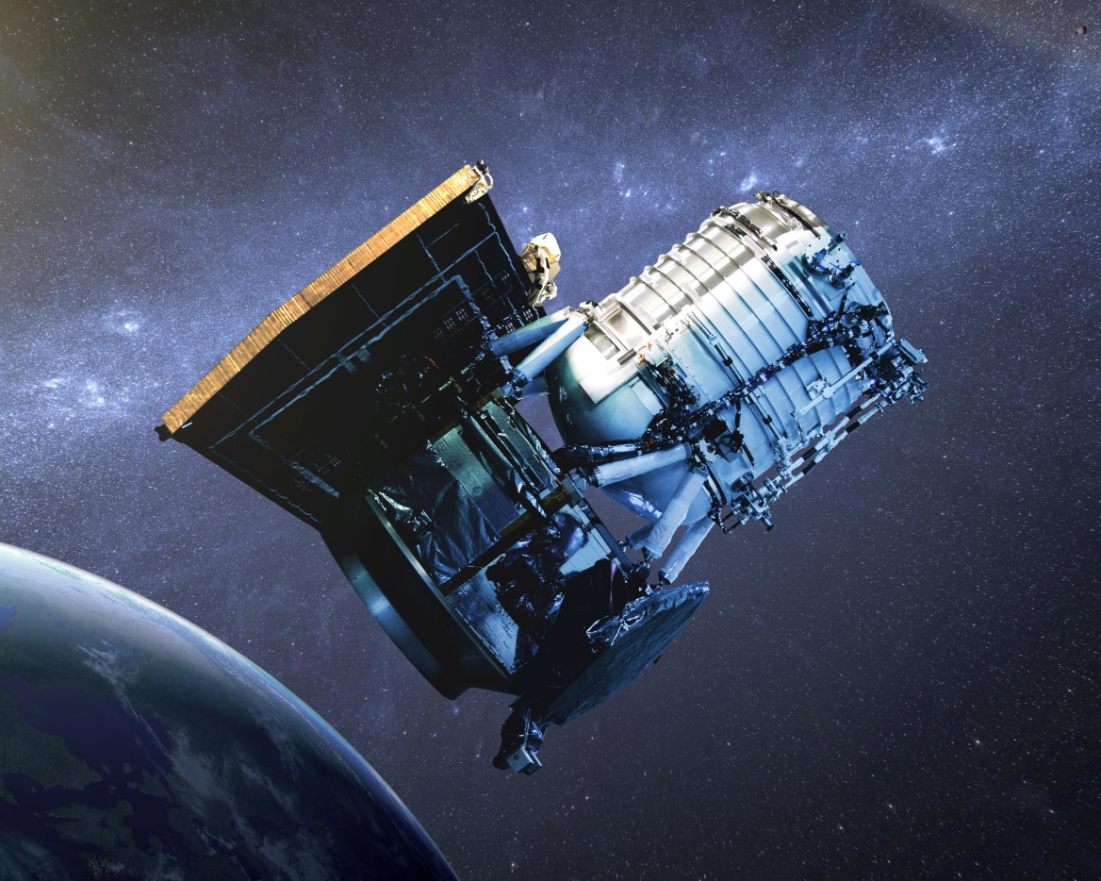
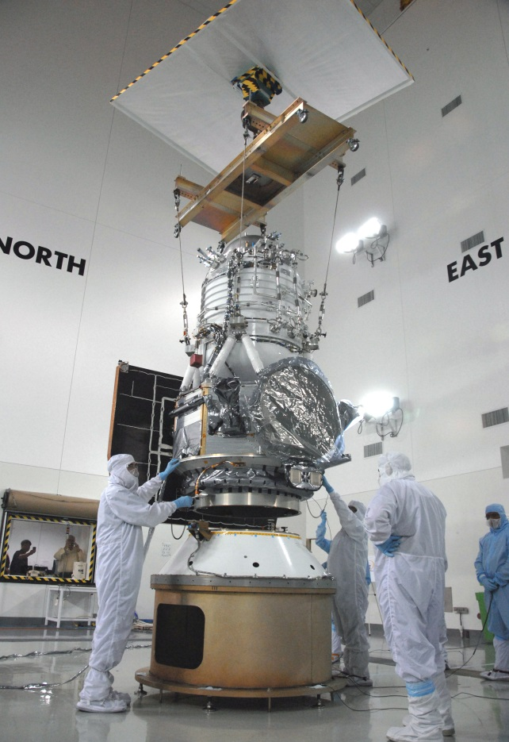
The WISE telescope (NASA Wide-field Infrared Survey Telescope)
Essentially a 0.4 meter (16 inch!!!!) telescope in a giant Thermos bottle
to keep it cold, so the telescope itself doesn’t glow in infrared!
Launched in 2009, it is still observing! (NEOWISE)
All-sky survey at 3.4, 4.6, 12 and 22 micron bands.

Slide 32
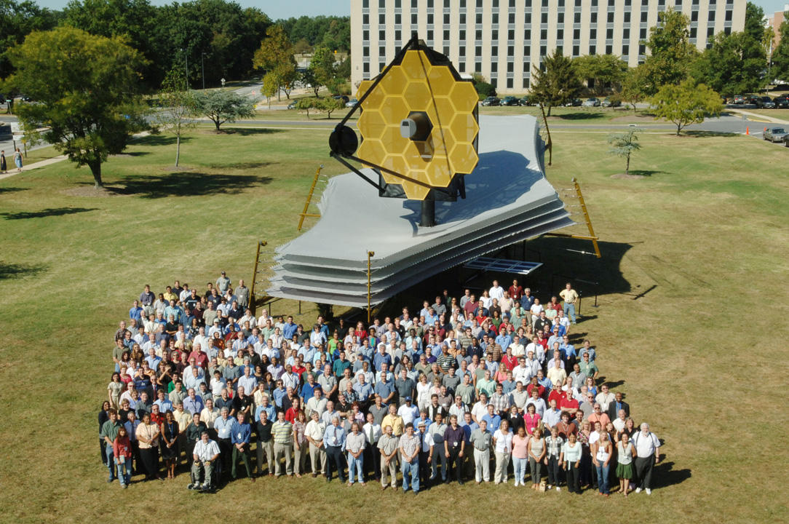
(Aside) JWST (James Webb Space Telescope) – launching in 2018?
This is an actual size model. The weird 5-layer structure is the sun shield.
By keeping all sunlight off the telescope, the telescope will cool naturally (passive cooling). (Its way too big to put in a Thermos bottle like WISE!)

Slide 33
Using infrared brightness of emitted thermal radiation of asteroid (plus
distance from asteroid to telescope), we can calculate the size of an asteroid, as we can calculate how much radiation each square meter emits once we know temperature (which we can get from peak wavelength of emitted infrared).
Combining the size measured using infrared and the amount of reflected sunlight we can determine the albedo.
SO, combining infrared (thermal emission) and visible (reflected sunlight) we can determine both the size AND the albedo of an asteroid!!
Using data from WISE, combined with visible light data from telescopes on ground, we can now calculate albedos and sizes for 10s of thousands of asteroids.
Astronomers (including myself) are just starting to study these large treasure troves of information to look for patterns in sizes and albedos of
different classes of asteroids.

Slide 34
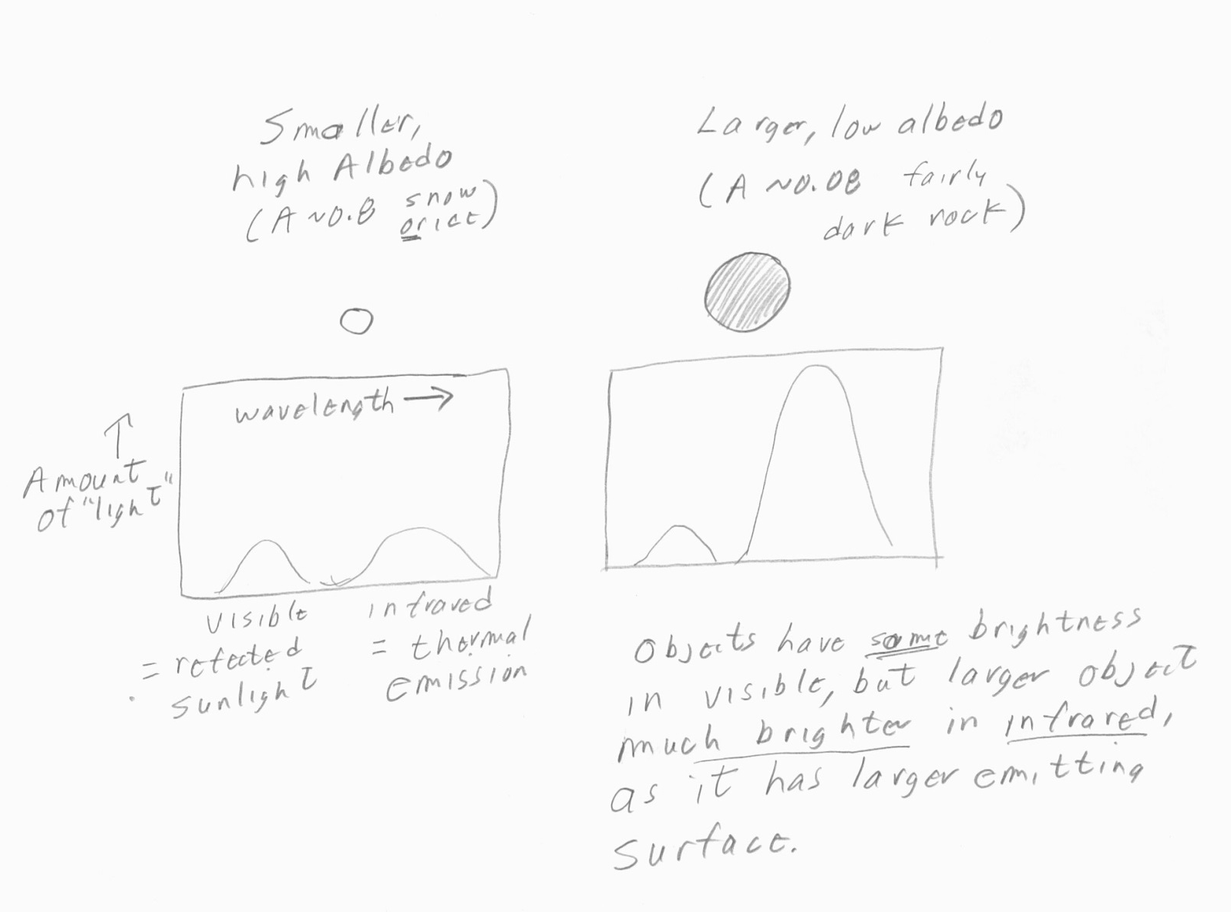
Two asteroids at same distance from earth that look equally bright in
visible light (reflected sunlight), but one is darker and larger than other.
How can we sort out albedo and size??

Slide 35
Why bother using two different ways to measure the sizes of asteroids?
These two methods (occultations and thermal emission) use very different physics.
If we make a measurement with two methods and the answers agree, this gives us confidence that perhaps we know what we are doing!
If we find different answers, then we know we have to think about what we may be doing wrong and try again.
That’s how science works!

Slide 36
Just a few last slides on another unsung space telescope (besides WISE):
One of the vexing problems of doing occultations is that the position
(on the sky) of the star must be known very accurately. If the cataloged star position is a little off, the actual shadow path can be off from the predicted path, and you could set up your telescope many miles from the actual
path and see nothing.
The science of measuring star positions is called astrometry. Due to “twinkling” of stars, the best way to do astrometry is to put your telescope in space. The Europeans have a currently operating space telescope (launched December 2013) , called Gaia, which is measuring very accurate positions for about 1 BILLION stars! The primary purpose is to map the Milky Way, but of course there will be many “spinoffs”- such as providing people who do occulations (occultationists?) with much better path predictions.
Some initial Gaia data has been released, but most will become available in next few years.

Slide 37
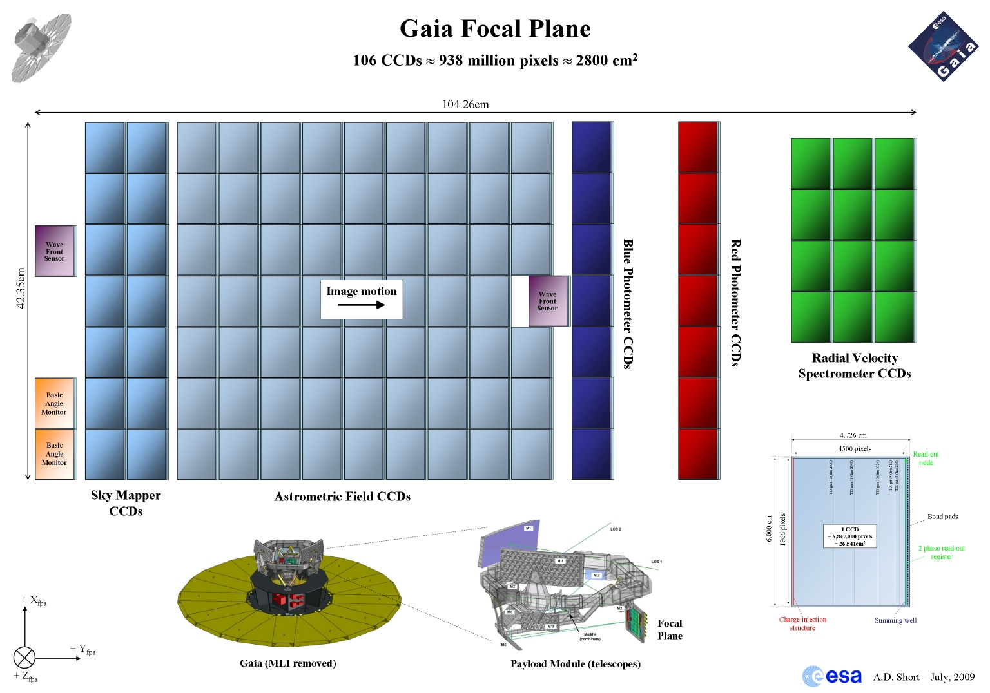
Gaia – ESA astrometric satellite- observing now- will provide much better star positions than we have now- will allow better occultation predictions

Slide 38
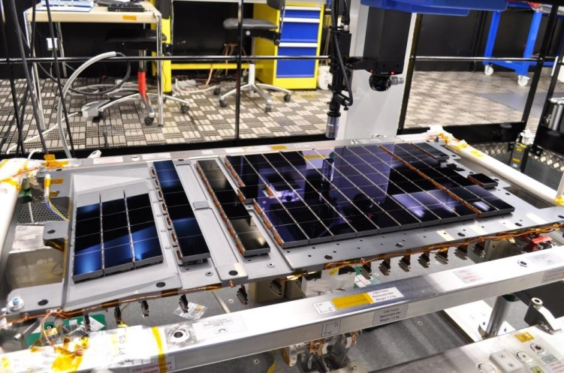
Gaia focal plane CCD array (0.5 x 1 meter in size!!!) - almost 1 Gigapixel camera!!

